Slide 1
Supporting Youth Experiencing COVID Related Grief
Kimberly van Vulpen, PhD, LCSW-C, MSW
Associate Professor, School of Social Work College of Health and Human Services Interprofessional
Education Coordinator
1-855-MD-BHIPP (632-4477)

Slide 2
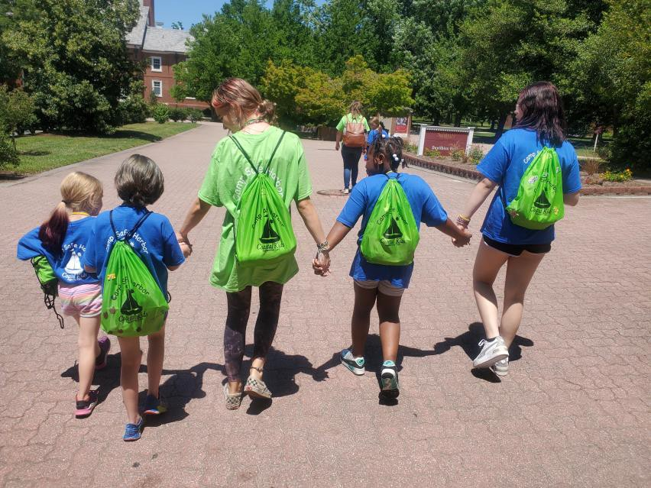
Introduction and Objectives
Identify the common grief responses for youth.
Recognize the role of child development in grief responses.
Examine how the pandemic complicated the grief journey for families and youth.
Describe current problematic grief risks.
Explore treatment recommendations.

Slide 3
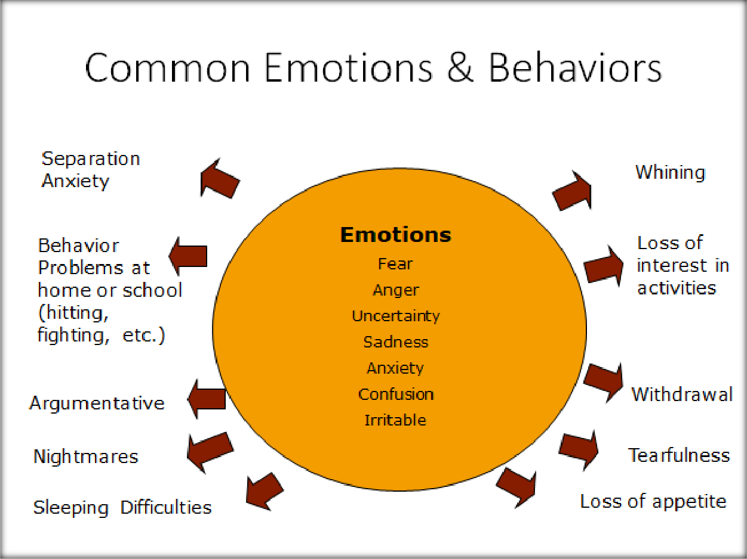
Grief, Emotions, and Behaviors
The Many Types of Losses

Slide 4
Factors that Impact How a Child Reacts or Copes with Loss
Child’s Developmental Stage
The age of the child
The parent/child relationship
How the death occurred (Example: Did the parent die from a sudden accident, long-term illness, or suicide?)
A Key Factor in how a child reacts to the death of a loved-one is:
How the parent/caregiver is doing after the loss.
Retrieved from Lecture Series of Dr. Thomas Matthews at Clarity Child Guidance Center in Texas
https://www.youtube.com/watch?v=aOa6LOX3F0o

Slide 5
Youth Grief and General Risks
Childhood bereavement increases risks for depression, poor school performance, increase suicide ideations, post-traumatic stress, etc.
1 in 5 youth that experience a loss may also experience problematic grief (Deangelis, 2023).
Moderating variables (Alvis et al., 2021)
Situation of death, time since death, caregiving environment, etc.
Limitations in Youth Grief Studies
Conceptualization of grief, Lack of representative sample (culture), etc.

Slide 6
COVID Specific Considerations
Approximately 204,000 Youth in U.S. lost parents or caregivers due to COVID (COVID Collaborative, 2022).
Ethnic and racial disparities
Normal traditions and approaches to grief/loss were restricted due to the pandemic.
During the pandemic we saw:
Anxiety and rates of depression increased
Increases in drug overdoses, alcohol-induced deaths, self-harm and suicide risks (Panchal et al., 2023)

Slide 7
Psychosocial Development and Crises
Normal Developmental Tasks
Impacts ability to understand concept of “death” or “loss” (Cognitive Development)
Development theory- Each stage has a developmental task to accomplish
Human brain doesn’t fully develop until early 20’s
Prefrontal Cortex is underdeveloped and consequences are not able to be considered
Examples
Child 6 to 12
Piaget’s Cognitive Development Concrete Operational
Erikson’s Industry versus Inferiority
Child focuses on concrete events, creates very vivid ideas, problem solving is limited, can perceive the permanence of death, etc.
Adolescent
Piaget’s Formal Operational
Identity versus Role Confusion
Understanding of death similar to adults, comparison to peers, risk taking, strong emotions, tons of hormones, etc.

Slide 8
Recommendations and COVID Barriers
General Recommendations
Talk and Listen
Allow for routines
Offer choices
Provide time for normalcy
Outlets for Self-Expression
Include traditions
(Dougy Center, 2020)
COVID
Household Stress
Schools closed
Sports were canceled
Social connections were restricted
Funerals and Celebrations of Life were limited
Politization of COVID, Stigma

Slide 9
Theories-Tasks of Mourning
Four Tasks of Mourning (Worden, 2018)
Accept the Reality of the Loss
Experience the Pain (Process)
Adjust to life/environment w/out the loved-one
Find an enduring connection
Continuing Bonds Theory (Klass et al., 1996)

Slide 10
3 Broad Dimensions Multidimensional Grief Theory
Separation Distress
Existential/Identity Distress
Circumstance-Related Distress
Adaptive versus Maladaptive
(Kaplow et al., 2013)

Slide 11
Theory-Stages of Grief
Shock and
Disbelief
Searching and Yearning
Disorganization and Despair
Rebuilding and Healing
Eberling and Eberling, 1991

Slide 12
Trauma Considerations
Intense feelings of:
Feelings of helplessness
Fear/ sense of danger
Impact of pain or loss
Lack of control of environment
Physical and emotional changes
– Brain (wired differently, “fight or flight”)

Slide 13
Assessment Tools
Systematic Review-Grief Instruments in Children and Adolescents (Zang et al., 2023)
Complex Trauma Standardized Measures (nctsn.org/resources)
Adolescent Grief Inventory (Andriessen et al., 2018a)
Inventory of Complicated Grief-Revised for Children (Melhem et al, 2013)
Hogan Inventory of Bereavement (Hogan et al., 2019)
Children Depression Inventory 2 (Kovacs et al, 2010)
Severity Measure for Depression-Child Ages 11-17 (Modified from the PHQ-A; Johnson
et al, 2002)
Impact of Event Scale-Revised (Weis & Marmar, 1997)

Slide 14
Prolonged Grief Disorder
Symptoms Experienced (3 everyday in last month)
1. Identity disruption (such as feeling as though part of oneself has died).
2. Marked sense of disbelief about the death. Avoidance of reminders that the person is dead.
3. Intense emotional pain (such as anger, bitterness, sorrow) related to the death.
4. Difficulty with reintegration (such as problems engaging with friends, pursuing interests, planning for the future).
5. Emotional numbness (absence or marked reduction of emotional experience).
6. Feeling that life is meaningless.
7. Intense loneliness (feeling alone or detached from others)
DSM-5-TR (2022)
1 year for adults, 6 months for youth
Significant and Problematic “Longing” or
“Yearning”
“Persistent” Preoccupation
Cause impairment in functioning
Outside Cultural Norms

Slide 15
Troubled Emotions/Behaviors (Red Flags)
Extended Sadness/Depression
Significant Withdrawal (avoidance)
Change in Behavior at School/Home
Disheveled and Lack of Concentration
Intrusive Memories
Panic and Extreme Anxiety
Self-abusing behaviors
Extended Problems with Sleeping/Nightmares

Slide 16
Treatment-Family Systems Approach
Family Therapy-Family Bereavement Program (Ayers et al., 2014)
Family Meeting-Sharing and Discussing Loss
Helping the Family Members through their Own Grief Process
Family Education, Psychoeducation
Helping the Family with Resources
Focus on Family Resilience
Cultural Appropriate Care

Slide 17
Treatment Approaches
Expressive Arts and Play Therapy
Cognitive-behavioral
Grief Help (Boelen et al., 2006)
Multidimensional Grief Therapy (Hill et al., 2019)
Grief Camp
Trauma and Grief Component Therapy for Adolescents
Trauma-Focused Cognitive Behavioral Therapy

Slide 18
Intervention/Work at School
Be patient with behavior challenges
Provide a safe place
Maintain routines
Be sensitive to the cues (educate yourself on the risks)
Anticipate challenges
Help the parents or caregivers get help
Remember special days
Child Trauma Toolkit for Educators (NCTSN, 2008) https://www.nctsn.org/resources/child-trauma-toolkit-educators

Slide 19
Take Home Thoughts
Assess not on “normal” grief
COVID grief may be delayed
Include caregivers in treatment
Consider age/development
Culturally appropriate care
Identify resources and gaps
Provide safe “space” for expression
Resilience

Slide 20
Thank you!
Maryland Behavioral Health Integration in Pediatric Primary Care (BHIPP)
1-855-MD-BHIPP (632-4477)
www.mdbhipp.org
Follow us on Facebook, LinkedIn, and Twitter! @MDBHIPP
Notes:
You will a copy of these slides

