Slide 1
A Primer on Maryland’s Mental Health System of Care for Youth and Families September 29, 2022 Emily Frosch, MD Associate Professor, Department of Psychiatry & Behavioral Sciences Division of Child & Adolescent Pscyhiatry, Johns Hopkins Univ. School of Medicine

Slide 2
Who We Are – Maryland BHIPP
Offering support to pediatric primary care providers through free:
Telephone consultation (855-MD-BHIPP)
Resource & referral support
Training & education
Regionally specific social work co-location (Salisbury University and Morgan State University)
Project ECHO®
Direct telemental health services:
Care coordination
Psychiatry
Psychology
Counseling
Notes:
Maryland Behavioral Health Integration in Pediatric Primary Care or BHIPP is a Child Psychiatry Access Program that supports the capacity of primary care providers in Maryland to manage pediatric mental health concerns.
BHIPP offers free behavioral health telephone consultation, resource and referral networking, training and educational opportunities, Web-based longitudinal learning through Project ECHO, telemental health services, care coordination, and social work co-location in select primary care practices in collaboration with Salisbury University (SU) and Morgan State University (MSU).
BHIPP also recently received additional funding to expand warmline consultation services to select hospital Eds, and to provide Technical Assistance to select primary care practices with goal of practices becoming mental health hubs.

Slide 3
Partners & Funding
BHIPP is supported by funding from the Maryland Department of Health, Behavioral Health Administration and operates as a collaboration between the University of Maryland School of Medicine, the Johns Hopkins University School of Medicine, Salisbury University and Morgan State University.
This program is supported by the Health Resources and Services Administration (HRSA) of the U.S. Department of Health and Human Services (HHS) as part of an award totaling $433,296 with approximately 20% financed by non-governmental sources. The contents of this presentation are those of the author(s) and do not necessarily represent the official views of, nor an endorsement, by HRSA, HHS or the U.S. Government. For more information, visit www.hrsa.gov.

Slide 4
Disclosures
None

Slide 5
Learning Objectives
Identify 3 differences between high, medium, and low acuity services for youth
Identify at least 2 situations that allow a youth to access high acuity services
Identify what resources can be combined to support youth and families

Slide 6
Outline
Dilemmas
Review the various providers & levels of care
Define (as best is possible) what each level can/cannot offer
Review movement between levels
Case scenario
Notes:
So in the hour, we are going to try to make sense of the mental health system of care for youth
And we will start thinking asbout what the challenges are, who provides care in what setting, what happens in those settings, how youngsters move between care settings and then use a case to highlight it all.

Slide 7
Dilemmas
Variety of providers/settings
Different disciplines contributing
Funding streams may change
Programs open/close
Availability/affordability of care
Tele/in person
In/out of networks
No centralized source of state-wide information
State oversight but County specific
How does a clinician know what the options are for any given youngster & family??
Notes:
So if we start with the dilemmas in thinking about the system of care, Im sure everyone can create a list quickly of what the barriers are, but here are a few..
Variety of providers and settings and not always consistent from setting to setting or what they think is wrong or what they want to do about it.
Funding streams are fragile and programs that we have come to appreciate and use regularly may close or new ones open up that we don’t know about
There are issues with access to care—both availability of providers and cost—in or out of network, will they do tele or only in person and depending upon where you are, these access barriers can be extremely high
There is state oversight of services, however there isn’t really a centralized source of state wide information about services that one can easily google and find what you need for where you are for the issues facing any given youth or family
Which means how on earth are any of us supposed to know what to do
And we hope that today’s session will give you all some grounding in what is out there and how to navigate

Slide 8
Maryland Hospital Association
In April 2019, MHA’s Behavioral Health Task Force launched a study of factors that contribute to discharge delays for behavioral health patients in emergency departments. The study found that:
42% of behavioral health ED patients experienced a delay being discharged or transferred
These patients were delayed for 1,676 days—an average of 20 hours per patient
Delays account for 48% of the time those patients spend in Eds
Three of the top five causes for a delay were related to actions taken by the prospective receiving “agency” or placement site
Children and teenagers were delayed twice as long as adults; discharge planners cited age as a contributing factor to the delay

Slide 9
Maryland Hospital Association
“Heightening the hospital crisis is a lack of placement options for children. One hospital leader recently attributed “an alarming increase” in the lengths of stay for young behavioral health patients to an inability to transfer them to more appropriate settings of care, in turn causing longer wait times in the emergency department.
Some hospitals report children being hospitalized more than 100 days beyond what is medically necessary; others have experienced their entire pediatric unit being filled with behavioral health patients. Many hospitals report that when transfers of pediatric and adolescent patients do take place, they are increasingly being sent to an out-of-state facility. “
Notes:
So the bad news is real
The good news is that it is not only clinicians and families who are aware of it…

Slide 10
Providers who care for youth and families
Licensed Clinical Professional Counselor (LCPC, LGPC)
Licensed Certified Social Worker – Clinical (LCSW-C, LGSW)
Psychiatric Nurse Practitioner (PNP)
Psychologist (MA, PhD)
General Psychiatrist (MD)
Child & Adolescent Psychiatrist (MD)
Overlapping skills but with important differences in type of training, focus, and scope of practice
Notes:
Luckily—there are lots of different types of providers who see youngsters and families.
Training is different
Therapies, assessment, medications/prescribing
Within each discipline there are scope of practice definitions and then each individual provider has strengths and limits to their skills and comfort
In addition, some employers have parameters for “who does what” in a multidisciplinary group…psychologists may focus on testing or focus on individual or family work…
The good news is that there are a lot of invested clinicians

Slide 11
(DO)
Figure modified from: https://igda.org/resources-archive/mental-health-providers-what-the-hck-is-the-difference/
Notes:
This is another way of thinking about the range of clinicians who provide care—
All but the life coach have state regulation and specific education requirements
I might add assessment to many of the clinicians here but you can see that there is overlap but also important differences
Psychiatrist…assessment, formulation…

Slide 12
Horizontal Levels of Mental Health Care
Office practice
Community Clinic
Non-specific/specific to funder
School Based Mental Health
After School Program
Intensive Outpatient Program
Partial Hospitalization Program
Inpatient Hospitalization
Residential Treatment
Mobile treatment
Urgent Care/Crisis Centers/Walk in clinics
Emergency Departments
Notes:
SO where do these providers deliver their services—in many different settings
I’ve labeled this as horizontal levels of care with the idea that one can move along a road from one to another
But there are many different levels of care—ranging from xxx to yyy
And some youth only use 1 level, others use more than one
Some who use more than 1 move seamlessly up and then down in intensity
And then, alongside all of these, are services such as mobile treatment and crisis intervention care
Those can be added on to any of the others as needed
Some move back and forth between and dip into the ones on the right—as either short term or as a repeated add on service

Slide 13
Vertical Provider Systems
One overarching organization that has multiple levels of care
Sheppard Pratt, Catholic Charities, University of Maryland, Johns Hopkins/Bayview, others across the state
May have all elements of the horizontal continuum or subset
Single levels of care
Specific programs/clinics
Notes:
Another way to think about how care is delivered is in vertical systems—so large organizations may offer various levels of care, sometimes described as their continuum of care
And then of course there are specific programs that exist solo

Slide 14
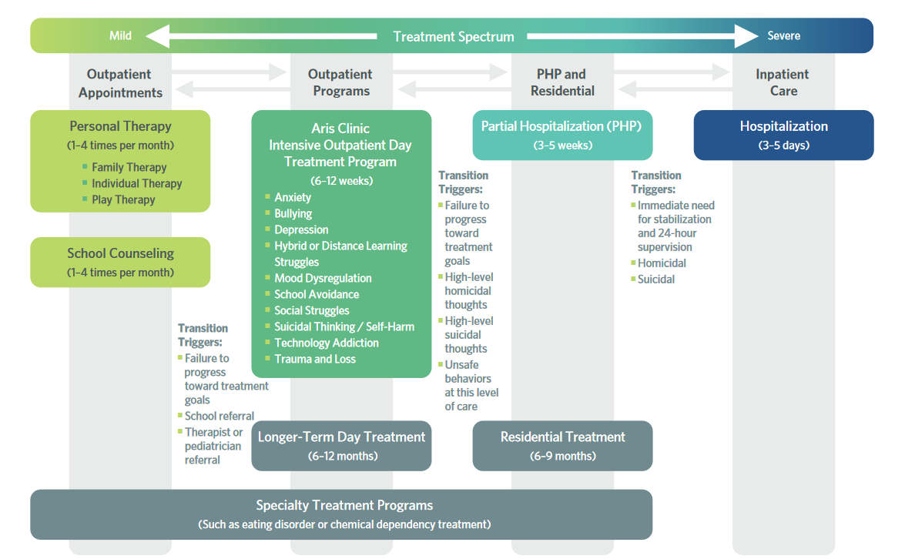
Figure modified from aris-clinica.com
Notes:
So this is a visual of what I was describing—one particular example of how one can move from outpatient care to higher levels of intensity
We’ll come back to this slide to remind us of where we are as we begin to dissect the various levels

Slide 15
Levels of care
Office Practice
Fee for service, Insurances, Different disciplines, Solo vs group
County or Community Clinic
Insurances, Medicaid, Sliding Scale,
Different disciplines
May be seen for long time
May have variable availability for access and/or frequency of follow up
May have capacity for multiple providers to collaborate
Notes:
So at the low intensity end, there are two main categories:
Various providers seeing patients in an office and community or county based clinics

Slide 16
County Resources
https://www.mhaonline.org/transforming-health-care/healthy-hospitals-healthy-communities/behavioral-health/maryland-behavioral-health-resources-services-directory

Slide 17
Figure modified from aris-clinica.com
Notes:
So revisiting this slide, Im going to shift to some other types of services that can be really helpful

Slide 18
Levels of care
School based Mental Health Services (SMH)
School clinicians (counselors and social workers) provide direct care in the school
Some schools have access to prescribing from CAP or NP/PNP
Provides primary, secondary, tertiary prevention efforts
Afterschool/Intensive Outpatient Program
A few hours/day (staring ~2P, ending ~6p), variable therapeutic activities
2-5 days/week
May see PNP/PhD/CAP MD once/week
LOS ~2weeks -12 weeks typically, with variation in average length of stay by program
Step up or step down service
Notes:
Primary—universal practices, info sharing, positive milieu management
maybe there are groups that kids participate in for social skills—not for identified kids, but for whole classes…or maybe they do education about what to watch for in the classroom for all teachers…
Secondary—identify risks and intervene, e.g. youngster whose parent died from covid—what does that child need? How can we support them?
So teacher may alert the counselor when the child shares something has happened to provide support
Tertiary—once a child has developed MDD, how can we ensure optimal treatment and return to pre-morbid functioning
When a child is being discharged from a higher level of care back to school, counselor would help transition and support to optimally reintegrate into regular classes

Slide 19
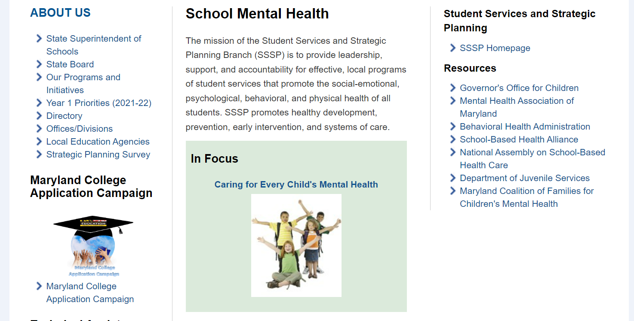
MARYLAND PUBLIC SCHOOLS
https://marylandpublicschools.org/about/Pages/DSFSS/SSSP/SMH/index.aspx
Notes:
If we take a deeper dive into what the school system offers,

Slide 21
Figure modified from aris-clinica.com
Notes:
And back to this as we move to the right in intensity…

Slide 22
Levels of care
Partial Hospitalization Program (“Day Hospital”)
School day hours (~8-3p) 5 days/week, M-F
Marked “present” in school
Sees PNP/PhD/CAP MD once/day
Family participation required
LOS ~1-3 weeks typically
Multidisciplinary team—may include MD, PhD, MA, LCSW, OT, others
Step up or step down service
Planned/urgent admission not emergent admission

Slide 23
PARTIAL HOSPITALIZATION PROGRAMS & DAY HOSPITAL PROGRAMS
Notes:
This is a map of the PHP/DH in Maryland—and you can see at a glance that they, like so many other services are constentrated in the I95 corridor between Baltimore and DC and that the western counties and eastern shore don’t have this type of program
That’s one of the dilemmas I mentioned earlier—are the services available where the kids are

Slide 24
Levels of care
Urgent care/Crisis Center/Walk in
Vary by county
Can sometimes be 1x can be ongoing can be referral/connector
Notes:
As we move up that intensity scale, we often find use of urgent care/crisis care becoming part of the picture
These too are limited in access given their locations

Slide 25
COUNTY/REGION | # EMERGENCY DEPARTMENTS | # URGENT CARE CENTERS
Anne Arundel | 2 | 4
Baltimore City | 16 | 2
Baltimore County | 6 | 5
Central Maryland (Frederick, Howard, Carroll, Harford) | 7 | 8
Eastern Shore (Caroline, Cecil, Dorchester, Queen Anne’s, Somerset, Talbot, Wicomico, Worchester) | 8 | 9
Montgomery | 17 | 13
Prince George’s | 7 | 5
Southern Maryland | 3 | 1
Western Maryland | 3 | 1
Total | 69 | 48
Notes:
This is a list of all Eds and urgent care centers in Maryland—and while there is some geographic spread here, it is limited AND, these urgent care centers do not have MH resources…and as I said, there are limited child MH resources in ED settings
We will talk a bit later about what to expect from an ED visit..

Slide 26
SHEPPARD PRATT URGENT CARE SERVICES
Psychiatric Urgent Care | Care Finder | Sheppard Pratt
Notes:
Here is an example of a crisis service—elkridge and towson

Slide 27
Figure modified from aris-clinica.com
Notes:
And we keep moving to the right…

Slide 28
Levels of care
Inpatient Hospitalization
24/7 care for acute illness/safety concerns
Multidisciplinary team
LOS 5-10 days typically “ICU” model, leave when less acutely ill vs well
Residential Treatment Center
24/7 care for non-acute situation in which youth is unable to be maintained in the home and community—requires a primary agency to sponsor
Notes:
Inpatient…
ICU model—can still be unwell, fragile, in need of a lot, just not imminent…
That can be frustrating for families and also for outpatient providers who struggle to provide the necessary services
RTC is here—but that is a rare bird these days, and certainly not something any of us can access quickly

Slide 29
INPATIENT PSYCHIATRIC SERVICES
Notes:
Here is a map of inpatient units…you’ll see the same concentration of location, a bit more spread but not in western or eastern shore

Slide 30
Delaware Child and Adolescent Inpatient Services
Notes:
And there are some that are in Delaware that may actually be closer for many parts of the state…

Slide 31
Hospital | Age Range | Legal Status | Number
Medstar Franklin Square Hospital | 12-17 | Vol/Certs | 443-777-7207 or 2718 Fax: 410-350-7590
Johns Hopkins Hospital | 6-17 | Voluntary only | 410-955-5280 After hours: 443-287-2798 Fax: 410-502-5283
Sheppard Pratt Hospital | 3-17 | Vol/Certs | 410-938-3800
Medstar Montgomery General (Mixed with adults) | 13+ | Voluntary only | 301-774-8888 Fax: 301-570-7422
Carroll County (Mixed with adults) | 13+ | Vol/Certs | 410-871-6971 Fax: 410-840-4015
Calvert Health Medical Center (Mixed with adults) | 13+ | Vol/Certs | 410-535-4000 or 8144 Fax: 410-535-8136
Adventist Behavioral Health Shady Grove | 13-17 | Vol/Certs | 301-251-4545 Fax: 301-251-4519
Brooklane | 5-17 | Vol/Certs | 301-733-0330
Children’s National Hospital | 2-12 13-17 | Voluntary only | 202-476-4085 After hours Child: 202-476-5166 Adolescent: 202-476-3867
PIW | 10-17 | Voluntary only | 202-885-5610 Fax: 202-885-5614
Notes:
This is info about the ones in Maryland—
And you can see they all have different ages, they vary in whether or not they take youth on involuntary certification, and some are mixed with adults—which is something that could be ok but could also be scary for a 13yo to see a floridly manic and psychotic adult so I think it at times can be even more limited.In addition, you can see that there are many more beds available for teens than for pre-pubertal youngsters…

Slide 32
Emergency Departments
Setting of “last resort”
After hours
Acute safety
Delays in accessing other services
Uncertainty of what else can be done/how to do it
Repeated use can unintentionally reinforce maladaptive behaviors
Staffing
May or may not have behavioral health staff
Few have in house child psychiatrists
Resources
May have social workers who can make referrals/connections
BHIPP
ED’s Purpose
Admit/discharge vs diagnose/treat
Dilemma of waiting for other levels of care, especially inpatient
Notes:
Sub-optimal care setting…

Slide 33
New Approach
Notes:
Given that, the state is trying to make additional crisis services available

Slide 34
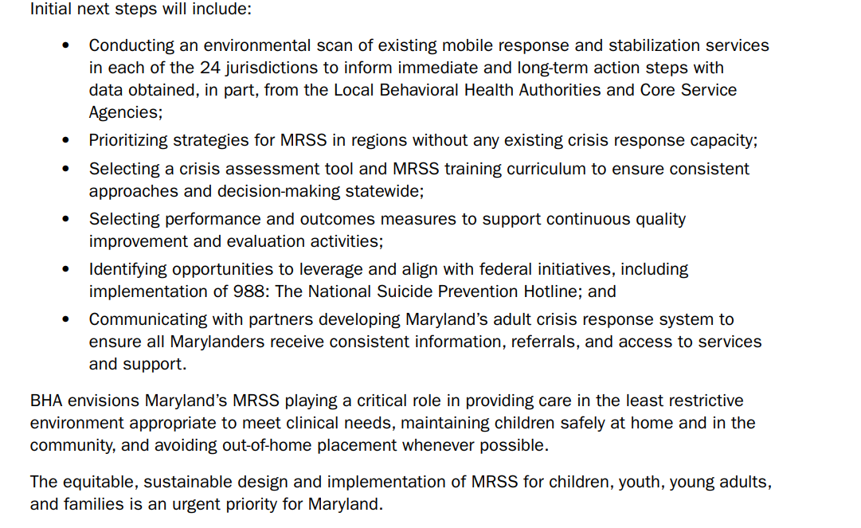
New Approach
Notes:
And a year ago, they shared this strategic vision recognizing the urgency of the need for children and youth across the state
If there is anyone on the call who might know where things are, please share in the chat!
I don’t know when this will turn into actual resources, but it is important that it is recognized as a priority need and plans are in progress

Slide 35
New Approach
Pages - 988md (maryland.gov)
Notes:
In addition, there has been a new approach
Moving from 211 to 988—a year where both work…
Open link—
It is important for patients and families ot know about it—but also if you have someone in the office, that might be a good time to call together

Slide 36
988
Calling 988 connects callers directly to the National Suicide & Crisis Lifeline which encompasses all behavioral crisis services, to include all mental health and substance use (problems with drug and alcohol use).
The 988 Suicide & Crisis Lifeline replaces the National Suicide Prevention Lifeline AND expands services to cover all behavioral health crisis services.
What does this mean for Marylanders?
When someone in Maryland calls 988, they routed to one of the state’s eight call centers. These centers provide phone-based support and information regarding local resources. Marylanders can also text 98​8.
Maryland has been operating its own crisis hotline, 211 press 1, and that number will remain in operation and accessible to Marylanders throughout the transition period and beyond.
Who can call 988?
Anyone in need of assistance with behavioral health related needs can call 988.
The new 988 feature is available nationwide for call (multiple languages), text or chat (English only). Both “211, press 1”
The existing Lifeline phone number (1-800-273-8255) will remain available throughout the transition period and beyond.

Slide 37
988
What can you expect when calling 988?
Callers will hear a greeting message while their call is routed to the Maryland Lifeline network crisis center (based on the caller’s area code)
A trained call specialist will answer the phone, listen to the caller, understand how their problem is affecting them, provide support, and share resources if needed
If the Maryland crisis center is unable to take th​e call, the caller will be automatically routed to a national backup crisis center
The Lifeline provides live crisis center phone services in English and Spanish and uses Language Line Solutions to provide translation services in over 150 additional languages for people who call 988
How does 988 help Marylanders?
988 call specialists located at crisis call centers around Maryland can immediately provide phone-based support and connections to local resources.
By directing cases to 988 when a behavioral health crisis (mental health and substance use) isn't life threatening, the response provided by public services, such as law enforcement and EMS, can be reserved for situations in which lives are endangered.
In 2020, Congress designated the new 988 calling code to be operated through the existing National Suicide Prevention Lifeline​. The ​Sub​stance Abuse and Mental Health Services Administration (SAMHSA) sees 988 as a first step towards a transformed crisis care system in America.​​
Notes:
I don’t know if anyone here has used the line, if you have, it might be helpful to share what that was like in the chat
The goal is to divert from 911 when urgent but not life threatening

Slide 38
Why might care escalate to a higher level?
Anxiety—someone is worried…might be the youth, caregiver, clinician, teacher…something about what is going on is increasing distress in the system surrounding the youth.
This might be related to illness (whose?) or temperament (whose?) or behavior (whose?) or life events (whose?)
Anger—someone is angry…might be the youth, caregiver, clinician, teacher…something about what is going on needs to be interrupted to ensure safety.
This might be related to illness (whose?) or temperament (whose?) or behavior (whose?) or life events (whose?)
Ability—someone is not able to manage what is going on, despite best efforts…might be due to competing demands, inadequate resources, caregiver distress/illness, etc.
This might be related to illness (whose?) or temperament (whose?) or behavior (whose?) or life events (whose?)
Notes:
M going to transition now to how youth move between services
And first, why does that happen
I find it helpful to think about this as the 3 As…
So if those are the why’s, let’s talk about what we as providers can expect when we look at the various levels of care

Slide 39
How do youth move to a higher level of care?
Acute event
Suicide attempt or serious threats with impulsive/unpredictable behavior, aggressive/markedly disruptive behavior, other acutely unsafe behavior
Failure of progress/worsening of symptoms
Despite various efforts, persistent and potentially worsening psychiatric sxs
E.g. affective illness that starts to impact eating/drinking and may be sliding into catatonia
Diagnostic dilemma
Similar to prior bullet—when nothing is working, patient is decompensating, and it is unclear what to do next

Slide 40
What can a provider expect from a higher level of care?
IOP/Afterschool
Planned admission
Several days/week for several weeks at a time
Group activities
PHP/Day Program
Planned admission
Multidisciplinary team
Therapeutic groups
Individual and family meetings
Medication adjustment
Discharge planning
Urgent Care/Crisis
One time contact typically
Referral resources

Slide 41
What can a provider expect from a higher level of care?
Inpatient Psychiatric Hospital
Admitted from an ED or other care setting—they may or may not be connected to outpatient care
3-10 day stay
Multidisciplinary team
Diagnostic assessment, medication adjustments, individual and group work, family meetings, therapeutic milieu
Discharge planning with aftercare including formalized safety plan
Residential Treatment Center
Requires lengthy process to be accepted (at times an interview)
Requires multiple failed other placements/levels of care
Requires funding from DHMH, PS, or DSS (or private pay…)
LOS may range from 6 weeks to 6 months depending upon type of facility
Multidisciplinary team
Medication adjustments, family meetings, therapeutic milieu
Discharge planning with aftercare including safety plan

Slide 42
How do youth move to lower level of care?
Less clear…
Depends upon variety of factors
Target sxs—are they present in care setting? If not…harder to keep
Adherence to program—is family participating? Youth coming to PHP?
Insurance constraints—”Doc to Doc” reviews
Program’s own parameters
Progress—best reason!

Slide 43
URGENT CARE or MOBILE CRISIS or EMERGENCY DEPT Figure modified from aris-clinica.com
Notes:
This is that same graphic covered in arrows…just to highlight that kids move in all directions all the time…and that can be a measure of success or a measure of something not working…

Slide 44
Added Dilemmas
Waiting lists
Inclusion/exclusion criteria
Insurance barriers
Geographic barriers
Youth/family barriers
Fit of need/skills
And many more…

Slide 45
Case Example
13yo cis-gender boy, + family hx of maternal anxiety, + personal hx of delayed language development, repeated 2nd grade for failure of majority of classes leading to IEP for speech/language and SW support, family moved mid academic year last year due to financial stressors and now in new middle school, IEP did not continue, and he now presents with escalating disruptive behaviors at school and at home. He has been diagnosed with ADHD/Depressive Disorder NOS in the past, but is not on any medication currently.
Had fallen out of treatment with family move, however, his new middle school has School based Mental Health who saw him weekly for several few weeks, but has gotten worried about his mood as he seems really angry and short-fused and referred him to an afterschool program
He attended the afterschool program and initially seemed to be doing better—or at least no worse. After about 1 week of participating, he skipped the transportation to the program and decided to walk home, stating he didn’t want to go back. He then refused to go to school the rest of that week.
Given this, he was referred to a Day Program and began the next week.

Slide 46
Case Example
There, he was noted to be sullen and minimally cooperative with group activities. His mother missed the first family meeting, was late for the 2nd one. He appeared more irritable on the day his mother did not come for the meeting. He was marginally cooperative in individual sessions, appeared easily confused/overwhelmed by group activities but did seem to engage more with art-based activities.
In week 2, he did not come to the program on Monday, outreach to the family led to learning he had stayed out all night Friday (unknown whereabouts) and had come home Saturday refusing to say what had happened. His mother was distraught and took him to the closest ED and he was waiting there for an evaluation.
His mother stated she cannot handle him at home, sharing he has been increasingly aggressive with his younger sister who is actually in the same grade in school (they are 1 year apart but he repeated a grade).

Slide 47
Case Example
Services used…
Outpatient
School Mental Health
After school + School Mental Health
Day Program
Emergency Department
Reason for movement…
Adherence/improvement
Anxiety/Anger/Ability

Slide 48
Summary
Complex, multilayered system that is both rich with resources in some ways and hard to navigate in other ways
Matching services with youth and families in the locations needed and timeframe needed are significant barriers
BHIPP is a great resource to help connect and identify options

Slide 49
Questions & Discussion

Slide 50
Links
https://www.mhaonline.org/transforming-health-care/healthy-hospitals-healthy-communities/behavioral-health/maryland-behavioral-health-resources-services-directory
https://health.maryland.gov/bha/Documents/MDH%20MRSS%20Document%20-%20Spring%202022.pdf
https://health.maryland.gov/bha/Pages/988md.aspx
https://health.maryland.gov/bha/Documents/2022%20Suicide%20Prevention%20Toolkit.pdf

