Slide 1
Maryland Behavioral Health Integration in Pediatric Primary Care (MD BHIPP) BHIPP Resilience Break: Avoiding Provider Burnout Mary Ann Booth, M.D.
1-855-MD-BHIPP (632-4477)
www.mdbhipp.org
Follow us on Facebook, LinkedIn, and Twitter! @MDBHIPP

Slide 2
Who We Are – Maryland BHIPP
Offering support to pediatric primary care providers through free:
Telephone consultation (855-MD-BHIPP)
Resource & referral support
Training & education
Regionally specific social work co-location (Salisbury University and Morgan State University)
Project ECHO®
Direct Telespsychiatry & Telecounseling Services
Care coordination
Notes:
Maryland Behavioral Health Integration in Pediatric Primary Care or BHIPP is a Child Psychiatry Access Program that supports the capacity of primary care providers in Maryland to manage pediatric mental health concerns. We do this, currently, in a number of ways: 1. We offer a free behavioral health telephone consultation service, including resource and referral support, 2. education and training, 3. Through our partnership with Salisbury and Morgan State University, we offer co-location of social work interns at select primary care sites, 4. Web-based longitudinal learning through Project ECHO similar to today’s event, 5. Direct telepsychiatry and telecounseling services (coming soon) , 6. Care Coordination (coming soon)

Slide 3
Partners & Funding
BHIPP is supported by funding from the Maryland Department of Health, Behavioral Health Administration and operates as a collaboration between the University of Maryland School of Medicine, the Johns Hopkins University School of Medicine, Salisbury University and Morgan State University.
This program is supported by the Health Resources and Services Administration (HRSA) of the U.S. Department of Health and Human Services (HHS) as part of an award totaling $433,296 with approximately 20% financed by non-governmental sources. The contents of this presentation are those of the author(s) and do not necessarily represent the official views of, nor an endorsement, by HRSA, HHS or the U.S. Government. For more information, visit www.hrsa.gov.

Slide 4
Disclosures
I am a physician with the BHIPP TAP Program
I have no conflicts of interest

Slide 5
Objectives
Define 3-4 risk factors for provider burnout
Identify three internal strategies/coping mechanisms to avoid burnout
Identify three external strategies/coping mechanisms to avoid burnout

Slide 6
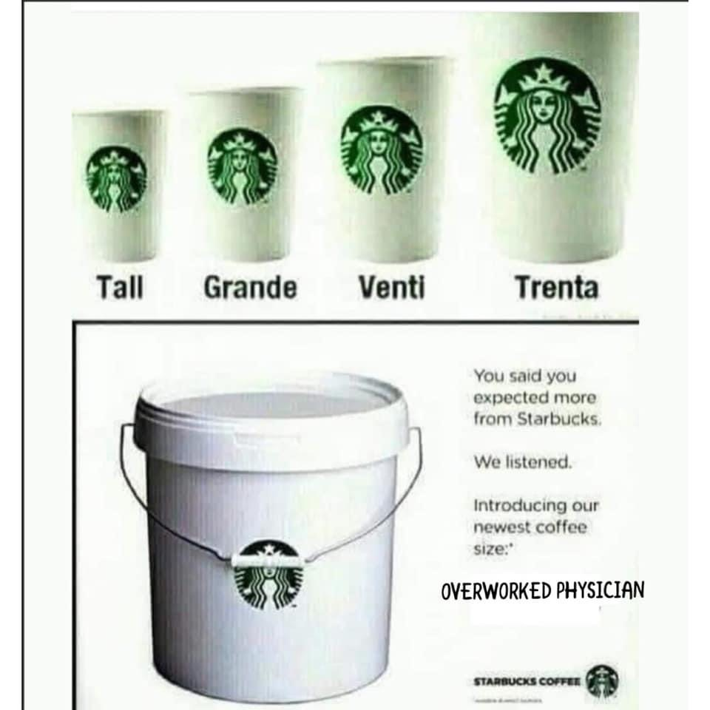

Slide 7
What Is Burnout?
First described in 1974 by psychiatrist Herbert Freudenberger
Defined as “a state of mental and physical exhaustion caused by one’s professional life” and clearly distinct from depression or other psychiatric illness
Caused by social conditions, in particular “excessively striving to reach some unrealistic expectation imposed by oneself or by the values of society”
Starts with gradual “emotional depletion” and leads to a loss of motivation and commitment
It is both a state and a process
Notes:
Although burnout has been best studied among physicians and nurses, practitioners and trainees in other health care professions also have been noted to exhibit high burnout rates [2]. The risk factors associated with burnout may be similar among all health care professionals [3]; however, there are enough diff erences among professionals to warrant discussions of burnout within individual professions, and among demographic subgroups.

Slide 8
The Maslach Burnout Inventory includes items such as “I feel emotionally exhausted because of my work” and “Working with people all day is stressful to me” and “I feel worn out at the beginning of the working day” Primarily a research tool Quantified by how often the individual experiences these feelings
Notes:
Although burnout has been best studied among physicians and nurses, practitioners and trainees in other health care professions also have been noted to exhibit high burnout rates [2]. The risk factors associated with burnout may be similar among all health care professionals [3]; however, there are enough diff erences among professionals to warrant discussions of burnout within individual professions, and among demographic subgroups.
The most widely used measures of burnout include the Maslach Burnout Inventory (MBI), the Oldenburg Burnout Inventory, the Copenhagen Burnout Inventory, and the Physician Work-Life Study’s single-item questionnaire
Burnout has been identifi ed among medical students, residents, and practicing physicians at all career stages. The burnout rate is estimated to be approximately 50 percent among US physicians and medical students [13,14]. Unfortunately, many studies of burnout do not report data by gender. Those that have, found that burnout is experienced by and manifests in men and women diff erently: as measured by the MBI, women physicians are more likely to suff er from emotional exhaustion, whereas men are more likely to describe depersonalization.
It is currently not clear if burnout is actually more common among women, or if gender-based diff erences in its expression—such as emotional exhaustion—make it easier to identify among women. Regardless, surveys (refl ected in Table 1) have found that the prevalence of burnout may be as much as 20 to 60 percent higher among women physicians than among men physicians [16]. A 2017 survey of 15,000 physicians from 29 specialties found that burnout was self-reported by 48 percent of women physicians and 38 percent of men physicians [17]. Smaller specialtyspecifi c studies have also found that women are more likely to exhibit burnout symptoms than are men [18,19]. Regarding trainees, a large national sample of internal medicine residents found that women physicians were more likely than men physicians to report being burned out and dissatisfi ed with work-life integration [20]. Whether physician gender plays an independent role

Slide 9
Alarming signs that burnout is on the rise
Out of 7000 physicians, only 1 in 10 would recommend a career in medicine
In the same survey (2012), half of primary care physicians age 50 and above, planned to leave practice in 5 years
30 percent of PCPs ages 35-39 planned to leave practice in 5 years
From A Survey from Doctors Company 2012
Notes:
Doctors company 2012

Slide 10
Contributing Factors To Burnout
Type of Speciality
Work Load
Work Hours
Administrative Tasks
Increased Responsibilities
Lack of autonomy
Financial Stress
Career Stage
Loss of meaning and joy at work
Having Children at home
Work/life integration
Decreased support
Real or perceived lack of fairness in promotion
Sexual harrassment

Slide 11
Specialties with the highest rates of burnout:
ER
OB/GYN
Family Medicine
Neurology
Pm and R
Radiology
Urology
Internal Medicine
General Surgery
Internal medicine subspecialty
Notes:
Mayo clnic study from 2017

Slide 12
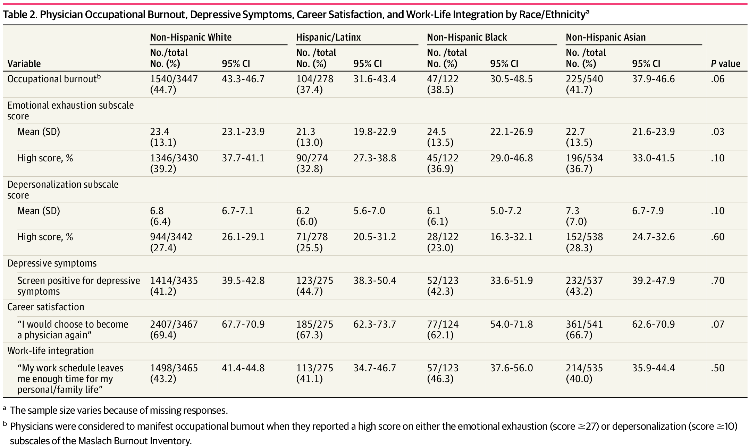
Notes:
Burnout was observed in 44.7% (1540 of 3447) (95% CI, 43.3%-46.7%) of White physicians, 41.7% (225 of 540) (95% CI, 37.9%-46.6%) of Asian physicians, 38.5% (47 of 122) (95% CI, 30.5%-48.5%) of Black physicians, and 37.4% (104 of 278) (95% CI, 31.6%-43.4%) of Hispanic/Latinx physicians (Table 2). The mean (SD) emotional exhaustion subscale scores of the MBI were 24.5 (13.5) among Black physicians, 23.4 (13.1) among White physicians, 22.7 (13.5) among Asian physicians, and 21.3 (13.0) among Hispanic/Latinx physicians (P = .03). The mean (SD) depersonalization subscale score of the MBI among Asian physicians was 7.3 (7.0) compared with 6.8 (6.4) among White physicians, 6.2 (6.0) among Hispanic/Latinx physicians, and 6.1 (6.1) among Black physicians (P = .10). In bivariate analyses, no statistically significant differences by race/ethnicity were observed for physician burnout, depressive symptoms, career satisfaction, or WLI.
Given previous studies15-18 demonstrating that physicians in minority racial/ethnic groups experience social exclusion, bias, and increased professional burden serving as diversity ambassadors, the results of this study may be considered counterintuitive. Possible explanations for these results could include stigma associated with decreased disclosure of burnout symptoms, poor retention of medical students in minority racial/ethnic groups and residents who experience burnout (ie, survival bias), differences in personal resilience by race/ethnicity, or a selection process that favors resilience among minority racial/ethnic groups during medical training. Previous literature suggests that stigma may reduce disclosure and help-seeking in minority racial/ethnic groups experiencing psychological distress or mental health concerns.43-45 Therefore, it is possible that physicians in minority racial/ethnic groups may be less likely to disclose burnout symptoms compared with White counterparts. In addition, previous studies46-49 have demonstrated lower retention of trainees and early-career faculty in minority racial/ethnic groups. Trainees in minority racial/ethnic groups who experience burnout may be more likely to leave medicine earlier in their careers, resulting in measurement bias (ie, sample selection bias). Furthermore, it has been reported that medical students in minority racial/ethnic groups were more likely than non-Hispanic White counterparts to be resilient to and recover from burnout,50 leading researchers to posit texperiences of minority racial/ethnic group populations may promote resilience and, consequently, reduced vulnerability to burnout.42 The possibility of a selection association should also be considered. For instance, the challenges disproportionately experienced by minority racial/ethnic groups during medical training could impose barriers that are surmountable only by the trainees who are most resilient and, as a result, less vulnerable to burnout. For Black physicians in our study, greater satisfaction was also observed with WLI, which may help attenuate experiences of burnout. These hypotheses regarding disclosure and resilience may explain why we observed that physicians in minority racial/ethnic groups were less likely to experience occupational burnout and emotional exhaustion, but more research is needed to identify and validate underlying mechanisms. In addition, no differences in physicians’ depressive symptoms or career satisfaction by race/
Burnout, Depression, Career Satisfaction, and Work-Life Integration by Physician Race/Ethnicity
Luis C. Garcia, MS¹; Tait D. Shanafelt, MD^{2,3}; Colin P. West, MD, PhD^{4,5}; et alChristine A. Sinsky, MD⁶; Mickey T. Trockel, MD, PhD⁷; Laurence Nedelec, PhD³; Yvonne A. Maldonado, MD^{1,8}; Michael Tutty, PhD⁶; Liselotte N. Dyrbye, MD, MHPE⁴; Magali Fassiotto, PhD¹
Author Affiliations Article Information
JAMA Netw Open. 2020;3(8):e2012762. doi:10.1001/jamanetworkopen.2020.12762
editorial comment icon EditorialComment
Burnout, Depression, Career Satisfaction, and Work-Life Integration by Physician Race/Ethnicity
Luis C. Garcia, MS¹; Tait D. Shanafelt, MD^{2,3}; Colin P. West, MD, PhD^{4,5}; et alChristine A. Sinsky, MD⁶; Mickey T. Trockel, MD, PhD⁷; Laurence Nedelec, PhD³; Yvonne A. Maldonado, MD^{1,8}; Michael Tutty, PhD⁶; Liselotte N. Dyrbye, MD, MHPE⁴; Magali Fassiotto, PhD¹
Author Affiliations Article Information
JAMA Netw Open. 2020;3(8):e2012762. doi:10.1001/jamanetworkopen.2020.12762
editorial comment icon EditorialComment
Burnout, Depression, Career Satisfaction, and Work-Life Integration by Physician Race/Ethnicity
Luis C. Garcia, MS¹; Tait D. Shanafelt, MD^{2,3}; Colin P. West, MD, PhD^{4,5}; et alChristine A. Sinsky, MD⁶; Mickey T. Trockel, MD, PhD⁷; Laurence Nedelec, PhD³; Yvonne A. Maldonado, MD^{1,8}; Michael Tutty, PhD⁶; Liselotte N. Dyrbye, MD, MHPE⁴; Magali Fassiotto, PhD¹
Author Affiliations Article Information
JAMA Netw Open. 2020;3(8):e2012762. doi:10.1001/jamanetworkopen.2020.12762

Slide 13
Special Stressors For Women Providers
Child-rearing and family responsibilities
Having children slows career progression of women in academic medicine
Women physicians work more than male physician with children, averaging 90.5 hours/week, vs 68.6 hours/week
Women with children often subject to “micro-inequalities”
Notes:
A perceived stigma towards part time work and taking time off work
Why do we waste all our money on women who don’t work full time?
Statistic from How to be a Rockstar Doctor (this includes professional and unwaged activities)
A micro inequality example is that Dr. x is paid a reduced salary for working part time by not being eligible for additional perks that full time faculty receive, but she is also “working” during her off time, checking the computer, looking for labs, doing med refills etc.
Over the entire length of their career, women earn less than men, despite increased work productivity, (women see more patients per office hour, about 17% more on average, over time)
Women PCPs earn about 70% as much as male physicians.
Women physicians also have higher rates of successful suicide
Women physicians spend 40-60 percent more time talking with patients, engage in more positive talk, partnership building, question asking, and information giving (from Rockstar Doctors)
Women physicians see more female patients, more patients with complex psychosocial problems, spend longer with patients, and perform more preventative medicine.
Women have a 1.6 odd of reporting burnout compared to men
And this burnout significantly increases with working more than 40 hours per week
(Journal of Gen Internal Medicine Volume 15, Issue 6, pages 372-380 June 2000)
Both men and women report that challenges in work-life integration contribute to burnout. However, men and women defi ne work-life integration diff erently [25,26]. Tdepression have been reported as early as six months into the fi rst postgraduate year and are more common among women than among men [27]. Women are more likely to perform most of the work within the home, and this leads to increased time pressures and fewer opportunities for self-care. Women are more likely than men to have partners who are employed full time. Women employed full time spend 8.5 additional hours per week on child care and other domestic activities, including care for elderly parents [28]. On average, women who are employed and whose partners also work perform an additional two hours of work at home per day, an increase three times higher than that reported by men whose partners work
Women physicians are often victims of bias and discrimination. Discrimination includes disparaging or disrespectful treatment or comments; lack of career promotion; and disparities in resources (including fi - nancial and administrative support), rewards, and reimbursement. More than 70 percent of women physicians report experiencing gender discrimination [30]. Women who belong to racial or ethnic minority groups may face additional discrimination at all levels of their careers, impacting their sense of well-being and their perception of work stress [31]. Sources of bias and discrimination include more senior physicians, administrators, peers, allied health professionals, and patients. Gender bias and discrimination, which may be unconscious, can leave victims feeling marginalized and disenfranchised, adversely aff ecting their self-confi dence and career advancement [30]. Bias, often unconscious, can result in diff ering dayto-day experiences for men and women. Men and women academic physicians frequently receive diff erent levels of fi nancial support at the beginning of their careers and also experience disparities in mentoring and sponsorship throughout their careers [32,33,34]. Women physicians consistently earn less than their male colleagues across multiple specialties [35], despite similar levels of clinical or academic productivity. Women are less likely than men to be speakers at grand rounds.
A review of introductions of grand rounds speakers at two internal medicine departments found that men who introduced speakers
were more likely to use professional titles if the speaker was a man but more likely to use informal address, typically fi rst name only, if the speaker was a woman.
Gender-related bias seems to be even more prevalent among women physicians who are mothers. In a survey of an online group of physician mothers, onethird of respondents noted experiencing discrimination related to their role as a mother. Among those who experienced discrimination, almost 90 percent reported that this was related to pregnancy or maternity leave; almost half were subjected to disrespectful comments from support staff about breastfeeding. Exposure to maternal discrimination was associated with an increased incidence of self-reported burnout [40]. In addition, women who are mothers have reported being held to higher standards, experiencing lack of support during pregnancy and the postpartum period, and having even more limited opportunities for career advancement, as though they were being “punished” for becoming mothers [41]. The reported incidence of burnout rises even higher if women physicians are caring for someone with a serious health problem or disability (e.g., child, partner, parent, other relative), in addition to a child [42].
Lack of autonomy or control can also contribute to burnout. A large survey of primary care physicians revealed that women are less likely to believe that they have suffi cient time to see patients during offi ce visits and that women report having less control over their workload and their schedules than men physicians do [17]. Institutional pressures to perform administrative tasks and support patients’ emotional needs may disproportionately aff ect women, because women are more frequently identifi ed culturally as caretakers and nurturers. Women physicians spend, on average, two minutes more on each patient visit than men physicians and are more likely to explore socioemotional and psychosocial issues during the visit [52]. The gendered approach to patient care, called “the motherly approach,” has been described as personally draining for women surgeons over time and has also been described as leading to compassion fatigue [25,53]. Gendered expectations from patients may also contribute to diff erential stresses experienced by women and men physicians [54]. Individual Factors Some physicians may be more susceptible to burnout
Women physicians are much more likely than men physicians to be victims of workplace sexual harassment, which can range from sexist comments to sexual coercion and assault [46]. In addition, women who belong to a sexual minority group are at risk of experiencing harassment based on their sexual orientation [47]. Workplace sexual harassment and bullying have been linked to mental health issues, such as depression and anxiety, and may contribute to the development of burnout among victims of both direct and indirect harassment [48,49,50]. Women physicians who have been victims of sexual harassment note that the experiences negatively aff ected their self-confi dence and career advancement. Some victims even changed jobs or careers [30,51]. Women physicians (like many other victims) may not acknowledge or report instances of sexual assault because of concerns about confi dentiality, reprisal, and negative career consequences.

Slide 14
Workplace factors that may predict burnout
The workload
The degree of control a provider/physician has
The congruence between the provider’s values and those of administration
Notes:
The workload- and the changing complexity of patients
Patients have gone from 1-2 problems to 10 or 20
Fewer diagnostic tests in the old days
Preventative protocols are more complex
Small practices have given way to more hospital based groups
Daily barriers and frustrations-a small change in an her may make 20 more clicks and 30 more seconds of time for something that used to take 5 seconds and a quick sig
A patient with 5 chronic diseases and 12 meds is discharged from a hospital and shows up for her new appt without any hospital records
Control of the work environment-practice setting, the days and hours worked, length of appts, rooming procedures (lower rates of burnout if physicians can spend 10-20 percent of time doing what is most meaningful to them-teaching, research, direct patient care)
Compensation models-flat salaries, vs RVU (relative value units)
Pay for call-an expected physician duty, or should be compensated
Performance bonuses, pay for administrative work
Several factors have reduced take home pay , most prominently insurers lowering reimbursement via RVU
Then physicians increase the number of patients seen, own ambulatory centers, pursue higher pay for call coverage, find ways to cope with reduced income
There is a wide gap in financial reward vs effort in primary care
Diminished contact with colleagues (ehr driven shift in how clinicians review information with eachother)
Wachter describes doctors and nurses “just inches away staring at their computer screens without exchanging a word.” Digital doctor, hope , hype and harm in the computer age.
The loss of community in a hospital-the trip to the radiology wing in the basement of the hospital on rounds
Or the call to the subspecialist to discuss the reason for the consult

Slide 15
Additional signs of burnout at an organizational level:
High staff turnover
Vacant positions and difficulty recruiting physicians and other medical staff
Disruptive physician behavior
Lack of physician engagement on strategic projects or improvement work
Flat refusal to see additional patients
Lack of attendance at Medical staff meetings
Angry complaints about EMRs, quality metrics
Notes:
Burnout is not whining but a predictable response to chronic stress

Slide 16
From a systems perspective causes of burnout may include:
Numerous changes in reimbursement models
Regulatory policies
Shifts in patient demographics
Advances in technology and treatments
Notes:
The practice of medicine has become increasingly stressful, besides actual medical care, which has become more complex with science and technology advances, now there are new political and economic climates in healthcare as well.
Charting and prior auth-bearing down on you, declining reimbursement, 10 min visit
While you fantasize about an early retirement
The reality is we all go into medicine to help people, but somewhere along the line, time crunches, paperwork, minutiae, gets in the way, distracts us. We have to take control by getting “on-stage” (something that Rebekah Bernard describes in her book Rockstar Doctor) to learn to practice medicine in a way that leads to improved patient care and personal job satisfaction

Slide 17
Debt as a stressor for burnout
Average amount of medical education debt 180,000 dollars
One hospitalist who left said this about her debt “I thought when my residency ended that there was a light at the end of the tunnel. So I kept going and going. And then I realized it was a train coming.”
Notes:
From the AMA 2015
From Preventing burnout

Slide 18
Imposter Syndrome and Burnout
A persistent fear of being undeserving of one’s achievements
Seen in women and men, physicians, physician assistants, nurses, and others
More prevalent in women than men
Can persist throughout one’s medical career
Notes:
Also referred to as the impostor experience, this syndrome is a pattern of thinking and behavior exhibited by individuals who cannot internalize their own successes and instead have a persistent fear that they do not deserve what they have achieved, despite objective evidence to the contrary [55]. Although fi rst described among high-achieving women, impostor syndrome is found among men and women and across professions. The syndrome has been observed in nurses and physician assistants, as well as physicians [55,56,57,58]. An exploratory study of impostor syndrome among medical students at one US institution found it to be present in 49.4 percent of women and 23.7 percent of men [59]. Impostor syndrome can persist among some physicians throughout their careers [60]. Some researchers have found a relationship between the presence of impostor syndrome and conditions such as anxiety, depression, and lower self-esteem among women [59,61]. There is less evidence exploring the role of oth

Slide 19
Medical errors as a cause of burnout and mental health suffering
Symptoms include:
Anxiety about future errors (61%)
Loss of confidence (44%)
Sleeping difficulties (42%)
Harm to one’s reputation (13%)
Notes:
One of the most serious causes of distress in physicians is the perception of having made a mistake.

Slide 20
Consequences of Burnout
Dissatisfied physicians and other providers are two times more likely to cut back or leave practice within two years than more satisfied colleagues
Burnout and physician/provider distress can become a risk factor for alcohol abuse or dependence issues
Burnout, depression and fatigue are significantly associated with an MVA
Burnout is associated with a reduction in cognitive functioning that can be seen on fMRI
Burnout is associated with more medical errors
Notes:
This is from a study of surgeons from 2012
From a 2012 study of residents
This is from a study by Golkar in 2016
Burnout and depression are independent predictors of reporting a recent major medical error ( Shanafelt 2010)

Slide 21
Burnout, Depression, and Suicide
Burnout, depression, and suicidal ideation are separate but related entities. It is critically important to distinguish between these conditions, because their remedies are different. Burnout is situationally specific and is related to the workplace. Depression and suicidal ideation can occur in some physicians suffering from burnout but typically reflect the presence of additional issues.

Slide 22
Suicide and Physicians
Doctors have the highest rates of suicide of any profession
Male physicians 1.4x higher rate, Females 2.3x higher rate
Possible reasons include undiagnosed and untreated depression, inadequate mental health treatment, and problems related to job stress
Notes:
The death rate of physicians is lower than that of the general population for every major cause, including cad, stroke, cancer, and respiratory disease, with the exception of suicide which is much higher

Slide 23
A Central Question:
Is Provider/Physician Burnout a systems issue or more of an inherent issue due to stresses of practice, traits of physicians and others, mental health issues and the effects of the culture of medicine?
Notes:
In the book Preventing Physician Burnout: Curing the Chaos and Returning Joy to the Practice of Medicine , the authors pose this central question. They make the case that clinicians who are burned out are not “weak links” in the system but “canaries in the coal mine.”
In their book they talk about professional burnout coming from a mismatch between worker and workplace that harms the worker (Maslach 2001) and that when more than half of all workers report burnout (physicians) the problem is the environment.

Slide 24
Avoiding workplace drivers of burnout
Communication at the frontlines
Have physicians invest the time to understand and fix work processes
Enable physician leadership to occur
Improve the daily workload by truly operating as a team based model
Notes:
Sometimes things have to fixed at an organization level,
Mindfulness is great, but if something is going on in an organization, and you only give personal resources, that is saying to physicians, “If you only knew how to swim better, this toxic ocean wouldn’t be a problem.”
This is from Oregon Medical Group-give the leader a view of the future of the organization and allow them to collaboratively create the shared vision; sign a compact outlining the responsibilities of the organization and physicians to each other
Medical Associates Clinic in Iowa (170 provider, multispeciality group practice) shifted to a team based model
The nurse or MA would complete pre-visit planning 2-3 days before the patient visit, review the notes, ensure the labs were available, identify any preventive or chronic care needs, the nurse or MA would prescreen the patient, update the EMAR, reconcile the meds, complete the initial hpi, and identify the cc. During the physician or provider part of the visit, the MA would document info in the ehr. Then at the end of the visit the MA can arrange the f/u visit, submit requests for referrals, etc. Members of the care team hold a morning huddle of 15 min or less.

Slide 25
Strategies to Use the Patient Schedule to Your Advantage
Assess
Assess what type of office schedule works best for you (traditional model, with room for 4-6 sick slots vs “open access scheduling”)
Manage
Manage the dreaded challenges to the schedule - the “Frequent Flyer”, the No-shows, and Overbooking
Print out
Print out your schedule and patient information for the next day (perhaps the last note when you saw them)
Be
Be creative with scheduling to maximize productivity and minimize downtime
Notes:
Assess what type of office schedule works best for you (traditional model, with room for 4-6 sick slots vs “open access scheduling”)
Traditional-retirees love it, lots of no-shows can send it into disarray
Open access-working people may love it, but more challenging for staff
Don’t be afraid to play around with your schedule depending on your patient population, the time of year it is (summer, cold and flu season, etc)
Manage frequent flyers by scheduling frequent follow up visits (to avoid same day phone calls, crisis situations, etc); get your anxious people in before you leave on vacation
Chronic no-showers need to have a warning letter, and then dismissal letter (because it jeopardizes patient care and the physician-patient relationship)
If you’re running late, because of over-booking, you have to have good staff that let your patients know when they check in
If the schedule is really backed up, offer a reschedule with a plum appt-the first of the day or first afternoon appt.
Try to start your day 15 minutes early to create a small buffer zone in your schedule if you are running late, later in the day
Using the preprinted schedule/last note can be helpful if the computer crashes, you can write notes for your MA on the schedule.
Instead of trashing your last note that was printed, use it as a handout for the patient, with any changes in meds or directions
Emily Nabors, MD 9-5 on Mon, Tues, 9-12 Wed, 7:30-3 on Thursday and Friday. My brother has one day a week off and works 4 10s;

Slide 26
Know How to End the Patient Visit Gracefully
Notes:
Having prepared statements available is really helpful such as
‘Did we miss anything important?
If the patient continues to list things, its ok to say something like,
We’ve covered a lot of territory today-lets set up a follow up appt to address additional issues
You can bring in your MA at the end to help wrap up the minutia
If the patient thinks up additional questions at the check out, have them schedule another appt
Important to have phrases like,
Im glad you mentioned it
I really want to explore that more..lets schedule a follow up to give blank the attention it deserves

Slide 27
Ways to lower practice stress and get home sooner
Move from EHR “Hater” to power user
Document the minimally necessary data set
Use EHR software to automate what you can
Make documentation a team sport
Pilot the use of a scribe
Look for BROKEN record moments
Do the team HUDDLE once or twice daily
Embrace batch processing
Notes:
When using your electronic health record (EHR) this week, notice your attitude. Do you feel that your EHR program was written by the devil himself in the fires of hell? Do you find yourself tensing up when you sit down to type? Do you often complain about your EHR to others and say things like “It won't let me do [fill in the blank]”? If so, you might be an EHR hater. This attitude leads to avoidance behavior, such as avoiding documentation until the end of the day, which can sabotage any attempts to improve your charting skills and get home on time.
EHRs are evolving, but they are not going to go away, so hating them isn't an effective strategy. In fact, it wastes your energy. Instead, devote yourself to becoming a power user. The first step is to find and study the power users around you. They are the ones using the same software, seeing basically the same patients, and getting home on time with a lot less frustration. They know things you don't.
If you need help identifying a power user, ask your nurses who the power users are. If you practice solo, ask your EHR vendor to connect you with one. Ask if you can watch them chart – they always say yes. Then sit right behind them while they are at the computer and get ready to yell “Stop!” when they do some keystroke combination that magically completes a chart note. Ask how they did that. Take notes. Pick up two to three tips you can use. Before you leave, ask if you can have their templates – they always say yes. Two or three of these power-user training sessions later, you will be well on your way to becoming a power user too.
There are three reasons to write a chart note: billing, medicolegal, and continuity. If what you are writing in the chart is not supporting your billing code, covering your “legal part,” or helping the next provider take over where you left off with this patient, it probably doesn't need to be in your note.
This is not to say that your notes should be void of the patient narrative. By all means, chart well, but do not write the great American novel. You do not need to use complete sentences and should never touch the semicolon key. Longer is not necessarily better.
EHR software is meant to semi-automate your chart notes through the use of templates. Here is a test: If you piled up all your documentation from a week onto your desk, how much of it did you produce by free typing into the chart? If your answer is more than 30 percent, you are not as automated as you could be. The secret is to look for “broken record moments.”
A broken record moment is when you notice, “This is the fourteenth time I have written the same note this week.” The typical reaction to a broken record moment is to become frustrated, but don't stop there. This is a golden opportunity to automate and get home sooner. Here is the process:
As you notice these moments, write them down. Make a list.
Once a week, take one item off the list and template it. Ask an IT person or your power user friend for help if you need it.
The templating process will take about 30 minutes or so. In a month, you will have transformed four frustrating broken record moments into simple keystroke combinations.
If you have superhero, perfectionist, or lone ranger tendencies like most of us physicians, you are almost certainly doing too many of the charting chores yourself. Realize that all documentation is team documentation. You don't have to do it all. However, if you want your team to help, you will have to ask them. Because of your position, staff may not feel comfortable initiating this discussion.
Ask your staff for help with documentation in an open-ended way and see how they respond. It could sound like this: “Hey everyone, I am working on ways for us to become more efficient at charting. We are a team, and all of us are in the chart at some point. What are your ideas about how we can share the work more effectively so I can get from patient to patient more quickly?” Then be quiet and see what they say. This is much more effective than trying to figure it all out yourself and giving them orders.
Some groups have had success allowing medical assistants (MAs) to document key portions of the visit on their own (including the chief complaint, review of systems, and past medical, family, and social history) and then act as a scribe recording the history of present illness once the provider is in the room.² Experiment, and see what documentation efficiencies your team can find.
I often hear physicians complaining that their administrators won't allow them to have a scribe. “If only I had a scribe, I could be more efficient and see more patients,” they say. The administrator is thinking, “Prove it.” For you to have a scribe, the administrator has to come up with the money and the scribe. That is a risk.
One way to get past this hurdle is to pilot the use of a scribe, perhaps even agreeing to take all the risk yourself initially. There are several national scribe companies that will find, hire, and train a scribe for you. You pay about $25 per hour for the scribe's services. The process would look like this:
Get your administration to OK a scribe pilot in your practice. Run a detailed production and billing report for your last three months. Hire and implement a scribe. After a three- to six-month period, when you feel you and your scribe are working at maximum efficiency, run another three-month production and billing report. If the data proves that you are now seeing more than enough patients to pay for the cost of the scribe, ask your group to make it permanent.
In method #3, we discussed broken record moments in your documentation that can be addressed with automation. Another category of broken record moments is patient education. If you listen, your internal voice will point out, “This is the thirteenth time I have said this same thing to a patient this week.”
Once again, step one is to make a list of all these moments. Write them down. Then decide how you will handle this teaching going forward. There are four main methods:
Written materials. Make (or find) patient handouts to cover the broken record moments in your practice. Print them on colored paper. Keep them stocked in an accordion file folder in your exam rooms. Put your nurse or MA in charge of keeping them stocked.
Videos. Record videos of you doing your best teaching on your broken record subjects (or find ones you like online). Load them onto a cheap tablet computer that your nurse or MA can give to the patient to review at the conclusion of the visit. Or put them on the Internet at YouTube.com and give the patient the link, or post them in your patient portal for the patient to watch in the office or at home.
Delegation. For situations that require face-to-face education, train your staff to handle these broken record moments.
Combination. Combine any or all of the above methods as needed to save you time, such as having your nurse give a patient an educational handout with a link to a video on the same topic.
The team huddle is a time-honored method of preventing fires from breaking out in your day by anticipating needs and problems. Some experts recommend a once-a-day huddle,³ but I have found it more effective to huddle twice a day.
Here are the basics:
Meet for six minutes before each session (morning and afternoon).
Include all members of your patient flow team: your receptionist, whoever rooms your patients, the float nurse, etc.
Make it a stand-up meeting. This keeps it short.
Go to your team. Do not make them come to your office for this meeting.
Make sure one of you has the schedule in hand, so you can review it together and do two things: 1) Troubleshoot the patients on the schedule; know who is sick or upset, who has special needs, and who needs specific equipment or a special room, and 2) Let your team know what to do with any open appointment slots; know when your next available appointment is.
Address any other issues the team might be facing in the next four hours, such as “the printer is down” or “we just ran out of flu vaccine.”
A huddle can reduce your stress by increasing your team's efficiency and reducing the feeling of chaos in your day. (See “Huddle power tips” for more ideas.)
To make your team huddles even more effective, try the following tips:
Ask everyone how they are doing today. Find out if there is anything going on either at work or in their personal lives that you need to know about, both good and bad. Know whose child is sick and whose child just got a college scholarship.
Say thank you. Acknowledge and thank the members of your team for anything they have done in the last several days that helped you or the team do a better job. Praise early and often and be specific.
Delegate. Encourage your team to be on the lookout for things you are doing as the doctor that they could take off your plate. For example: “We are a team. Caring for patients and completing the documentation are team activities. We share the load. Any time you see something you could do instead of me, something that would help the team be more effective, please bring that idea to the next huddle.”
Clear and center the whole team. Invite your team to take a deep cleansing breath and become centered before you start seeing patients.
Have you ever noticed that, if a dog is sitting on the porch and you get his attention by throwing a tennis ball, he cannot not chase it?
With doctors, the tennis ball is that message your nurse just placed on your desk or that popped up on your EHR screen – a refill request, test result, referral paperwork, telephone message, etc. Even when it is not urgent or important, how often do you drop what you are doing to address it?
This activity fractures your day into a hundred pieces for one simple reason. You are taking care of these items one at a time and allowing them to interrupt your patient flow.
One solution is batch processing. Take all the tasks that are nonurgent, put them into piles (you may have to do this virtually for EHR messages), and process the batch twice a day at a time when you and our team can address them all at once. In a standard office day where you have a morning and afternoon schedule, some good times to do batch processing are 11:30 a.m. and 4:30 p.m. That way, the morning's work is done before lunch and the afternoon's work is done before you go home.
To identify what you should batch, make a list of all the little things that interrupt your day repeatedly. Then ask for your teams' input: “What tasks happen every day – things that are not urgent yet have to be done before the day is over – that we can put in batches and do all at once, twice a day?” Pick one item from the list and design a batch process. You'll have to decide the following:
Where will you collect the items to be batched? Is it a physical basket where you will put forms or messages, or a virtual basket that will hold emails or test results?
Who is doing the batch processing – you or one of your team members?
What are the screening criteria that mean you as the physician must get involved?
Here's an example: Your nurse screens all lab results as they come in, alerting you between patients to any abnormal values. All lab results are batched in a lab folder in your EHR, which you process at 11:30 a.m. and 4:30 p.m.

Slide 28
Additional steps to prevent burnout at an organizational level
Ensure that any metrics for institutional success include Physician Satisfaction and well being
Incorporate Mindfulness and Teamwork for trainees and practicing clinicians
Decrease stress from electronic health records
Address challenging work conditions
Cover predictable events with float pools
Allow clinicians to customize their schedules
Support manageable primary care panels, appropriate staffing ratios, and longer visit times
Address career “Fit” so faculty can do what they are most passionate about
Notes:
From Journal of General Internal Medicine 29 18-20
By changing visit length

Slide 29
Strategies to manage, prevent and treat burnout on the individual level
Decide if the burnout is acute or non-acute
Use both external and internal strategies to manage feelings of burnout

Slide 30
Why Do Doctors Neglect Their Psychological Care?
Fear of possible repercussions from medical boards or employers
The stigma
A sense of failure of needing help
Denial
Lack of trust in others
Waiting until hitting rock bottom

Slide 31
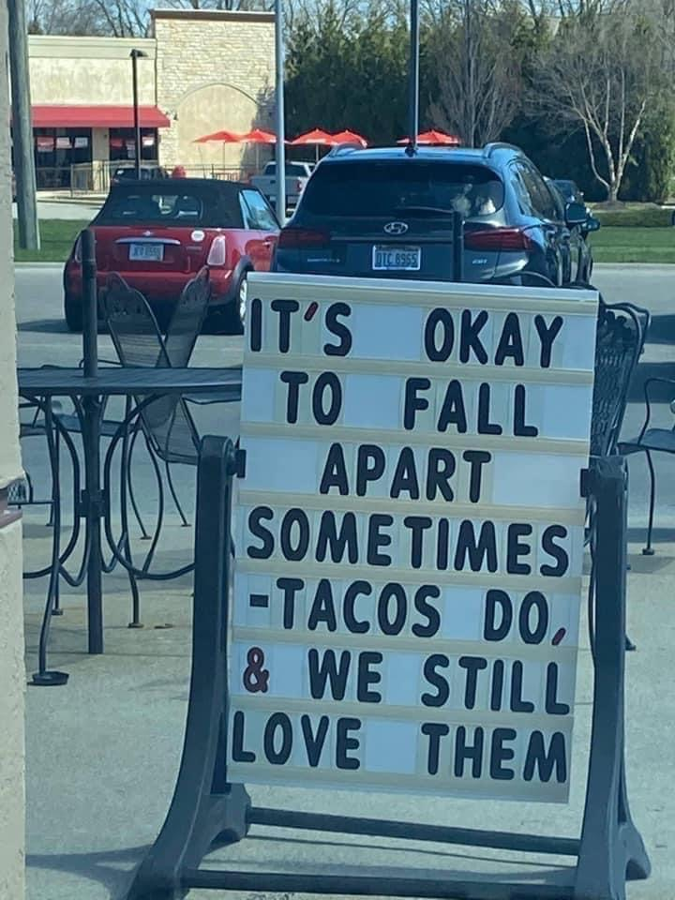

Slide 32
Ways To Improve Your Psychological Health
Exercise
Self Care
Nature
Fun
Spirituality
Relationships
Vacation/Leisure
Notes:
Consider taking 1 weekday off. You can take care of your own needs, see your doctor, dentist, psychiatrist, financial advisor etc
May have to work a 10 hour 4 day week.

Slide 33
Stress Reduction Techniques
Breathing techniques
Visualization
Stretching/yoga
Guided Imagery
Mindfulness
Positive self-talk
Venting-In a safe way
Notes:
Advocates usually say to meditate for 20 minutes 1-2 x per day, which is usually not possible for busy clinicians. But let’s focus on things that we can do for a few minutes each day
Breathing techniques- slow, deep breath, lowers bp, stress levels, improves sleep, can do in between patients, or am and pm. Smart watches sometimes remind you
Visualization-a distraction technique to remove persistent negative thoughts. A simple exercise is to close your eyes, and imagine a train carrying something pleasant (such as daisies). The train pushes the unpleasant thought off the track, and you watch cars go by as the train passes. Open your eyes. If the thought pops in again? Repeat the exercise
Stretching/yoga-do a few sun salutations
Guided Imagery-a deliberate effort to imagine yourself in a certain environment- ie your “happy place”. Close your eyes and see yourself in that place and involve all your senses.
Mindfulness-the idea here is to become aware of your surroundings, emotions, how you interact with the world around you in a “non-judgemental” way.
Positive self-talk-envision positive results instead of negative ones. Called in for a meeting with the boss? Envision something positive out of the conversation instead of the worst.
Venting-some physicians find it helpful to journal about stressful thoughts during the workday. One physician has said “I Can’t deal with stressful thoughts during my workday so I write my concerns down and give myself permission to think about them later. Dr. Keehbauch who uses the notes section of her iphone to do this.
Or an anonymous physician site like Sermo.

Slide 34
Individual Prevention Strategies
Stress reduction techniques
Counseling
Searching out New CHALLENGES
Work-life Balance
Financial Balance
Sense of meaning
Peer Support
Notes:
Meditation and yoga
Mindfulness-described as present moment awareness, or non-judgemental attentiveness to physicial and mental processes
The new challenge-might be coaching and speaking, might be changing to a whole new practice setting
Don’t forget about the vacation time! (this can be accomplished through float pools of physicians, locums, etc)
Sometimes physicians become trapped in a stressful practice in order to generate sufficient income to support their lifestyle.
One example of peer support groups is Schwartz rounds- debriefing after difficult cases, facilitated, confidential, multidisciplinary

Slide 35
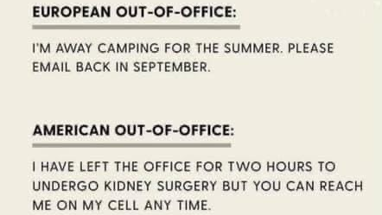

Slide 36
How Can Women Providers Cope?
Enlist the support of colleagues, a spouse, or significant other for balancing home and work issues
1
Seek help from a therapist
2
Women need to work to support each other and provide positive role modeling
3
Notes:
Studies show the odds of burnout are 40% less when female physicians have the support of colleagues, spouse, or a significant other
Enlightened leadership is essential in eff ecting change and addressing burnout at the organizational level [73]. Leadership qualities of supervisors are associated with individual physicians’ burnout and satisfaction scores [74]. Leaders can play an important role in leveling the playing fi eld for women at every stage of their careers by addressing disparities in opportunities, pay, and support staff and by working to eliminate gender discrimination and harassment [75,76]. Clear and credible reporting structures, as well as accountability metrics for managers and supervisors, may help to reduce or, ideally, eliminate workplace harassment and bullying [77,78]. Organizations can also foster improvements in culture by addressing issues related to harassment and by working with administration to regularly survey
A supportive work culture may mitigate some of the challenges of achieving optimal work-life integration [81]. Because many women clinicians experience unique pressures related to balancing personal and professional demands, organizations can foster balance by promoting gender-specifi c mentorship programs and implementing policies and practices intended to improve work-life integration [82,83,84,85]. These policies should include availability of child care—especially for parents of sick children who are unexpectedly unable to attend school or day care—lactation facilities and time to use them, and family leave that allows both women and men adequate time to care for children and other family members throughout their careers. Such policies would be more consistent with those that have been adopted for physicians in Europe [86] and those that are currently available in other industries in the United States. In addition, workplace sexual harassment and gen
Those physicians who exhibit symptoms of burnout or depression must be able to obtain appropriate care. Thus, the stigma associated with these problems must be eradicated, and mental health resources must be readily available to busy physicians. Seeking help for burnout and mental health issues should be encouraged and should not place one’s hospital privileges, licensure, or certifi cation status in jeopardy. State medical boards should adopt the recommendations of the Federation of State Medical Boards in their Report and Recommendations of the Workgroup on Physician Wellness and Burnout published in 2018 [88], including reviewing current procedures to determine if obtaining information regarding a physician’s mental health status is necessary to ensure patient safety, making clear diff erentiation between past mental health issues and current impairments, and clearly stating that obtaining additional information regarding physician physical or mental health does not constitute an investigation. These can help to reduce the stigma of mental health issues among physicians and the public and encourage

Slide 37
4 tools to reduce burnout by finding work-life balance
The Life Calendar
Intentional Date nights
The BIG Bucket and the weekly bucket Lists
The Work-Life Boundary Ritual
Notes:
Tool #1: The life calendar
One of the laws governing your work-life balance strategy is “the strongest structure wins.” By “structure,” I mean the calendar you are probably carrying on you right now.
If I asked you to hand me your calendar, what would I find? It would probably list your work commitments, but would it include the following:
Your spouse or significant other's schedule?
Your children's schedule?
Your workout schedule?
Your next date night?
Your next vacation?
Some blocked-off free time for yourself (heavens, just imagine that for a moment, will you)?
Anything not on the calendar you are carrying around with you is not likely to happen. Therefore, one of the keys to taming the gorilla is to create a life calendar and carry it with you at all times.
Creating a life calendar doesn't require you to purchase or learn any new technology, and maintaining it takes only 20 minutes a week. Here are the things you'll need:
A simple paper calendar (you probably have one at home hanging on the side of the refrigerator),
Some colored pens,
Your cell phone.
Here's the three-step process:
Step one: Build your life calendar for the week ahead. Pick a time in the week when everyone in your family or household is available. A popular time is Sunday after church and before football. Pull that paper calendar off the fridge, grab the pens, and put them all on the kitchen table. Gather everyone in the household, and build your life calendar for the week ahead.
Think about not only the regular activities your family has planned but also what you personally want in your life outside of medicine in the upcoming week. Remember, if you don't put it on your life calendar right here and now, it will almost certainly not happen. Here are some things you might want to schedule:
Workouts,
Time for writing or journaling,
Free time,
Coffee with a friend or relative,
Time to read a book,
A class.
Whatever you want, you must put it on the calendar.
The final thing to put on the calendar is the date and time of your next life calendar session. Everyone needs to be clear on when you will meet again.
Step two: Take a picture of your life calendar with your cell phone. Yes, it really can be that easy. Your life calendar can now be in your pocket or purse at all times right there on your cell phone.
Step three: Defend your life calendar. Now you are prepared to say the magic two-letter word that is key to work-life balance: “No.”
With your life calendar in hand, if someone at work asks, “Can you cover a few extra hours on Thursday?” or if someone at your child's school asks, “Can you come to the book fair meeting next week?” you can pull out your cell phone and say, “Let me check my calendar.” If you are already booked, you can say, “I'm sorry, I have another commitment at that time. I won't be able to help.”
As you read the conversation above, did it make you feel a little uncomfortable? If you're like most doctors, it probably did because we are horrible at saying “no.” Our discomfort may stem from being completely out of practice at saying “no,” but that is fixable. Saying “no” is a skill we can practice, and “practice makes better.” We may also be afraid to say “no” because we don't want to be perceived as not being a team player or being weak, imperfect, or unable to do it all. Give that up.
Here is what will drive your discipline to say “no”: When you carry your life calendar, see a conflict, and say “yes” anyway, you will know immediately who you need to get ahold of, apologize to, and reschedule with because you just threw your plans under the bus.
This process works every time you use it. By that I mean your life will be more balanced every week you build your life calendar than if you did not take that 20 minutes to pop it into your cell phone. By proactively scheduling the items you want your family or yourself to be involved in each week, you will have less capacity for those items that aren't a priority.
Tool #2: Intentional date nights
If you think being intentional about date nights isn't a serious issue or has no relation to physician burnout, think again. A healthy relationship can recharge and strengthen you, while an unhealthy relationship can quickly deplete you, and even cause health problems.² My coaching clients have found the optimum frequency for a quality date night is twice a month, minimum. If it has been more than two months since your last date night, you are way overdue. Date nights are not the only way to strengthen your relationship, but they are critically important, so do not skip them. If you do not have a significant other, date night could be a date with someone you'd like to know better, time with a friend, or doing something nice or unexpected all by yourself. (Yes, you can take yourself out on date night, too.)
When you are really busy, figuring out what to do on your date night can seem like just another item on your task list. I encourage you to do an attitude check here. What is more important to you – the 800-pound gorilla or some love, romance, adventure, and fun? Date night is a chance to break out of survival mode and do something extraordinary.
Here are a few ideas:
Take turns planning your date nights, but keep your plans a secret. Only reveal when to be ready and what to wear.
Write down several date night ideas onto slips of paper, and drop them into a hat. Pick one, raffle style, and go for it.
Make it a game, and set rules. Here is a fun one: Your date can't involve calories or money.
Buy in bunches. In other words, if you have a shared interest and there is a season-ticket option, buy them. This will take care of multiple date nights in a single purchase.
On any date night, even before you order drinks or appetizers, your first action is to schedule the next date night. This way, you will always have a date night on your calendar. If you want to be an overachiever, as most of us do, instead of putting just the next date night on your calendar, schedule out six date nights – three months' worth.
Bucket list (noun): The list of things you want to do before you “kick the bucket.” Bucket lists are important because they encourage you to work toward a goal that is personally meaningful. This sense of purpose and excitement can help boost your energy levels and make you more resilient.
My clients have found it useful to build two bucket lists.
1. The BIG bucket list. This is the classic list of “things I must do before I die.” A common problem with the big bucket list is putting too many things on it. This sets you up for failure. If you have too many items on your list, you will never cross any of them off and you will feel guilty.
Here is a reality check that will dramatically shorten your big bucket list:
Make your big bucket list. Write it all down, and keep a copy in a folder somewhere.
Give someone the list, and have them read it back to you one item at a time.
For each item, take a moment to imagine you fail. Imagine you actually die before accomplishing this task. How does that feel?
Note which items break your heart when you contemplate them left undone. Those are your authentic big bucket list items, and if you are like most people, your list just got much shorter.
These big bucket list items can take a significant amount of time, energy, or money to accomplish. That is why they lay dormant for so long. Here are two keys to accomplishing them.
First, schedule them. Pick your first big bucket list item. Look out on your calendar as far as you need to in order to find a time that will actually work. It could be one, two, three years out or more. Schedule it anyway. Print out a calendar for that year or month, use a brightly colored pen, and mark off the dates. Hang it in a highly visible spot at home. Go into work and block it off your schedule on the work computer as well. Put a stake in the ground now. It may be something you schedule for one specific time period (e.g., a trip), or it may be something you have to schedule regularly (e.g., writing a novel).
Next, put skin in the game. Buy the tickets. Order the resources or equipment you'll need. Book the cabin where you'll write or study or whatever it might be. Put money down immediately. If you can't make the purchase yet, open a savings account and start putting money away. Whether it is Machu Picchu, Africa, the running of the bulls in Pamplona, visiting the country of your family's origin, a Spanish immersion school in Costa Rica, or rafting the Grand Canyon, get it scheduled and paid for. Nothing will make a doctor take a trip more than putting down cold, hard cash. Afterward, it will take its rightful place in your memories as a peak experience rather than a heartbreaking regret.
2. The weekly bucket list. Is there an activity or experience that turns your whole week around every time you do it? It's the thing that makes you say, “I wish I could do that every week.” Most people know what this item is and yet only manage to squeeze it in every once in a while. Common examples are a workout or sport, play time with your children, a massage, dinner with a friend, painting, playing music, or a religious practice or meditation. Often, these items contribute to larger personal goals, such as physical fitness, healthy relationships, or artistic endeavors.
What are two to three of your weekly bucket list items?
Putting these items on your life calendar is part of carving out time and space in your busy week. Defend these items just as vigorously as you do your work schedule to show that gorilla some healthy boundaries.
Be aware that as you contemplate doing something just for yourself, guilt can surface. A little voice might say, “What makes you think you are so special?” when you are blocking off time for your own personal use. This is your programming, pure and simple. Tell that voice, “Thank you for sharing,” and then block the time anyway. As you give yourself permission to experience the pleasant things in your life, you will see what a difference this can make for you, your home life, and your work life. Taking care of yourself can give you the energy you need to take care of others.
One of the keys to being able to recharge when you are not at work is creating a clean, solid, functioning boundary between work and home. This allows you to take the white coat off, leave work at work, and come all the way home.
Have you ever found yourself sitting at home thinking about work? It is almost a silly question. This happens when you miss the boundary. You have never been taught the “off switch” on your role as a doctor.
You can't recharge in this situation. Instead of recovering, you are still being drained by work stress even though you are not in the office or hospital.
Creating a boundary ritual is a mindfulness skill you can learn and practice. It is the energetic equivalent of an off switch on your role as a doctor. Your boundary ritual marks the transition from the environment where the patient comes first to one where you come first.
Fortunately, we have an excellent role model of a boundary ritual – Mr. Rogers. Yes, that one, from the children's television show. His personal boundary ritual had three steps:
He takes off his jacket and puts on a zip-up sweater,
He changes his shoes,
He sings, “It's a beautiful day in the neighborhood ….”
With his boundary ritual complete, he is the Mr. Rogers we know and love for the rest of the show.
I strongly encourage you to develop your own boundary ritual. The most effective rituals involve three things:
An intention to let go of work,
A releasing breath,
An action (change clothes, walk the dog, take out your contacts and put on your glasses, make a nice dinner, etc.).
A friend of mine's father – a small-town family doc – had a very simple but effective boundary ritual. Every day after coming home from work, he would shower and change clothes. He wouldn't talk to his family until this boundary ritual was complete. Afterwards, he was just “Dad” again.
Here is a simple boundary ritual you can use if you drive home from work:
Arrive at home, and park the car. Put your hand on the keys or off button. Say to yourself, “With this breath, I am coming all the way home.” Take a deep breath. As you exhale, release all thoughts and feelings about work. Turn the car off, take the keys out, and step out of the vehicle.
With a boundary ritual, you will find yourself more relaxed at home and thinking less about work. What will your boundary ritual be, and when will you start practicing it?
Pick an idea and take action
As discussed in previous articles, it is easy to read an article like this one, with multiple suggestions, and get overwhelmed. The key is to take just one step at a time. Pick just one action from the options above and put it into action. That is all. The first step might be to call your family together and create a life calendar for next week. Once you have taken the first step, the second one will become clearer. You will know exactly what to do next. It might involve taking an afternoon off and thinking about your bucket lists. Whatever it is, just take the next step, and the next, and the next ... to put one of these tools into action in your life. With just these simple actions, you'll be on your way to a healthier, more balanced life. Constructing a strategy to build and maintain life balance is one of the keys to preventing physician burnout.

Slide 38
Treatment for acute burnout
Time away from work
Professional Assistance (www.fsphp.org), the Sotile Center for Physician Resilience
Finding a Professional Coach
Notes:
No amount of yoga, mvi, meditation or sweaty exercise, or extreme time management will save us from the effects of extreme work (Krupka 2015)
Time may be a paid or unpaid leave of absence, a paid sabbatical, vacation time, or medical leave
Professional assistance (particularly with depression, substance abuse, or anxiety,)
Through physician health programs, individual counselors, substance use professionals etc
One resource I have here is the Federation of State Physician Health Programs
And also the Sotile Center for Physician Resilience where Dr Sotile uses his training in family systems to work with physicians and their families who may be experiencing burnout
Professional coaches help with issues related to time management and delegation, according to one professional coach, who is also a physician.
Many times a professional coach is also a physician.
Another professional coach Dr Mudge Riley stated that coaching offers support and mentorship. About 1/5 of her client choose to leave medicine altogether; the rest often make space for other endeavors such a starting a business, quality or regulatory work, medical writing or fiction writing.

Slide 39
References
Books
Bernard, Rebekah. How To Be A Rockstar Doctor. New York: McMillan.
Dechant, Paul. Preventing Physician Burnout: Curing the Chaos and Returning Joy to the Practice of Medicine. New York: Psychological Press. 2014
Leiter, MP, Bakker SB, Maslach C. eds Burnout at Work: A Psychological Perspective. NewYork: Psychological Press. 2014
Murphy T. Physician Burnout: A Guide to Recognition and Recovery. Aloha Publishing. 2015

Slide 40
References
Articles
J Gen Intern Med. 1992 Jul-Aug 7 (4): 424-31. The heart of darkness: the impact of perceived mistakes on physicians. Christensen, JF, Levinson W, Dunn PM.
Shanafelt TD, Bradley KA, Wipf JE, Black AL: Burnout and self-reported patient care in an internal medicine residency program. Ann Intern Med. 2002;136 (5):358-367
J Clin Outcomes Manage 2008 May ;15(5):240-247 Supporting health care workers after medical error: considerations for health care leaders White AA, Waterman AD, McCotter P, Boyle DJ, Gallager TH

Slide 41
References
Western J Med Jan 2001: 174 A qualitative study of physicians’ own wellness-promotion practices Eric L Weinter, Geoffrey R Swain, Mark Gottlieb
Psychiatric Illness in female physicians. Are high rates of depression an occupational hazard? Department of Psychiatry, Washington University School of Medicine, St. Louis 63110, USA. Postgraduate Medicine 1997 101 (5):233-6, 239-40, 242.
Fam Pract Manag 2016: Jan-Feb; 23(1):28-33 Four Tools for Reducing Burnout by Finding Work-Life Balance Dike Drummond
Fam Pract Manag 2015: Nov-Dec;22(6):13-18 Eight Ways to Lower Practice Stress and Get Home Sooner

Slide 42
Thank you!
Maryland Behavioral Health Integration in Pediatric Primary Care (BHIPP)
1-855-MD-BHIPP (632-4477)
www.mdbhipp.org
Follow us on Facebook, LinkedIn, and Twitter! @MDBHIPP
For resources related to the COVID-19 pandemic,
please visit us at BHIPP Covid-19 Resources.
Notes:
You will a copy of these slides

