Slide 1
Maryland Behavioral Health Integration in Pediatric Primary Care (MD BHIPP) Crisis Training
May 19th, 2022
Suicide Prevention Part 1: Active Suicidality and Nonsuicial Self-Injury
Robert Paine, DO
855-MD-BHIPP (632-4477)
www.mdbhipp.org

Slide 2
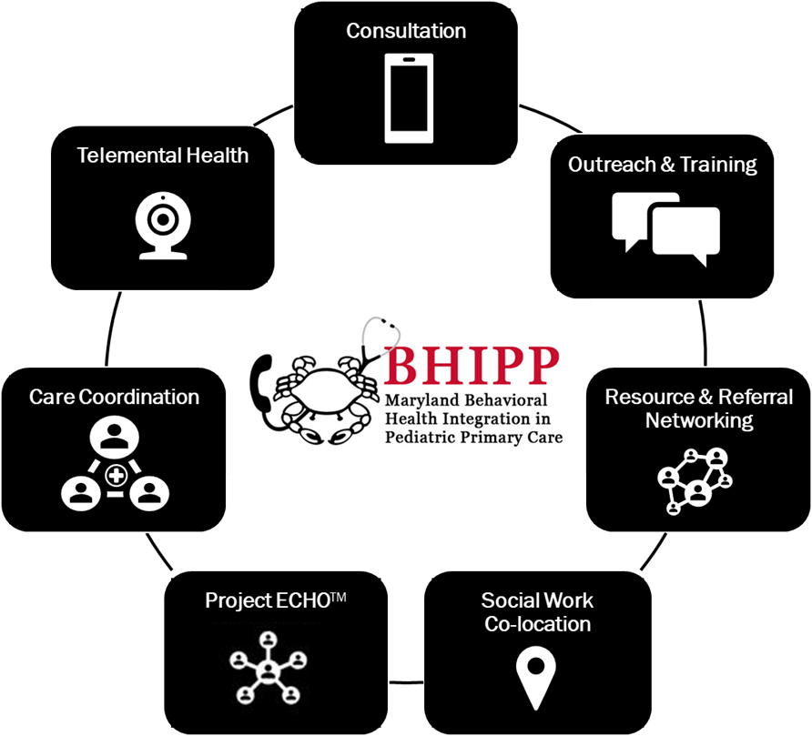
Who We Are – Maryland BHIPP
Offering support to emergency medicine and pediatric primary care professionals through free:
  Telephone consultation (855-MD-BHIPP)
  Resource & referral support
  Training & education
  Regionally specific social work co-location (Salisbury University and Morgan State University)
  Project ECHO®
  Direct Telespsychiatry & Telecounseling Services
  Care coordination
Notes:
Maryland Behavioral Health Integration in Pediatric Primary Care or BHIPP is a Child Psychiatry Access Program that supports the capacity of primary care providers in Maryland to manage pediatric mental health concerns. We do this, currently, in a number of ways: 1. We offer a free behavioral health telephone consultation service, including resource and referral support, 2. education and training, 3. Through our partnership with Salisbury and Morgan State University, we offer co-location of social work interns at select primary care sites, 4. Web-based longitudinal learning through Project ECHO similar to today’s event, 5. Direct telepsychiatry and telecounseling services (coming soon) , 6. Care Coordination (coming soon)

Slide 3




Partners & Funding
BHIPP is supported by funding from the Maryland Department of Health, Behavioral Health Administration and operates as a collaboration between the University of Maryland School of Medicine, the Johns Hopkins University School of Medicine, Salisbury University and Morgan State University.
This program is supported by the Health Resources and Services Administration (HRSA) of the U.S. Department of Health and Human Services (HHS) as part of an award totaling $433,296 with approximately 20% financed by non-governmental sources. The contents of this presentation are those of the author(s) and do not necessarily represent the official views of, nor an endorsement, by HRSA, HHS or the U.S. Government. For more information, visit www.hrsa.gov.

Slide 4
Conflict of interest disclosure
No potential conflicts of interest
Faculty at the University of Maryland School of Medicine
Salary funding from the State of Maryland (BHIPP)
Member of the American Academy of Child & Adolescent Psychiatry (AACAP)

Slide 5
Learning Objectives
Know how to differentiate suicidal behavior and nonsuicidal self-injury in children and adolescents
Identify risk and protective factors for suicide in children and adolescents
Learn how to conduct a suicide assessment

Slide 6
Acknowledgement
A special thanks to Dr. Hal Kronsberg of the BHIPP team who created the majority of the slide content presented today!

Slide 7
Defining Nonsuicidal Self-Injury (NSSI)
Nonsuicidal self-injury (NSSI) is the direct and deliberate self-inflicted damage of body tissue without suicidal intention or socially sanctioned purpose.
Brown and Plener 2017

Slide 8
NSSI in the DSM-5 TR
“This category may be used for individuals who have engaged in intentional self-inflicted damage to their body of a sort likely to induce bleeding, bruising, or pain (e.g., cutting, burning, stabbing, hitting, excessive rubbing) in the absence of suicidal intent.”
(R45.88) Current Nonsuicidal Self-Injury: If nonsuicidal self-injurious behavior is part of the clinical presentation
(Z91.52) History of Nonsuicidal Self-Injury: If nonsuicidal self-injurious behavior has occurred during the individual’s lifetime
DSM-5 TR (2022)

Slide 9
Self-harm as a behavior
Why see it that way?
  Self-harm is not necessarily a treatable disorder itself but can signal the presence of other disorders
  Something reinforces self-harm to enable the behavior to persist
  To stop self-harm, you must address the antecedents and consequences
Notes:
Unlike a diagnosis, which is sort of the endpoint of an investigation, with self-harm this is often where our investigation has to begin

Slide 10
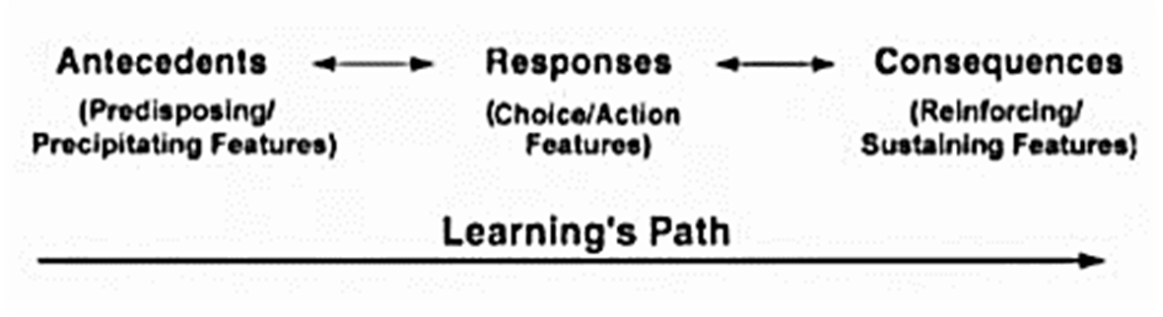
Triad of Goal-Directed Behaviors

Slide 11
Why Do Kids Self-Harm?
Understanding the problem more fully

Slide 12
Self Harm’s Four Outcomes
How does self-harm “work”?
Increase in desired feelings: self-punishment , self-stimulation, “endorphin release”
Decrease undesired feelings: feel less overwhelmed or sad or angry, reduce the feeling of emptiness
Increase a desired social response: gain attention or support (“manipulation”)
Decrease undesired social response: stop bullying or fighting
Nock, M. K. (2010). Self-injury. Annual review of clinical psychology, 6, 339-363.

Slide 13
What Kids Report
25% to increase a desired feeling
65% to decrease an unpleasant feeling
  35% to escape anxiety (feeling “overwhelmed”)
  24% to escape sadness
  20% to escape anger
  29% to escape a “bad thought” or “bad memory”
4% to create a desired interpersonal outcome
15% to decrease a negative interpersonal outcome
Nock, M. K., Prinstein, M. J., & Sterba, S. K. (2009). Revealing the form and function of self-injurious thoughts and behaviors: A real-time ecological assessment study among adolescents and young adults. Journal of abnormal psychology, 118(4), 816.

Slide 14
NSSI or Suicide Attempt?
The key distinction between a suicide attempt and NSSI is the intent underlying the act.
In NSSI, the person’s intent is to feel better in some way.
In a suicide attempt, the person has at least some intent to die, even if considerable ambivalence is present.

Slide 15
Assessment of NSSI
Physical Examination
  Signs of infection?
  Tetanus Vaccine Status
  Necessity of Somatic Treatment
Taking the History

Slide 16
The “What” of Cutting
When did it start?
How do you self-harm?
  Cutting? Burning? Scratching? Purging? Using drugs? How many different ways?
  How often?
  Where do you self-harm?
  With what?
  Ask to see scars
Who knows?
  How do those people feel about it?
  What do your parents know about your self-harm?
Notes:
Bold are the things you want to prioritize in a 15 minute visit

Slide 17
The “Why” of Cutting
In general, how are you feeling before you cut?
What does it do for you?
  Does it help you feel more or less of a particular emotion?
How do other people react to your cutting?
  How do you feel about that reaction?
How “well” does it work?

Slide 18
The “What Next” of Cutting
Assess suicidality (self-harm may not be a suicide attempt, but the person self-harming may still be suicidal)
  How much did you want to die when you hurt yourself?
  What did you want to happen when you hurt yourself?
Notes:
It’s likely you may want a quick return visit to more deeply dive into comorbidities

Slide 19
NSSI and Suicide
Just how worried should we be?

Slide 20
Self-harm and suicide
Predictors of self-harm and suicide attempts:
  Multiple methods of self-injury
  Hopelessness
  Parental conflict
  Depressive symptoms
Asarnow, J. R., Porta, G., Spirito, A., Emslie, G., Clarke, G., Wagner, K. D., ... & Mayes, T. (2011). Suicide attempts and nonsuicidal self-injury in the treatment of resistant depression in adolescents: findings from the TORDIA study. Journal of the American Academy of Child & Adolescent Psychiatry, 50(8), 772-781.

Slide 21
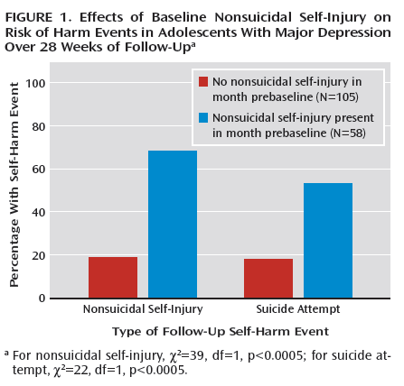
Self-harm and suicide
Study of depressed adolescents on SSRI treatment
Six months after assessment:
  No history of self-harm
    1 in 5 self-harm
    1 in 5 attempt suicide
  History of self-harm
    3x risk of self-harming again
    2x risk of suicide attempt
Wilkinson, P., Kelvin, R., Roberts, C., Dubicka, B., & Goodyer, I. (2011). Clinical and psychosocial predictors of suicide attempts and nonsuicidal self-injury in the Adolescent Depression Antidepressants and Psychotherapy Trial (ADAPT). American Journal of Psychiatry.
Notes:
Large treatment study of British adolescents
Even when depression is treated, self-harm can persist – it’s a “sticky” behavior
When self-injury and depression co-occur, we need to really emphasize safety planning around suicidal thoughts and urges

Slide 22
Key Take-Home Points
Whys
  Most kids typically self-harm to make a feeling go away
  Self-harm is rarely “for attention”
What nows
  Assess suicidality
  Determine the function of the self-harm
  Identify comorbidities
What next
  Treatments work!
Whats
Cutting alone doesn't tell us everything about diagnosis
Kids who cut rarely engage in more than 10 discrete episodes in their lives
Kids who self-harm struggle more with strong emotions
Kids who self-harm can have poor social judgment
Non-suicidal self injury is strongly associated with future suicide attempts

Slide 23
Youth Suicide: A Public Health Crisis
In the United States, youth suicide is a growing public health problem that contributes to health care costs, lost productivity, morbidity, and premature death.
Suicide is preventable, and we all have a role in its prevention.

Slide 24
Suicidal Behavior-Definitions
Suicidal Behavior Includes:
  Suicidal Ideation: thinking about ending one’s life
  Suicide Attempt: non-fatal suicidal behavior
  Suicide: ending one’s life

Slide 25
Suicidal Behavior in the DSM-5TR
This category may be used for individuals who have engaged in potentially self-injurious behavior with at least some intent to die as a result of the act. Evidence of intent to end one’s life can be explicit or inferred from the behavior or circumstances. A suicide attempt may or may not result in actual self-injury. If the individual is dissuaded by another person or changes his or her mind before initiating the behavior, this category does not apply.
Current Suicidal Behavior
(T14.91A) Initial encounter: If suicidal behavior is part of the initial encounter with the clinical presentation
(T14.91D) Subsequent encounter: If suicidal behavior is part of subsequent encounters with the clinical presentation
(Z91.51) History of Suicidal Behavior: If suicidal behavior has occurred during the individual’s lifetime
DSM-5 TR (2022)

Slide 26
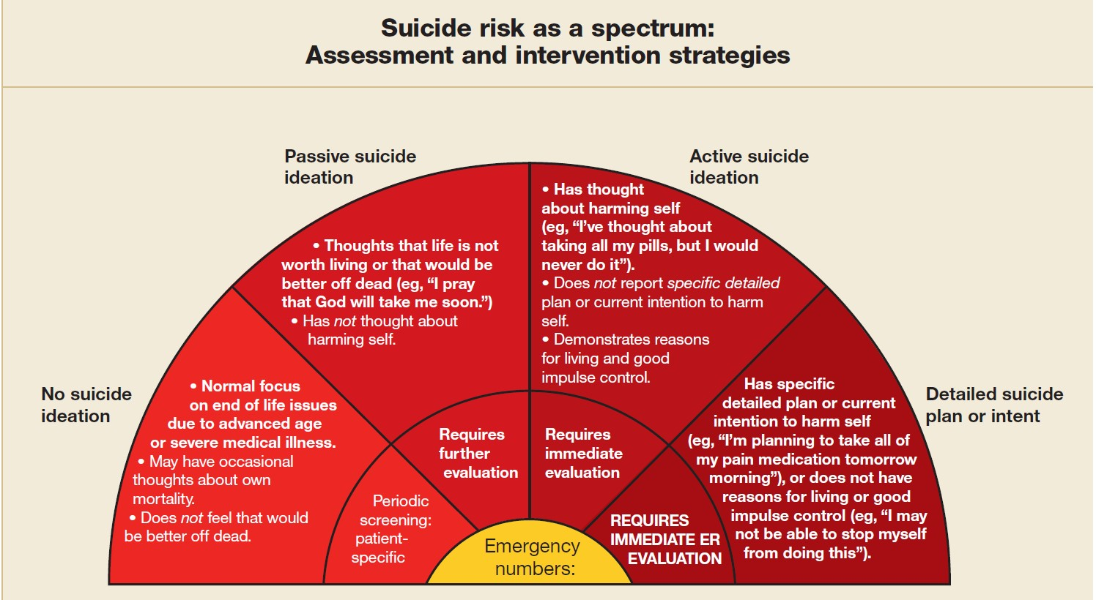
Raue et al 2006

Slide 27
Take Home from the Data
Per: Curtin SC, Hedegaard H. Suicide rates for females and males by race and ethnicity: United States, 1999 and 2017. NCHS Health E-Stat. 2019.
  Suicide rates are much lower among kids 10-14 compared with kids 15-21
  Suicide rates among kids 10-14 saw a much larger increase relative to older kids from 1999 to 2017
  Males are at higher risk for ending their lives by suicide than females
  Suicide rates do vary significantly by race
    American Indian and Alaska Natives are at highest risk for suicide by a factor of 2

Slide 28
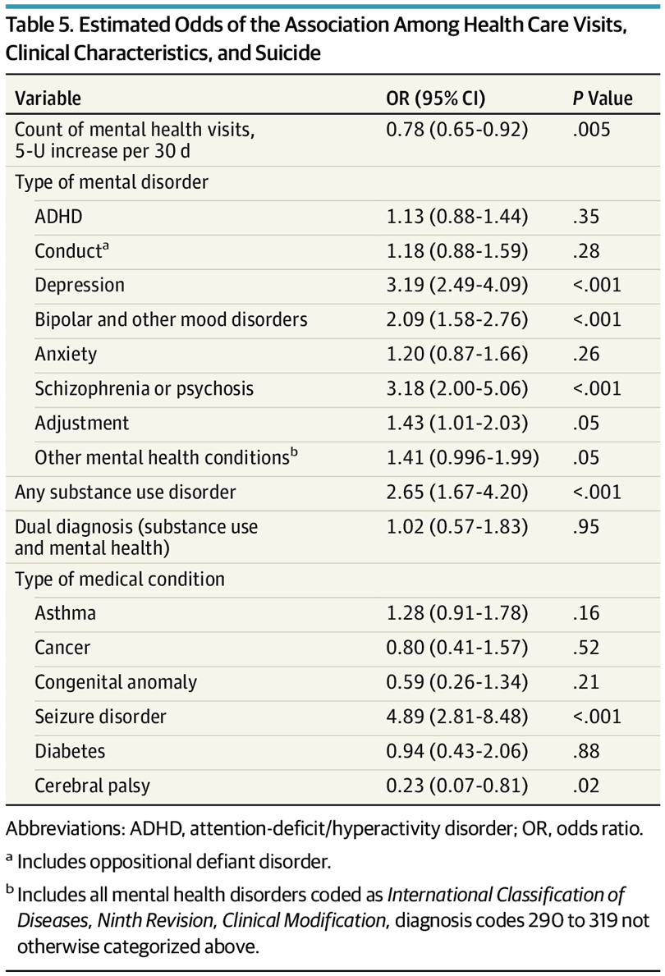
Risk Factors
Case-control study of Medicaid data of youth 10-18
More mental health visits w/in 30 days of a crisis decreased odds of suicide
Suicide most highly associated with MDD, psychotic illness, substance use disorder, bipolar disorder, and seizure disorder
Fontanella CA, Warner LA, Steelesmith D, Bridge JA, Sweeney HA, Campo JV. Clinical Profiles and Health Services Patterns of Medicaid-Enrolled Youths Who Died by Suicide. JAMA Pediatr. 2020;174(5):470–477. doi:10.1001/jamapediatrics.2020.0002
Notes:
Highest odds ratio for seizure disorder, then depression, then psychosis, then SUD

Slide 29
Risk Factors
Static Risk Factors
LGBTQ+ youth have more than 2x rate of suicidal ideation
Family history of suicide attempts
History of physical or sexual abuse
Previous suicide attempt
History of non-suicidal self-injury
Modifiable Risk Factors
Firearms in the home (regardless of how they are stored)
Pathologic internet use (such as visiting prosuicide websites)
Family conflict
Academic stressors

Slide 30
Suicide Screening Tools
Pros and Cons

Slide 31
PHQ-9A
The PHQ-9A (recommended by the GLAD-PC guidelines) also has suicide screening questions (below)
  In a large study in pediatric primary care use, 8.6% of kids were positive on the suicide screen and half of those kids did not meet the threshold to screen positive for depression (Farley et al 2020)

Slide 32
ASQ (Ask Suicide Screening Questions)
Very brief suicide screening tool developed by NIMH
Meant specifically for use in pediatric primary care
Validated in ED and outpatient settings in large-scale studies

Slide 33
ASQ (Ask Suicide Screening Questions)
ASQ is screening portion of a broader suicide assessment
Positive screens are meant to have a more comprehensive evaluation, including the Brief Suicide Safety Assessment
Meant to help divide patients into three risk groups requiring differing intensity of interventions

Slide 34
ASQ (Ask Suicide Screening Questions)
Pros
Cons
Takes very little time to administer
Part of a larger “toolkit” that includes a clinical pathway flowchart and more comprehensive suicide assessment (see right)
High sensitivity (100%) and high specificity (90%)
Fairly low positive predictive value (30% of positive screens were actually “true positives”)
Asking if kids have “ever” tried to kill themselves can be overly broad
Language used on the screener can be a little jarring to patients.
Notes:
The safety assessment is four page document that includes risk assessment, safety planning, and disposition planning

Slide 35
Assessing Suicide Directly
Start broad and open-ended: “Over the last month, how have you been feeling about being alive?”
Follow-up questions gently move up to a higher level of acuity: “Have you had moments when you wished you were dead?” and “Did you ever reach a point where you thought about trying to end your life?”
Ask about frequency, intensity, and “how do you manage those thoughts when they come?”
If there is a specific thought to commit suicide, follow-up again with questions about the plan’s details, including lethality, feasibility, and desire to act on it
Ask what’s kept them from acting on their plan thus far
Don’t forget to ask about home: to what extent can parents/caregivers supervise if needed?

Slide 36
Assessing Suicide Directly
At the end of your suicide assessment, you should know:
  Has your patient had thoughts of wanting to be dead?
  Has your patient had thoughts of committing suicide?
    How frequent and how intense?
  Does your patient have a plan for suicide?
    Specifically, what would your patient do?
    Does your patient have available the tools/objects to act on that plan?
    What has kept your patient from acting on that plan?
  Do parents/caregivers have the ability to provide additional supervision if needed?

Slide 37
Techniques for Eliciting Sensitive Information
Normalization
Shame Attenuation
Gentle Assumption
Symptom Amplification
Denial of the Specific
Behavioral Incident
Freedenthal, 2018

Slide 38
Normalization
Normalization involves asking about suicidal ideation only after making clear that it is normal to think of suicide at one time or another, especially in painful or difficult circumstances.
“Many people with depression like yours can feel so bad that they think of suicide. Have you had suicidal thoughts?”
Freedenthal, 2018

Slide 39
Shame Attenuation
Many people feel ashamed of their suicidal thoughts or behaviors and blame themselves.
The technique of shame attenuation blames the person’s pain, illness, or situation instead.
“With all the pain and hopelessness you feel, do you think of killing yourself?
Freedenthal, 2018

Slide 40
Gentle Assumption
If someone feels any shame, embarrassment, or fear about disclosing suicidal ideation, then “yes-no” questions can deter the person from answering honestly.
To avoid that problem, the technique of gentle assumption calls for you to act as if the person has already answered “yes.”
“What are some ways you have thought of killing yourself?”
“How many times in your life have you attempted suicide, if at all?”
Freedenthal, 2018

Slide 41
Symptom Amplification
You need to know not only if the person is thinking of suicide, but also how often and how intensely.
Symptom amplification calls for you to exaggerate the possibilities, which gives room for the person to answer honestly without necessarily feeling that they are thinking of suicide excessively.
“How many times a day do you think of suicide? 20? 30? (to which the person responds, “Oh gosh no, not that much. Only 5-10 times, I’d say.”)
Freedenthal, 2018

Slide 42
Denial of the Specific
Instead of asking a single overarching question that covers many possibilities, the denial of the specific technique requires you to ask separately about each possibility.
Ask separately about each specific possibility rather than stringing together multiple options in one question.
With each of these possibilities, the professional waits for the person’s response before moving on to the next possibility.
“Have you ever thought of jumping off a high place, like a bridge or a building…Have you thought of taking an overdose?....Hanging yourself?...Shooting yourself?...Cutting yourself?
Freedenthal, 2018

Slide 43
Behavioral Incident
Ask questions about each step in the person’s thoughts and behaviors in response to stress, pain, hopelessness, or other difficult emotions or situations that might trigger suicidal thoughts.
By breaking the person’s experience down into very concrete details, you help strip away any vagueness or distortions that might obscure the person’s true experience.
“When you took out the bottle of pills, what happened next?...What did you do next?...Then what did you do?...What were you feeling when you did that?”
Freedenthal, 2018

Slide 44
Resource for Patients
988
A new crisis hotline number
Patients experiencing mental health crises can call or text 988 and will be directed to the National Suicide Prevention Lifeline.
Coming July 16th nationwide!
Learn more at https://suicidepreventionlifeline.org/current-events/the-lifeline-and-988/

Slide 45
To Be Continued….
Please join us for Suicide Prevention Part 2: Safety and Crisis Planning on Thursday June 16th

Slide 46
Thank you!
Maryland Behavioral Health Integration in Pediatric Primary Care (BHIPP)
1-855-MD-BHIPP (632-4477)
www.mdbhipp.org
Follow us on Facebook, LinkedIn, and Twitter! @MDBHIPP
For resources related to the COVID-19 pandemic,
please visit us at BHIPP Covid-19 Resources.
Notes:
You will a copy of these slides

