Slide 1
Young Adult Perspectives: Conversations about Primary Care and Behavioral Health Featuring Haley Rizkallah and Brendel Mitchell of Taking Flight Friday, April 16th, 2021 12:30-1:30pm
1-855-MD-BHIPP (632-4477)
www.mdbhipp.org
Follow us on Facebook, LinkedIn, and Twitter! @MDBHIPP

Slide 2
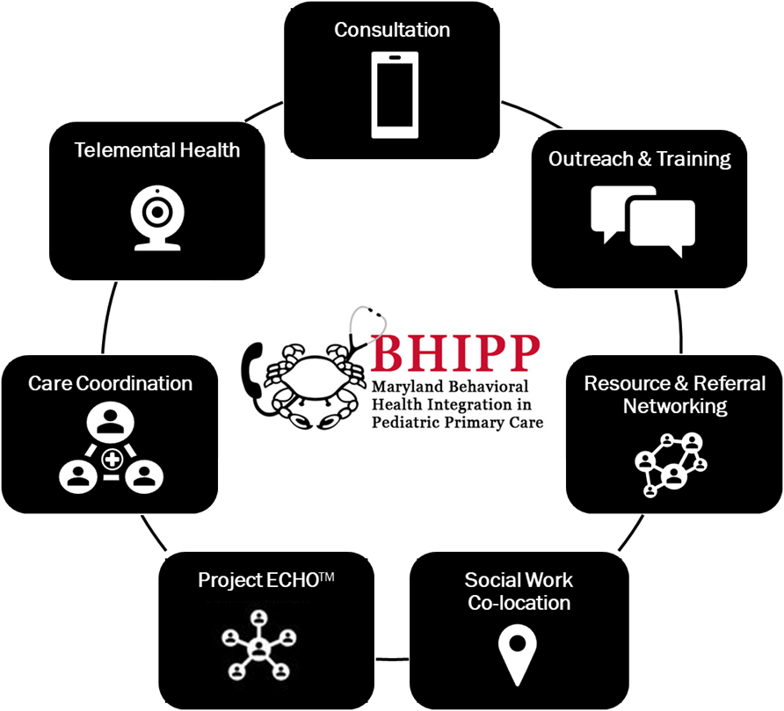
Who We Are – Maryland BHIPP
Offering support to pediatric primary care providers through free:
Telephone consultation (855-MD-BHIPP)
Resource & referral support
Training & education
Regionally specific social work co-location (Salisbury University and Morgan State University)
Project ECHO®
Direct Telespsychiatry & Telecounseling Services
Care coordination
Notes:
Maryland Behavioral Health Integration in Pediatric Primary Care or BHIPP is a Child Psychiatry Access Program that supports the capacity of primary care providers in Maryland to manage pediatric mental health concerns. We do this, currently, in a number of ways: 1. We offer a free behavioral health telephone consultation service, including resource and referral support, 2. education and training, 3. Through our partnership with Salisbury and Morgan State University, we offer co-location of social work interns at select primary care sites, 4. Web-based longitudinal learning through Project ECHO similar to today’s event, 5. Direct telepsychiatry and telecounseling services (coming soon) , 6. Care Coordination (coming soon)

Slide 3
Partners & Funding
BHIPP is supported by funding from the Maryland Department of Health, Behavioral Health Administration and operates as a collaboration between the University of Maryland School of Medicine, the Johns Hopkins University School of Medicine, Salisbury University and Morgan State University.
This program is supported by the Health Resources and Services Administration (HRSA) of the U.S. Department of Health and Human Services (HHS) as part of an award totaling $433,296 with approximately 20% financed by non-governmental sources. The contents of this presentation are those of the author(s) and do not necessarily represent the official views of, nor an endorsement, by HRSA, HHS or the U.S. Government. For more information, visit www.hrsa.gov.

Slide 4
Who we are – Maryland Coalition of Families and Taking Flight
Maryland Coalition of Families (MCF) is an organization that provides family peer support and navigation services to caregivers and other loved ones of a person with behavioral health needs, and helps families access needed supports and services. In addition, MCF supports and empowers family members to advocate for improving services in all systems of care for children, youth, adults and families.
Taking Flight is a young-adult peer group supported by Maryland Coalition of Families. Taking Flight is a Maryland Youth MOVE chapter that offers informal peer support services, leadership development opportunities, and involvement in advocacy for transition age youth across the state. Haley and Brendel also represent the youth voice at various statewide behavioral health committees.

Slide 5
Contact Us
Maryland Coalition of Families (MCF)
mdcoalition.org
For more information, reach out to info@mdcoalition.org
For referrals, contact referral@mdcoalition.org
Taking Flight (young adults 18-26)
taking-flight.org
Daily updates on Instagram: @mcf.taking.flight
Facebook: facebook.com/TakingFlightMD
hrizkallah@mdcoalition.org
bmitchell@mdcoalition.org
Notes:
You will a copy of these slides

Slide 6
Thank you!
Maryland Behavioral Health Integration in Pediatric Primary Care (BHIPP)
1-855-MD-BHIPP (632-4477)
www.mdbhipp.org
Follow us on Facebook, LinkedIn, and Twitter! @MDBHIPP
For resources related to the COVID-19 pandemic,
please visit us at BHIPP Covid-19 Resources.
Notes:
You will a copy of these slides

