Slide 1
Pediatric Anxiety: Identification and Treatment in Primary Care
Maryland Behavioral Health Integration in Pediatric Primary Care
Sarah Edwards, DO
Assistant Professor
Director and Medical Director
Division of Child and Adolescent Psychiatry
University of Maryland School of Medicine
Carisa Parrish, PhD
Associate Professor, Psychiatry & Behavioral Sciences
Director of Training, Pediatric Psychology Fellowship
Co-Director, Pediatric Medical Psychology Program
Johns Hopkins School of Medicine
Division of Child & Adolescent Psychiatry
1-855-MD-BHIPP (632-4477)
www.mdbhipp.org
Follow us on Facebook, LinkedIn, and Twitter! @MDBHIPP

Slide 2
Learning Objectives
Describe the evolution of normal childhood anxiety and pediatric child anxiety disorders across different developmental stages
Discuss how to evaluate when “normal” anxiety becomes “clinical” anxiety
Review common screening tools for pediatric anxiety disorders
Discuss evidence-based treatments including CBT

Slide 3
Calls to BHIPP
Presenting Concerns | What the PCP wanted/reason for the call | # of Records
Anxiety (612 records) | Resources | 379 (61.9%)
 | Medication Consult/Guidance/Question | 130
 | Consults (For this option is only said consultation or consult with no other info) | 25
 | Treatment Planning | 11
Attention/ concentration (202) | Medication Consult/Guidance/Question | 84 (41.6%)
 | Resources | 82
 | Treatment Planning | 7
 | Consults (For this option is only said consultation or consult with no other info) | 6
Depressed mood (554) | Resources | 353 (63.7%)
 | Medication Consult/Guidance/Question | 153
 | Treatment Planning | 11
 | Consults (For this option is only said consultation or consult with no other info) | 3
Worries/fears (31) | Medication Consult/Guidance/Question | 15 (48.4%)
 | Resources | 11
 | Treatment Planning | 2
 | Consults (For this option is only said consultation or consult with no other info) | 2

Slide 4
Childhood Anxiety: Developmental Lens

Slide 5

Anxiety disorders -- Background
Anxiety is an experience common to all people
  Some anxiety is helpful, some can be developmentally appropriate
The most common child mental health problem in the U.S. …but probably the most undertreated

Slide 6
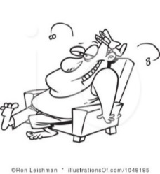
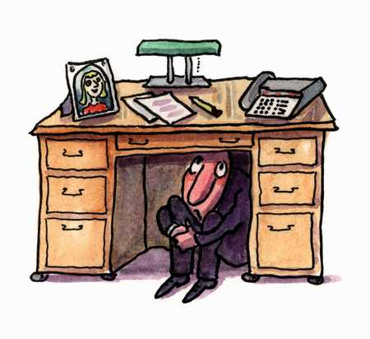
Fear/Anxiety: Adaptive vs. Excessive
Anxiety is normal and adaptive
It serves as a natural alarm system to alert us to danger

Slide 7
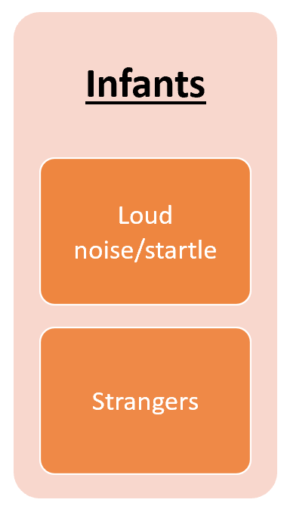

Normal Anxiety Evolves with Age
Stranger anxiety
Notes:
Infants, toddlers, preschoolers, school-aged, teens

Slide 8
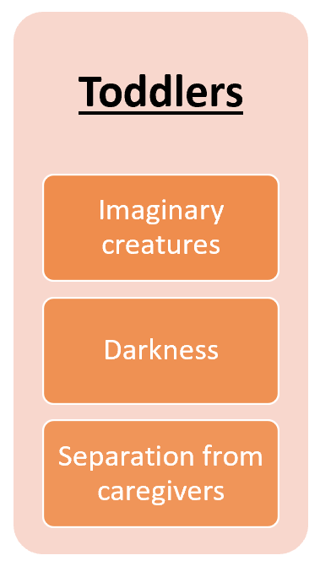
Normal Anxiety Evolves with Age
Separation anxiety
Notes:
Infants, toddlers, preschoolers, school-aged, teens

Slide 9
Normal Anxiety Evolves with Age
Fear of supernatural creatures
Notes:
Infants, toddlers, preschoolers, school-aged, teens

Slide 10
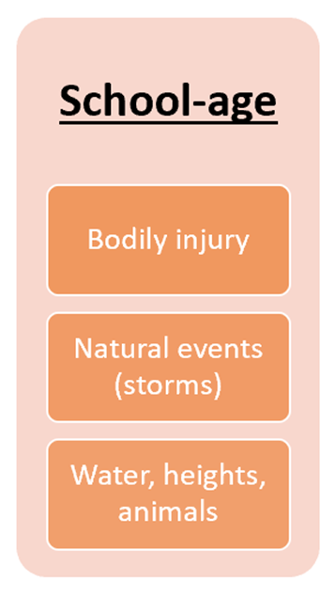
Normal Anxiety Evolves with Age
Fear of injury and natural disasters
Notes:
Infants, toddlers, preschoolers, school-aged, teens

Slide 11
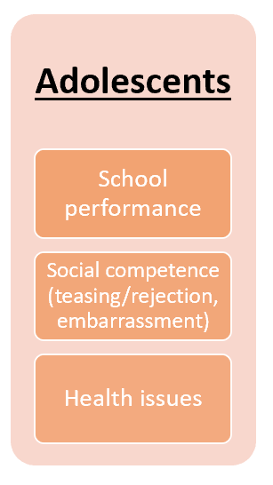
Normal Anxiety Evolves with Age
Social and existential anxiety
Notes:
Infants, toddlers, preschoolers, school-aged, teens

Slide 12
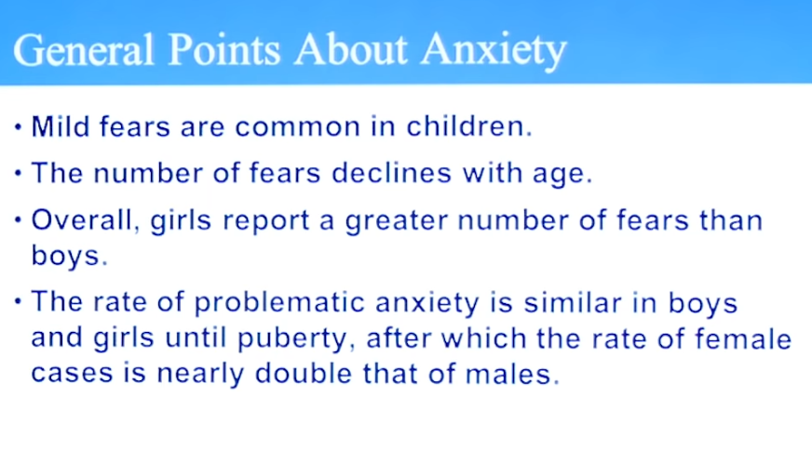
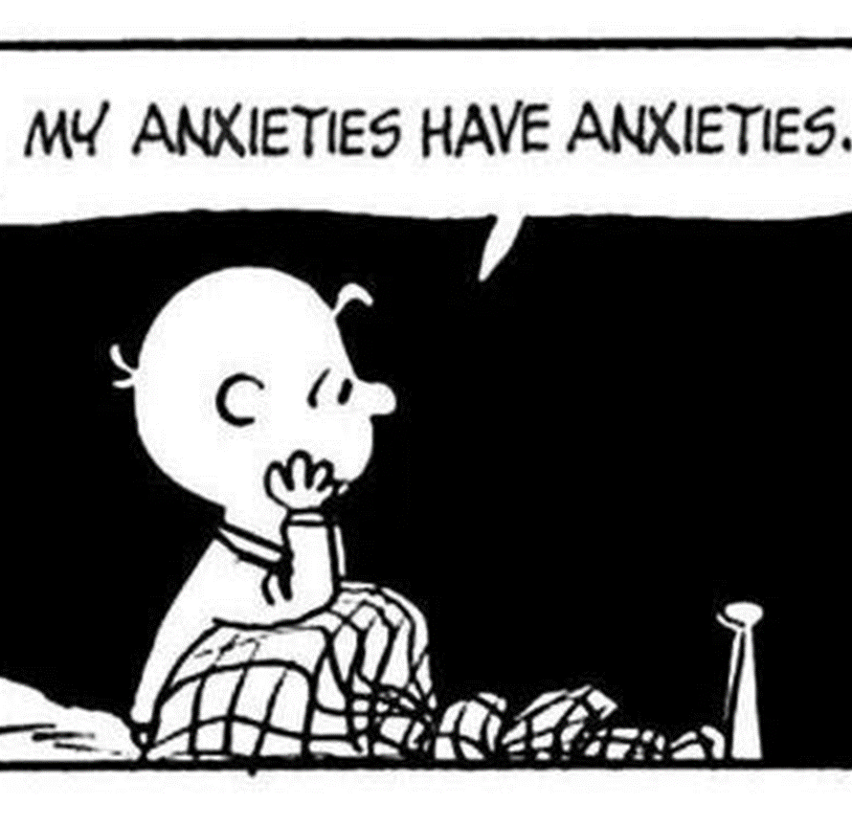

Slide 13
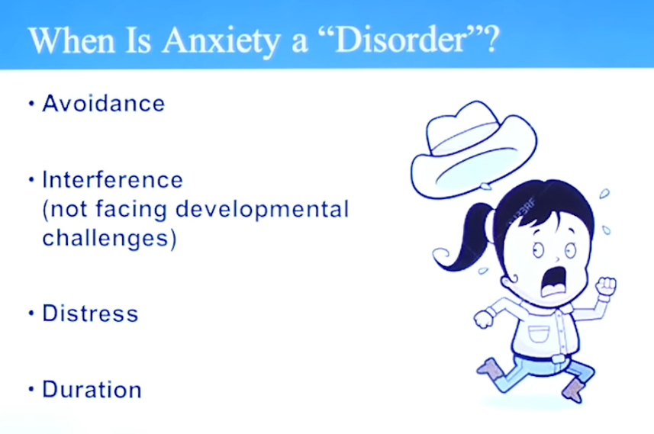

Slide 14
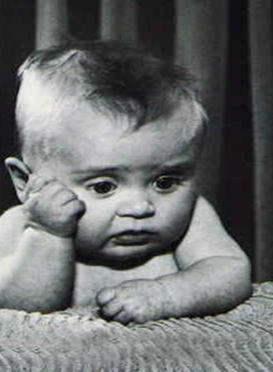
ANXIETY DISORDERS -- Background
Course
  Chronic, tends to wax and wane
Heritable
  Both genetic & environmental influences
Phenomenology
  Fears can be:
    Broad - as is the case with Generalized Anxiety Disorder (many, diffuse worries) –or-
    Specific - as with Specific Phobia (e.g., fear of dogs)
Comorbidities
  Most commonly comorbid with other anxiety disorders, depression, and substance abuse

Slide 15
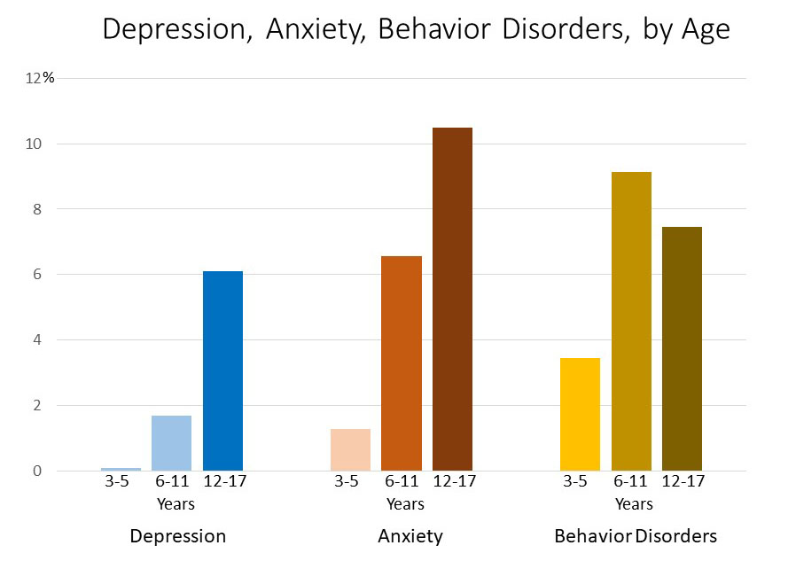
Childhood Anxiety Disorders Are Common
https://www.cdc.gov/childrensmentalhealth/data.html

Slide 16
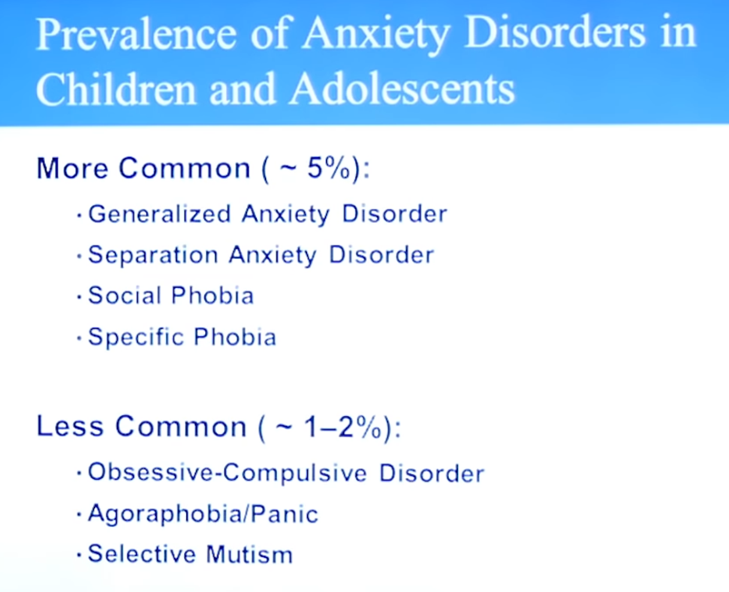
DSM-5 Anxiety Disorders
Separation Anxiety Disorder
Selective Mutism
Specific Phobia
Social Anxiety Disorder (Social Phobia)
Panic Disorder
Agoraphobia
Generalized Anxiety Disorder
Substance/Medication-induced Anxiety Disorder
Anxiety Disorder due to another Medical Condition

Slide 17

Anxiety Disorders in Children & Adolescents
Separation anxiety
  Worry about being separated from caregivers
  Difficult time at school drop-offs, poor attendance
Specific phobias
  Excessive, irrational fear of particular things
  Insects, thunderstorms, needles, heights
Social anxiety
  Anxiety in social situation, self-conscious
  Difficulty participating in class, presenting in front of class, socializing with peers, test-anxiety
  Selective mutism
    Hard time speaking in particular settings; not a speech/language disorder
    May not speak to teacher or peers, but speaks at home
Notes:
adaptive

Slide 18

Anxiety Disorders in Children & Adolescents
Generalized anxiety
  Worry about a variety of things
  Worry about school performance, perfectionistic, inattention, not turning in homework
Panic disorder
  Physical symptoms that may be precipitated by anxiety, i.e. difficulty breathing, heart racing, sweating
  May appear distressed, mainly physical complaints
OCD
Frequent trips to the nurse
Poor school performance

Slide 19
Core Symptoms of Anxiety
Core Symptoms of Anxiety
Worry
Fear
Somatic

Slide 20
Symptoms of Anxiety
Physical
symptoms
Thoughts
Behaviors

Slide 21
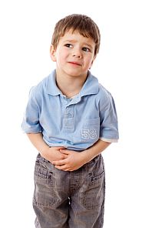
Physical Presentations
Anxious children listen to their bodies
Physical symptoms
  Stomachaches/Bowel problems
  Headaches
  Chest pain/fast heart rate/short of breath
  Frequent urges to urinate/defecate
  Dizzy/lightheaded
  Trouble relaxing or sleeping

Slide 22
Symptoms of Anxiety
Physical Feelings
Thoughts
Behaviors

Slide 23
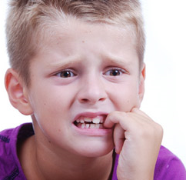
Thoughts
Catastrophizing
  Blowing things out of proportion
Overestimating
  Expecting the worst will happen
What if…?
  Fear of the unknown
  Difficulty paying attention, concentrating

Slide 24
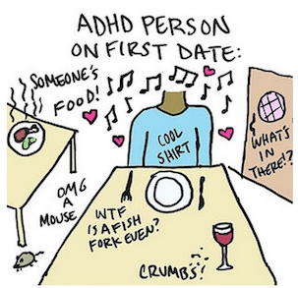
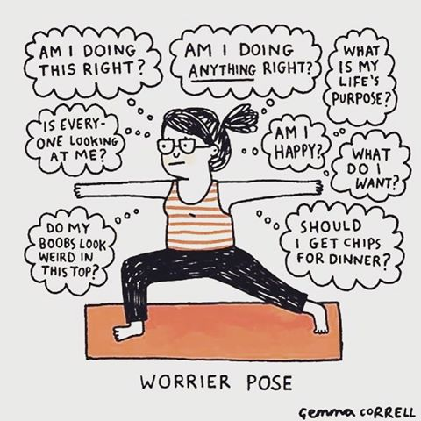
Distraction: external vs. internal
ADHD – externally distracted
Anxiety – internally distracted

Slide 25
Symptoms of Anxiety
Physical Feelings
Thoughts
Behaviors

Slide 26
Behaviors
Efforts to avoid feared situation
Observable fear behaviors
Crying, Clinging, Freezing
Perfectionism
“Just right”
Rigidity
Excessive reassurance seeking
Efforts to gain control
Difficulty with changes in routine or plan
Asking if they are doing something right
May take the form of tantrums, school refusal
Tantrums, refusal

Slide 27
Assessment

Slide 28
Assessment
Multiple informants (e.g., child, parent, teachers, clinicians, etc.)
Methods
Questionnaires
Interviews
Behavioral observation
Ongoing assessment
Notes:
*

Slide 29
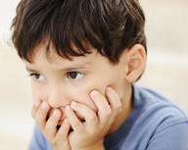
Getting an Account
Mostly not volunteered (or extent masked)
Ashamed or do not want to reveal cause
Fear/worry not recognized as unreasonable
Young children may be unable to articulate content of anxious thoughts
“Screening” questions
  Are there things that worry you so much you can’t get them out of your mind?
  Things you/your child are afraid of?
  Are you/your child often worried?
  Are you/your child easily scared?

Slide 30
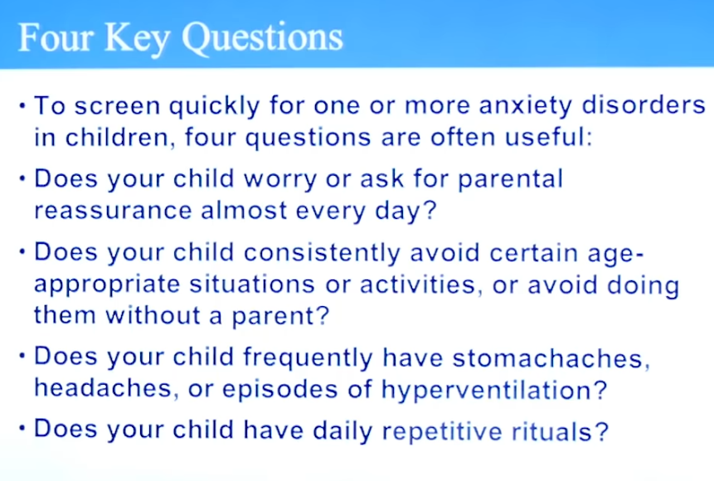

Slide 31
Use of Questionnaires
SCARED (parent and child version)
Preschool anxiety scale – Ages 3-5 (parent report)
GAD-7
Pediatric Symptom Checklist
*Parents often
under-report

Slide 32
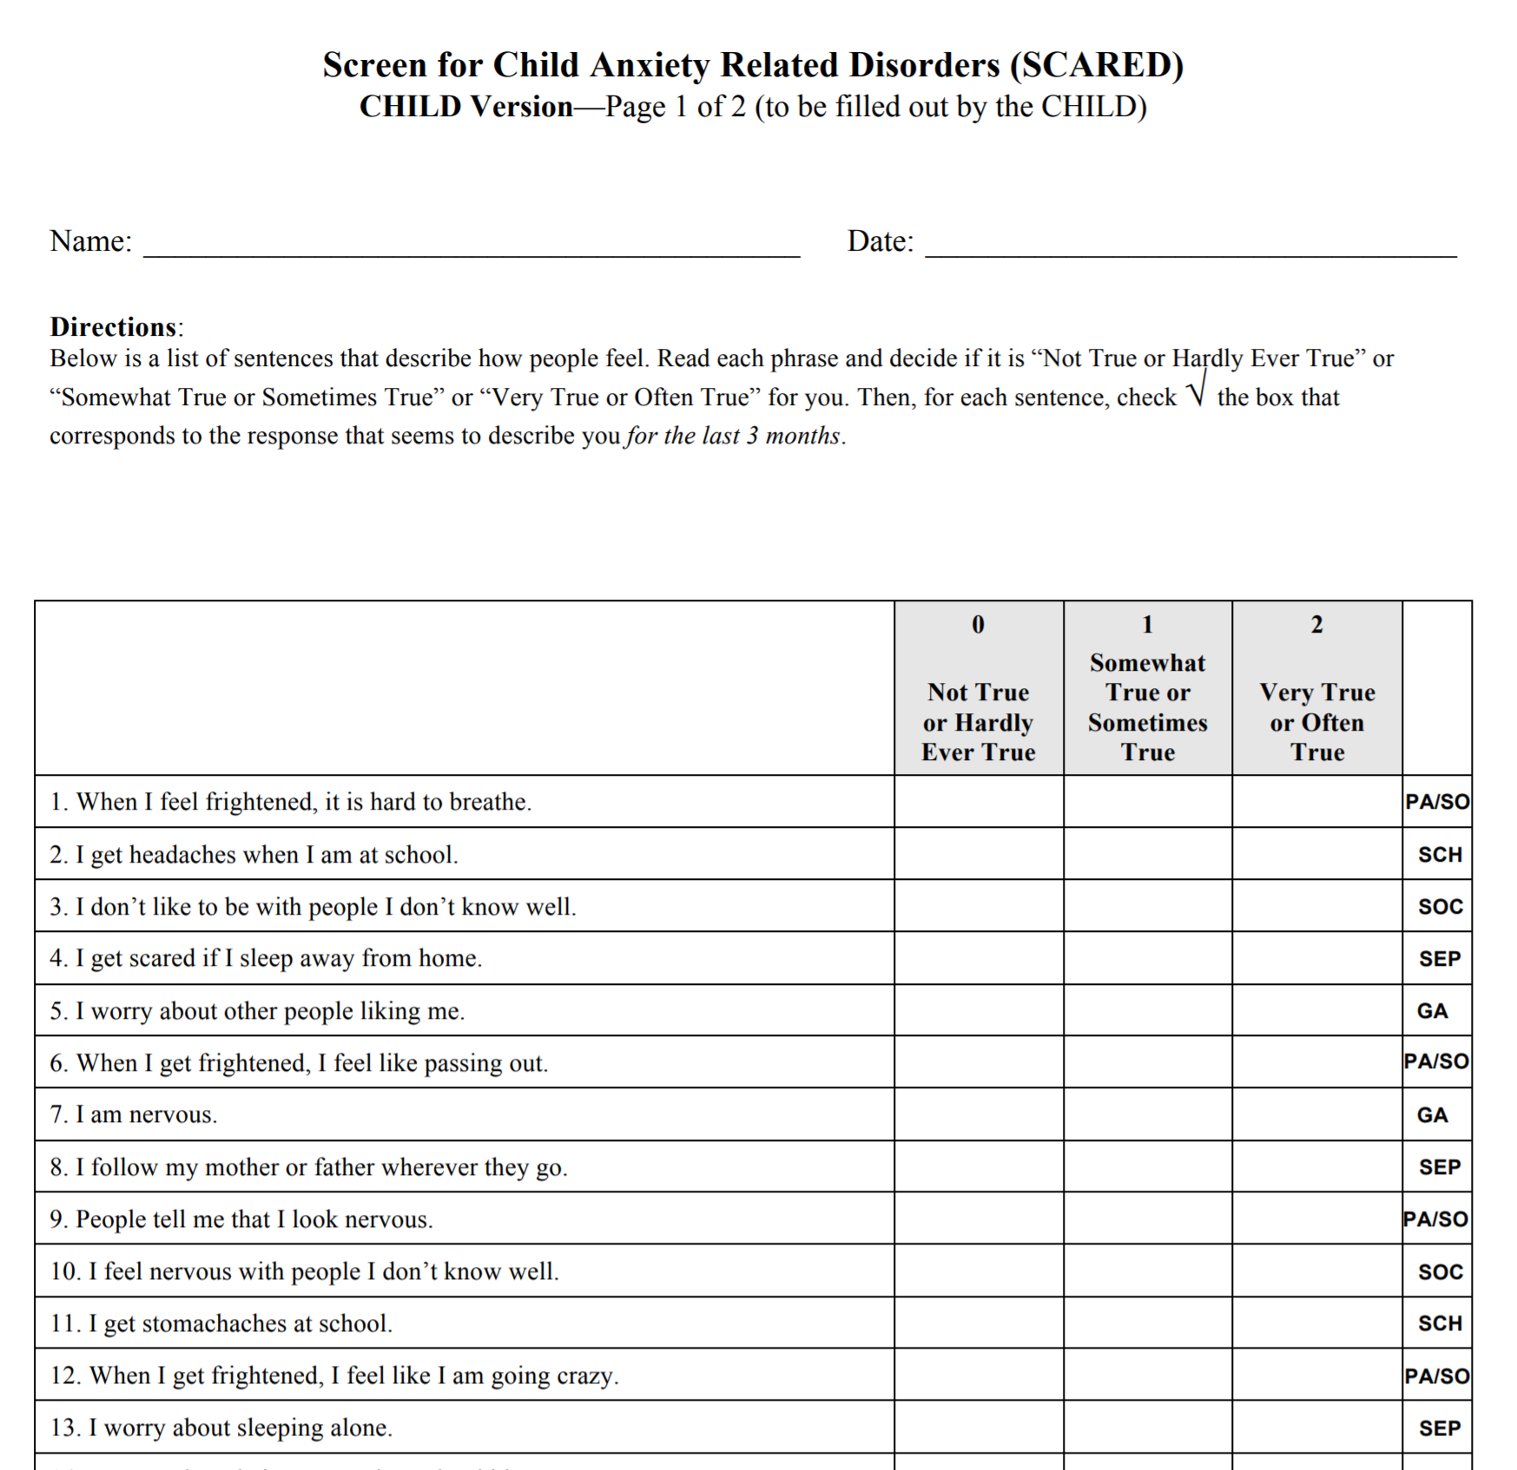
Screener: SCARED
2 versions: Parent about child & child about self
41 questions
Gives scores for
  Total anxiety
  Panic/somatic
  GAD
  Separation
  Social phobia
  School avoidance

Slide 33
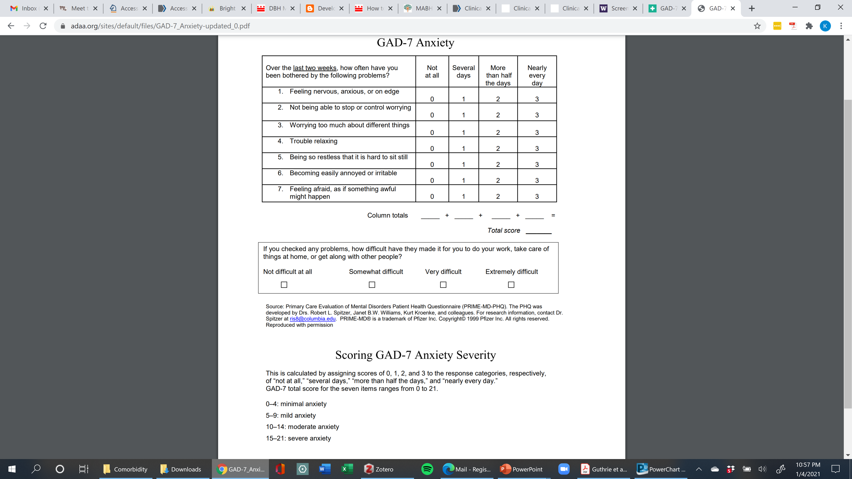
Screener: GAD-7
Ages 12+

Slide 34
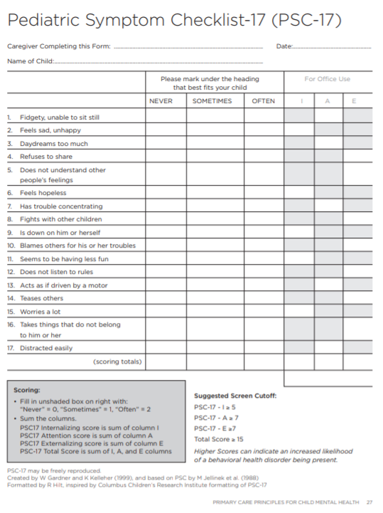
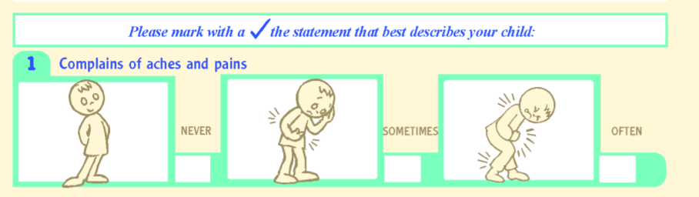
Screen for Anxiety: Pediatric Symptom Checklist-17 (PSC-17)
For ages 8-15
Child self-report and parent-report versions
Brief version of PSC-35 that correlates well with longer comprehensive measures (e.g., CBCL)
takes approximately 3–5 minutes for parents/caretakers to complete
https://www.seattlechildrens.org/globalassets/documents/healthcare-professionals/pal/ratings/psc-17-rating-scale.pdf → PSC-17
https://www.massgeneral.org/psychiatry/treatments-and-services/pediatric-symptom-checklist
  Includes multiple language, cartoon version, PSC-17 and PSC-35
W Gardner, A Lucas, DJ Kolko, JV Campo “Comparison of the PSC-17 and Alternative Mental Health Screens in an At-Risk Primary Care Sample” JAACAP 46:5, May 2007, 611-618

Slide 35
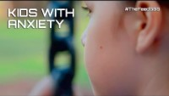

Slide 36
Evidence-Based Treatment

Slide 37

Treating Childhood Anxiety Improves Outcomes
Early anxiety predicts later psychopathology (depression, ADHD, BPAD, substance use disorder, learning disorders, eating disorders)
Untreated childhood anxiety predicts young adult impairment in social, educational, occupational, mental health, and physical health outcomes
Walter et al. JAACAP 2020; Bittner et al. JCPP 2007; Copeland et al. Arch Gen Psychiatry 2009; Copeland et al. JAACAP 2014.

Slide 38
Anxiety Severity
Subclinical anxiety
Moderate clinical anxiety (therapy +/- meds)
Severe clinical anxiety (therapy + meds)
Mild clinical anxiety (therapy)

Slide 39
Anxiety Severity
Subclinical anxiety
Moderate clinical anxiety (therapy +/- meds)
Severe clinical anxiety (therapy + meds)
Mild clinical anxiety (therapy)
“clinically significant distress or impairment in social, occupational, or other important areas of functioning”

Slide 40
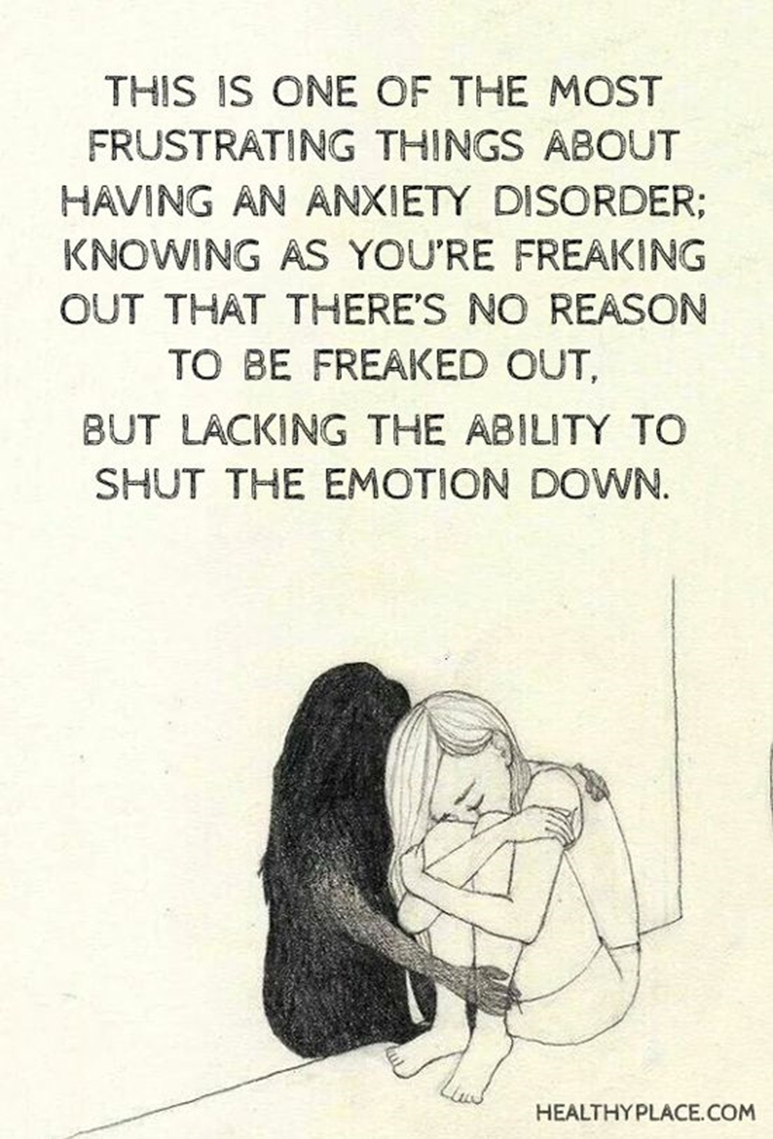
General Principles of Treatment
The goal isn’t to eliminate anxiety, but to help a child manage (tolerate) it
Don’t avoid things just because they make a child anxious
  This reinforces the child’s avoidant behaviors

Slide 41

Psychoeducation
Education regarding anxiety and its treatment
  Things will get better!
Key Points:
  Define anxiety
  Normalize anxiety
    Everyone has experienced anxiety
    Normal is certain situations
  Physical reaction to a situation…an alarm (“false alarm”)

Slide 42
Back to Basics
Nutrition
Exercise
Sleep
Healthy diet, avoid caffeine
Improves sleep and mood
Lowers heart rate
Improves mood and anxiety
No drugs, alcohol or tobacco
Notes:
Worry time

Slide 43
Treating Anxiety
Two primary evidence-based treatments
  SSRIs – see recordings on our BHIPP website:
    https://mdbhipp.org/bhipp-resilience-breaks.html
  Exposure-based Cognitive Behavior Therapy (CBT)
Exposure-based CBT for pediatric anxiety
  Efficacious in clinical trials
  Effective in community practice
  Structured approach to treatment
Whiteside, S. P. H., Sim, L. A., Morrow, A. S., Farah, W. H., Hilliker, D. R., Murad, M. H., & Wang, Z. (2020). A meta-analysis to guide the enhancement of CBT for childhood anxiety: Exposure over anxiety management. Clinical Child and Family Psychology Review, 23(1), 102–121. https://doi.org/10.1007/s10567-019-00303-2
Notes:
Now I’m going to shift and talk about treatment of anxiety. There are two primary EB approaches to treating anxiety – SSRIs and exposure-based CBT

Slide 44
Empirical Evidence Summary Cognitive Behavioral Therapy
> 20 controlled trials of CBT for anxiety for children and adolescents
Response: CBT 55-80%
Treatment gains maintained
Parent symptoms = poorer child outcomes

Slide 45
Treatment: Psychotherapeutic Interventions
Child/Adolescent Anxiety Multimodal Study (CAMS)
  Medication is effective
  Cognitive Behavioral Therapy (CBT) is effective
  Combination treatment (CBT + medication) has the best efficacy!
  Varieties: Trauma-focused CBT (TF-CBT), brief CBT for specific anxiety…
Notes:
CAMS
Child Anxiety Multisite Study (CAMS)
Medication effective
CBT effective
Combination most effective

Slide 46
Exposure Therapy for Anxiety
Exposure therapy: repeated approach toward fear-provoking stimuli
first proposed in the form of systematic desensitization, derived from extinction learning (Wolpe, 1958), thought to reduce fear through repeated trials
Efficacy may be limited by residual fear, lack of generalization, new fear-evoking stimuli
Inhibitory learning: creating a new meaning about feared situations, which competes with the prior fear
(I used to become anxious during this situation, and now I have learned that I feel LESS ANXIOUS)
The goal of therapy is to make new meanings of previously feared stimuli
Old association: “a dog bit me, I feel really scared, I avoid dogs”
New association: “Dogs do not always bite me, not all dogs are harmful”
Craske, M. G., Treanor, M., Conway, C. C., Zbozinek, T., & Vervliet, B. (2014). Maximizing exposure therapy: An inhibitory learning approach. Behaviour Research and Therapy, 58, 10–23. https:// doi.org/10.1016/j.brat.2014.04.006.

Slide 47
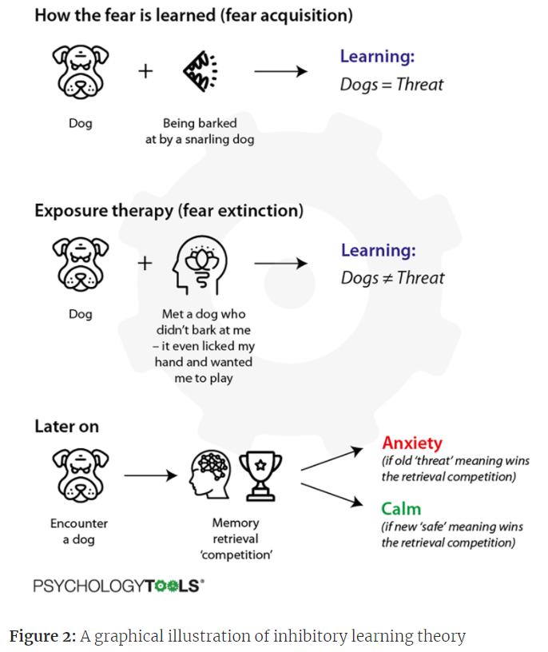
Inhibitory Learning Theory
Whalley, M. G. (2019). Delivering more effective exposure therapy in CBT. Psychology Tools. Retrieved on 8/22/21, from https://www.psychologytools.com/articles/delivering-more-effective-exposure-therapy-in-cbt/

Slide 48
Elements of Inhibitory Learning (or how to optimize exposure therapy!)
Focusing on Anxiety Tolerance instead of Habituation
  Decreasing emphasis on removal/avoidance of anxiety, increasing mindful acceptance of anxiety as a natural experience
Disconfirming Expectations and The Element of Surprise
  Set up exposures to teach through disconfirming, or learning through experience – which requires labeling expected/anticipated outcomes
  Strongest learning occurs when there is a large mismatch between FEARED and ACTUAL outcomes
Combining Fear Cues (rather than 1 cue at a time)
Variety of contexts (to promote generalization)
For more details (incl OCD and ERP examples), visit https://iocdf.org/expert-opinions/the-inhibitory-learning-approach-to-exposure-and-response-prevention/

Slide 49
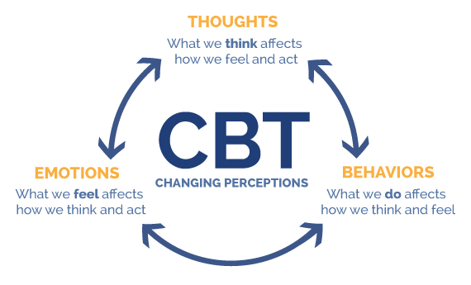
Cognitive Behavioral Therapy (CBT)

Slide 50
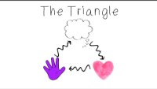

Slide 51
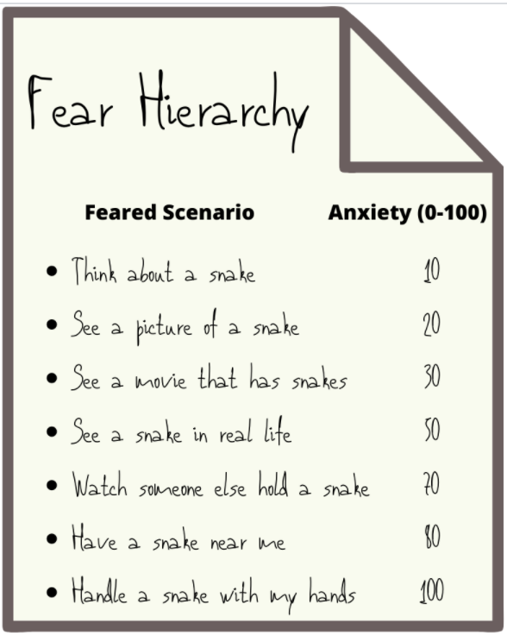
CBT for Anxiety Components
Psychoeducation about child/adolescent anxiety
Exposures or “behavioral experiments”
Cognitive strategies
Relaxation training
Homework Assignments

Slide 52
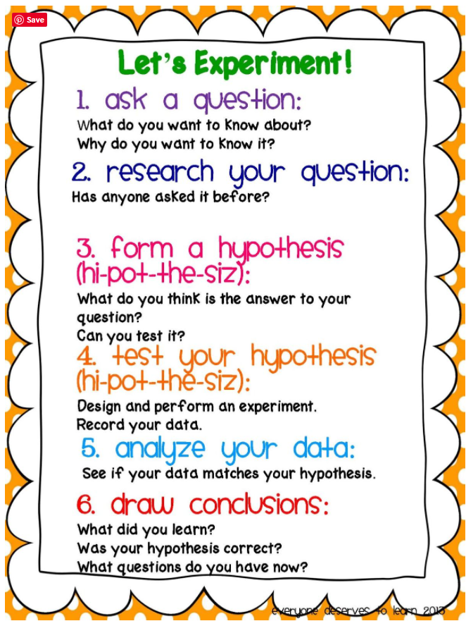
Behavioral experiments using the scientific method
Ask a Question: what do I need to learn? “…design exposures that maximally violate expectancies regarding the frequency or intensity of aversive outcomes… exposure tasks are designed to accommodate “what do you need to learn” rather than by fear reduction or “stay in the situation until fear declines”...” (Craske et al, 2014, p 58)
Form a Hypothesis: What is the feared outcome? Be specific! “The expectancy violation approach ties exposure parameters directly to consciously stated expectancies for aversive events.”
Test Hypothesis: What happened?! Learning is centered around whether the expected negative outcome occurred or not
Review data! After every exposure trial! Maximize discrepancies!
Draw conclusions: It is good to be wrong about bad outcomes

Slide 53
CBT for Anxiety Components – Hierarchy and Exposures
Generate list of anxiety-provoking situations
Get fear thermometer ratings
Create a hierarchy based on ratings
Set up exposures
Practice, Practice, Practice facing fears!
Types of Exposures:
Panic Disorder: physical symptoms (e.g., dizziness, heart racing)
Specific Phobias: dogs, vomit, alone in the dark
OCD: expose to germs w/o washing
GAD: Worries about getting a bad grade; being late to school, etc.

Slide 54
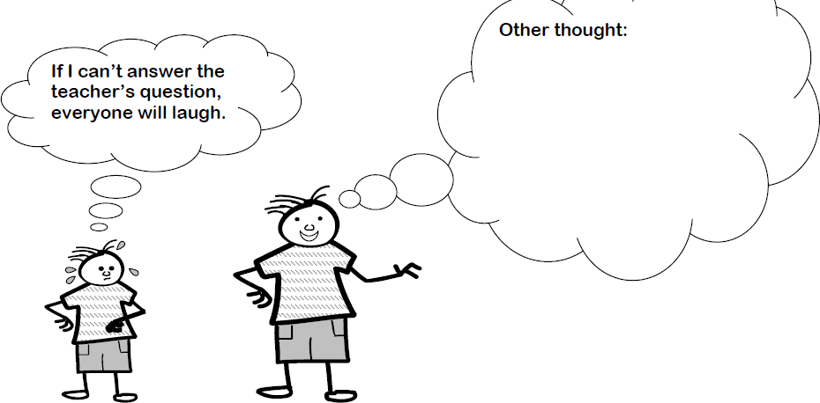
CBT for Anxiety Components – Cognitive Strategies
Anxious kids have “sticky brains” where worried thoughts get stuck and replay repeatedly
  Fortune Telling
  Mind reading
  Catastrophizing
Help children identify anxious thoughts, and:
  Restructure it (more helpful thought)
  Talk back to it
  Detach from it (“just another worried thought. Its not important”)
Notes:
Cognitive restructuring — Cognitive restructuring is a process of logically identifying and challenging maladaptive thoughts (eg, cognitive distortions) that may be contributing to or perpetuating anxiety. Common cognitive distortions, often labeled as “thinking traps,” are reviewed with patients and may include:
●Fortune telling – Predicting that negative events will occur in the future
●Mind reading – Assuming that others are thinking negatively about you
●Catastrophizing – Believing that a terrible event is likely to occur

Slide 55
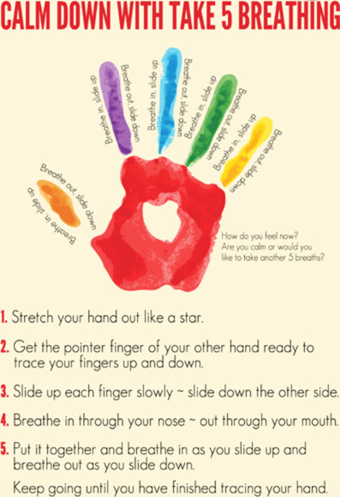
CBT for Anxiety Components – Relaxation Strategies
Changing physical/physiological reactions can help children feel less anxious
Common relaxation strategies:
  Deep, slow breathing or Belly breathing
  Progressive muscle relaxation
  Picturing a peaceful scene

Slide 56
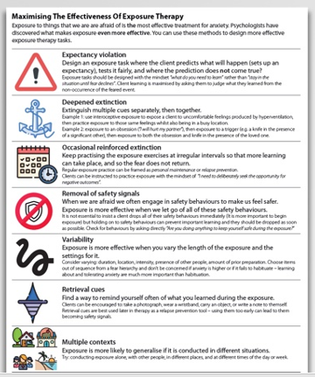
CBT Recap: Optimize Exposures via Inhibitory Learning…
Help child identify feared outcome (expectancy)
Create exposure to VIOLATE the expectancy (surprise!)
Practice exposures with multiple cues and across contexts to generalize learning
Practice remembering what was learned
Oh, and practice some more (relapse prevention)
Notes:
Personal example: 5 min talk at PTS, not my fav data to present…behavioral experiment was observing presenters and audience before me…

Slide 57
Course of CBT for Anxiety
“Typical” course of CBT – weekly therapy covering:
Education about CBT and exposures (ideally to optimize motivation)
Symptom hierarchy development
Relaxation training
Cognitive strategies
Exposures
Related CBT skills incorporated into treatment as needed

Slide 58
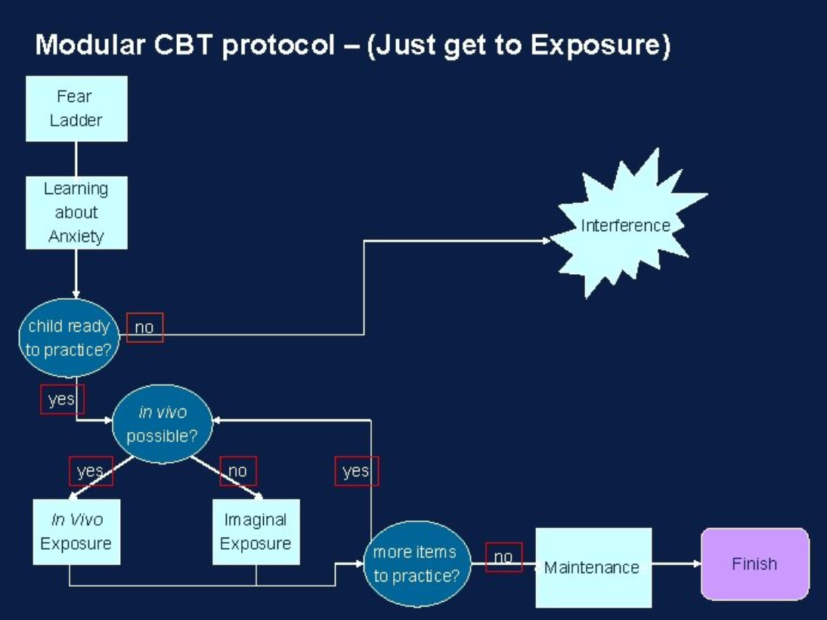
Possible CBT Flow for Anxiety

Slide 59

Becky Case
9 yo female with a history of ADHD. Currently on Adderall XR 15mg in the morning and Adderall IR 5mg in the afternoon. She had an evaluation which indicated concern for anxiety symptoms. She had been doing well in school on med regimen; but last 2-3 months is doing poorly in school due to poor concentration. She reports feeling more “nervous.” The patient’s therapist thinks that medication initiation for her mood would be appropriate.

Slide 60
Diagnostic Impression/Screening
  1. What do you do next?
  Have her come to the office and administer the CES-DC /
  PHQ-9 to screen for depression and screen with the
  SCARED to assess anxiety
  B. Send her to the emergency room because she should be
  screened for suicidal thoughts
  C. Call her therapist to obtain additional information
  D. A and C
Notes:
You may also consider calling the child’s teacher to gather more information about the child’s difficulties in the classroom.
Review Vanderbilt screens given at the beginning of the year. Also distribute new scales to the teachers/parents

Slide 61
Therapy and Management
  2. She comes to the office and screens high on the SCARED, there are no safety concerns. You speak with her therapist and learn she is doing “play” therapy. Next steps?
  Since the current therapist is unable to provide CBT, you may consider referring the family to another provider with this expertise.
  You start an SSRI because her symptoms are worse even though she is in therapy
  You stop the Adderall because stimulants worsen anxiety
  A and C
Notes:
Discuss next steps in treatment planning and whether an SSRI would be an appropriate intervention at this stage of treatment.

Slide 62
Medications
3. After switching to a new therapist and receiving CBT her symptoms have not improved. You decide to start Zoloft 25mg daily. After 2 weeks, there is no improvement. What do you do next?
  A. Do nothing, more time is needed before the SSRI will work.
  B. You confirm she is not having any side effects and you increase to Zoloft
  50mg po qam and schedule a return visit in a few weeks.
  C. Stop the Adderall because it is making her anxiety worse
  D. You give her Ativan as needed to help decrease anxiety
Notes:
Stimulants do not worsen anxiety: "Meta-Analysis: Reduced Risk of Anxiety with Psychostimulant Treatment in Children with Attention-Deficit/Hyperactivity Disorder”, 10/2015
Significant reduction in the risk of anxiety associated with psychostimulants compared to placebo, and higher doses of psychostimulants appear to be associated with a greater reduction in the risk of anxiety

Slide 63
Summary
Distinguish between developmentally appropriate and pathological anxiety
Anxiety disorders are common, yet under-recognized and under-treated
Treatment improves global function & quality of life, and decreases risk for future psychopathology
CBT, CBT, CBT for child specific treatment

Slide 64
References
AAP Toolkit…..and…..MD AAP Emotional Health Committee http://www.mdaap.org/biped.html
Bright Futures in Practice: Mental Health Vol 1 Practice Guide (2002)191-202 http://www.brightfutures.org/mentalhealth/
SCARED http://www.psychiatry.pitt.edu/sites/default/files/Documents/assessments/SCARED%20Child.pdf
J Am Acad Child Adolesc Psychiatry 46: 2007, pp 267-283 Practice Parameters for Assessment and Treatment of Children and Adolescents with Anxiety Disorders
http://www.dsm5.org/Documents/changes%20from%20dsm-iv-tr%20to%20dsm-5.pdf

Slide 65
Thank you!
Maryland Behavioral Health Integration in Pediatric Primary Care (BHIPP)
1-855-MD-BHIPP (632-4477)
www.mdbhipp.org
Follow us on Facebook, LinkedIn, and Twitter! @MDBHIPP
For resources related to the COVID-19 pandemic,
please visit us at BHIPP Covid-19 Resources.
Notes:
You will a copy of these slides

