Slide 1
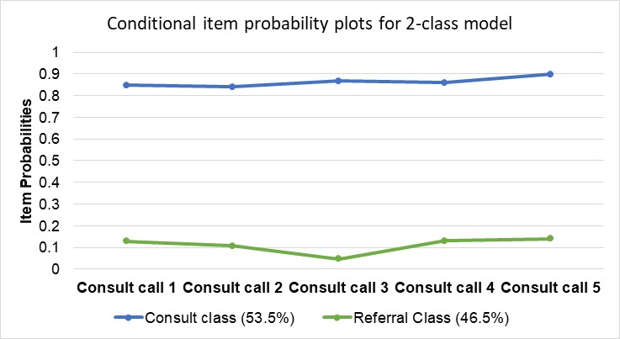
Characteristics of Providers Using a Child Psychiatry Access Program in Maryland Aronica Cotton MD, Amie Bettencourt PhD, Mark A. Riddle MD, & Shauna P. Reinblatt MD, DFAACAP
Maryland-Behavioral Health Integration in Pediatric Primary Care (MD-BHIPP)
Caroline Warren, MSN, RN, CHES¹, Diana Lyn Baptiste, DNP, MN, RN², Rebecca Wright, PhD, BSc (Hons), RN²
Background
¹Department of Emergency Medicine, The Johns Hopkins Hospital, Baltimore, MD;
²Johns Hopkins University School of Nursing, Baltimore, MD, USA
Results
Despite a significant increase in outpatient visits for diagnosis and treatment of mental health disorders among youth (Olfson, 2014),there is a growing gap between the need for and availability of pediatric mental health services(MHS) (Thomas, 2016). Child Psychiatry Access Programs (CPAP), like the Maryland Behavioral Health Integration in Pediatric Primary Care(MD-BHIPP) program have shown promise in increasing access to MHS (Sarvet, 2010, Harrison, 2016).
Table 1. Characteristics of PCCs Who Called BHIPP by Call Frequency
Provider Characteristics (N=678) | Low/Medium Volume Callers (N=506) | High Volume Callers (N=172) | Chi Square
All Providers Calling BHIPP | 74.6% | 25.4%
Average years in practice | 13.76(10.85) | 13.73(10.31)
Provider Type |  |  | 15.41*
MD/DO | 322(63.6%) | 135(78.5%)
NP | 122(24.1%) | 30(17.4%)
PA | 16(3.2%) | 1(0.6%)
Other (RN, SW, PhD) | 46(9.1%) | 6(3.5%)
Provider Specialty |  |  | 19.25**
Pediatrician | 364(71.9%) | 152(88.9%)
Family Practice | 62(12.3%) | 9(5.3%)
Other (e.g., Internal Medicine) | 76(15.0%) | 10(5.8%)
Unknown | 4(0.8%) | 1(0.6%)
Urbanicity of Practice |  |  | 0.92
Urban/suburban | 444(88.1%) | 153(89.0%)
Rural/semi-rural | 60(11.9%) | 19(11.0%)
Insurance Accepted
Uninsured | 143(28.3%) | 70(40.7%) | 9.22*
Sliding scale | 67(13.2%) | 18(10.5%) | 0.90
Public | 232(45.8%) | 120(69.8%) | 29.42**
Private | 236(46.6%) | 128(74.4%) | 39.84**
Provider Sex |  |  | 32.42**
Male | 56(11.1%) | 24(14.0%)
Female | 205(40.5%) | 107(62.2%)
Unknown | 245(48.4%) | 41(23.8%)
Provider race/ethnicity |  |  | 38.14**
African American | 28(5.5%) | 13(7.6%)
Asian | 30(5.9%) | 19(11.0%)
White | 151(29.8%) | 84(48.8%)
Other | 17(3.4%) | 7(4.1%)
Unknown | 280(55.3%) | 49(28.5%)
Notes. Low/Medium volume callers = 1-4 calls, High volume callers>=5 calls. *p<.05; **p<.001
Table 2. Comparisons of Call Reason by Type of Caller
 | Low/Medium Volume Callers | High Volume Callers | Chi Square
Call Reason |  |  | 47.23**
Clinical Consultation | 447(49.7%) | 1165(41.4%)
Resource/Referral | 384(42.7%) | 1534(54.6%)
Other | 68(7.6%) | 112(4.0%)
Notes. Comparisons based on N=3,710 calls to BHIPP so individual PCCs are counted multiple times. Other = calls about general information or calls deemed not appropriate. **p<.001
Purpose
The purpose of this study is to describe the types of primary care clinicians(PCCs) that call BHIPP and to examine patterns of their use of BHIPP services.
Methods
Data on N= 678 PCCs who called BHIPP between 2012-2019 were examined. The following measures were used:
PCC demographics (i.e., gender, race/ethnicity)
PCC type (e.g., MD, NP, etc.)
PCC primary specialty
Location of primary care practice
Reason for calling BHIPP (e.g., clinical consultation)
Descriptive statistics were used to compare call frequency by PCC characteristics. Longitudinal latent class analysis using call reason across a PCCs first 5 calls as class indicators was conducted to identify subgroups of PCC’s distinguished by call reason. Logistic regression was used to examine class differences on PCC characteristics.
Table 3. Latent Class Differences on Provider Characteristics
Provider Characteristic | Estimate | Std. Error | Odds Ratio | p-value
PCP is a doctor (MD/DO) | 0.09 | 0.21 | 1.09 | .68
PCP is a pediatrician | 0.34 | 0.25 | 1.40 | .17
PCP in rural/semi-rural area | 1.15 | 0.35 | 3.14 | .001
Note. N = 374 providers who called the BHIPP line at least twice for either clinical consultation or resource/referral. Please note that the reference group for this table is the Referral/Resource class so all estimates are for the consultation class.
Conclusions
PCCs who call BHIPP are demographically similar to PCCs across the state of Maryland. There are important differences between PCCs who call BHIPP frequently and those who do not. PCCs in rural areas are more likely to call BHIPP for clinical consultation while those in urban/suburban areas are more likely to call for resources/referrals. More research is needed to understand how interactions with CPAP services contribute to PCCs practice change.
Address email correspondence regarding this poster to acotton@som.umaryland.edu or abetten3@jhu.edu.

