Slide 1
Maryland Behavioral Health Integration in Pediatric Primary Care (MD BHIPP) Diagnosing and Managing Seasonal Depression in Primary Care BHIPP Resilience Break January 20th, 2022, 12:30 PM Alden Littlewood, MD Kelly Coble, LCSW-C Assistant Professor of Psychiatry Program Director, MD BHIPP University of Maryland School of Medicine
1-855-MD-BHIPP (632-4477)
www.mdbhipp.org
Follow us on Facebook, LinkedIn, and Twitter! @MDBHIPP

Slide 2
Conflicts and Off-Label Prescribing
No Conflicts of Interest
Some Off-Label Prescribing May be Discussed

Slide 3
Who We Are – Maryland BHIPP
Offering support to pediatric primary care providers through free:
Telephone consultation (855-MD-BHIPP)
Resource & referral support
Training & education
Regionally specific social work co-location (Salisbury University and Morgan State University)
Project ECHO®
Direct Telepsychiatry & Telecounseling Services
Care coordination
Notes:
Maryland Behavioral Health Integration in Pediatric Primary Care or BHIPP is a Child Psychiatry Access Program that supports the capacity of primary care providers in Maryland to manage pediatric mental health concerns. We do this, currently, in a number of ways:
We offer a free behavioral health telephone consultation service, where PCPs can call to discuss a case with a child and adolescent psychiatrist or to obtain resources and referrals for that case,
We offer free education and training events ranging from in-office presentations to monthly CME bearing virtual webinars that we call BHIPP Resilience Breaks to half-day CME events,
Through our partnership with Salisbury and Morgan State Universities, we offer co-location of social work interns at select primary care sites in Baltimore City, Frederick and on the lower eastern shore,
We also offer longitudinal Web-based educational programming that combines didactics and case-based learning through our Project ECHO,
In addition, we offer direct care coordination services for families who have experienced barriers with getting connected to resources in their area
And we offer direct telepsychiatry and telecounseling services on a limited basis.

Slide 4
Partners & Funding
BHIPP is supported by funding from the Maryland Department of Health, Behavioral Health Administration and operates as a collaboration between the University of Maryland School of Medicine, the Johns Hopkins University School of Medicine, Salisbury University and Morgan State University.
This program is supported by the Health Resources and Services Administration (HRSA) of the U.S. Department of Health and Human Services (HHS) as part of an award totaling $433,296 with approximately 20% financed by non-governmental sources. The contents of this presentation are those of the author(s) and do not necessarily represent the official views of, nor an endorsement, by HRSA, HHS or the U.S. Government. For more information, visit www.hrsa.gov.

Slide 5
Learning Objectives
Participants will be able to:
Understand how to screen and diagnose depression in pediatric primary care
Differentiate between Seasonal Affective Disorder vs. MDD vs. situational depression
Understand basic principles of non-pharmacologic therapy for depression, including the seasonal subtype, in children and adolescents
Understand how to implement and monitor medications to treat depression in children and adolescents

Slide 6
Outline
What is SAD/Seasonal Depression?
Clinical Assessment/Diagnosis
Treatment Overview
Nonpharmacological
Pharmacological

Slide 7
Case Example: December 2021
15 year old female BIB parent, “not herself” for the past month
Refusing family dinner and sports practice
Isolating to room
Failed 2 tests, low motivation
Irritable
Difficulty sleeping
“Something similar” happened last year but went away
Notes:
Anhedonia: refusing socializing, no longer enjoying things. Keeping to herself. Functional impairment. Fatigue, insomnia.
Something similar happened the year before but eventually improved. Forgot about it until now, but parent is concerned that this is happening a second time.
We know this patient is experiencing a change from her normal behavior, and it’s persisting!!
“Bernstein recommends thinking in terms of changes from your child’s normal behavior, whatever “normal” means for them. Maybe your child used to love making silly TikTok videos, but now they say that it’s not fun anymore. Or maybe they’ve been frustrated with school for a while, but only now are they refusing to do homework. If your child seems to be losing motivation or having a harder time enjoying things, those might be signs of depression, whether or not it technically qualifies as seasonal affective disorder.
Looking for patterns of change is key, says Dr. Bernstein. “We’re not talking about a kid who’s active all week and then has a hard time getting out of bed on Friday,” she says. “We’re talking about at least two weeks of not responding to friends, of not coming to the dinner table, of not doing schoolwork. When you see a persistent pattern is the time to reach out for help.””(Childmind)

Slide 8
Major Depressive Disorder
5+ symptoms, 2+ weeks:
Depressed/irritable mood*
Markedly diminished interest or pleasure*
Appetite or weight change
Insomnia or hypersomnia
Psychomotor retardation or agitation (observable by others)
Fatigue or energy drop
Worthlessness or excessive/inappropriate guilt
Impaired concentration, indecision
Recurrent thoughts of death, suicidal ideation, suicide attempt
Distress or functional impairment
Not due to substance use or another medical condition
Notes:
Depression DSM-5 Diagnostic Criteria
Five or more symptoms during at least a 2-week period and at least one of the symptoms must be either (1) depressed mood or (2) loss of interest or pleasure.
Depressed mood most of the day, nearly every day.
Markedly diminished interest or pleasure in all, or almost all, activities most of the day, nearly every day.
Significant weight loss when not dieting or weight gain, or decrease or increase in appetite nearly every day.
Insomnia or hypersomnia nearly every day
A slowing down of thought and a reduction of physical movement, or a speeding up of these (observable by others, not just subjective feelings)
Fatigue or loss of energy nearly every day.
Feelings of worthlessness or excessive or inappropriate guilt nearly every day.
Diminished ability to think or concentrate, or indecisiveness, nearly every day.
Recurrent thoughts of death, recurrent suicidal ideation without a specific plan, or a suicide attempt or a specific plan for committing suicide.
WITH: clinically significant distress or impairment in social, occupational, or other important areas of functioning.
The symptoms cannot be the result of substance abuse or another medical condition.
Seasonal Depression is a subtype
CHANGE FROM PRIOR FUNCTIONING
Sleep changes in kids with seasonal depression look more like those seen in adults with MDD than those seen in kids with non-seasonal depression

Slide 9
Seasonal Affective Disorder
Depressive OR bipolar spectrum disorder with seasonal pattern
Notes:
SAD: Bit of an umbrella term.
Basically a pattern of mood episodes occurring at a typical time of year
Not going to talk much about bipolar spectrum illness, but know that it can occur with a seasonal pattern as well
For the purposes of this talk, will try to talk about seasonal depression (SD), but SAD is often used interchangeably with SD

Slide 10
Major Depressive Disorder, Recurrent, with Seasonal Pattern
Pattern of depressive episodes occurring during a particular time of year
Doesn’t count if mood change is due to a different seasonally-related stressor (eg. School schedule)
Full remissions also occur at a characteristic time of year
For past 2 years, 2+ seasonal episodes, no non-seasonal episodes
Lifetime: seasonal mood episodes >>> non-seasonal ones
Notes:
“”
Temporal pattern
Doesn’t count if it’s due to another stressor that happens to occur at a particular time of year, like starting school, or exams or similar
Seasonal mood episodes substantially outnumber non-seasonal episodes

Slide 11
Major Depressive Disorder, Recurrent, with Seasonal Pattern
Typically, episodes start in fall/winter, remit in the spring
Decreased light, effects on circadian rhythm
Spring/summer recurrence pattern possible too (less common)
Sleep and appetite: strongest seasonal pattern (Lukmanji et al 2020)
Notes:
Mechanism: multiple hypotheses exist
-Variations in melatonin, serotonin, dopamine release
-Circadian phase delay
-Retinal light sensitivity
-low vitamin D
-Different factors may cause it in different people (heterogeneous condition)
“Circadian phase delay, retinal subsensitivity to light, altered neurotransmitter release (e.g., serotonin, melatonin, dopamine), hypovitaminosis D and genetic variations in clock, monoamine and retinal photopigment genes have all been proposed mechanisms underlying the etiology of SAD. ^{[6] ”}
Medscape: Seasonal Affective Disorder (pathophysiology section)
https://emedicine.medscape.com/article/2500054-overview#a3

Slide 12
Epidemiology of Seasonal Depression
Affects between 1.7% and 5.5% of children (Glod et. Al 1997)
Childhood prevalence increases with age (Swedo et. Al 1997)
More symptoms seen in northern latitudes (Carskadon and Acedo 1993)
More common in females than males (Childmind)
MDD generally more common after puberty
Notes:
“”

Slide 13
Demoralization, situational depression
Understandable reaction to troubling circumstances
Diminished interest or pleasure is not present
Useful concept for most preteens with low mood/irritability
---------------------------------------------------------------------
Not a DSM-5 diagnosis, but is an ICD-10 diagnosis
Explanation for placebo response of 50% in depression studies?
Think COVID-19 pandemic (and low motivation)
Notes:
-Dr. Riddle
Another important thing to consider, particularly in the context of COVID is whether this is really “Depression” or “Demoralization”?
Screening tools can’t really differentiate this
Follow –up questions are needed.
Demoralization, defined as persistent inability to cope, associated with feelings of helplessness, hopelessness, subjective incompetence, and diminished self-esteem, tends to be more fleeting and a reaction to circumstance like learning of a serious health problem, being stuck at home and not able to see friends
Depressive symptoms without anhedonia is likely more like “demoralization” than major depression and MDD has more “core” symptoms to it
Demoralization symptoms are one possible explanation for the placebo response of 50% in depression studies.

Slide 14
Winter Blues
Less severe form of seasonal mood change
Look for:
Decreased energy, increased appetite, low enthusiasm, low productivity
NO severely depressed mood, NO loss of interest/pleasure (Targum and Rosenthal 2008)
Not a DSM diagnosis
Notes:
“”

Slide 15
Outline
What is SAD/Seasonal Depression?
Clinical Assessment/Diagnosis
Treatment Overview
Nonpharmacological
Pharmacological

Slide 16
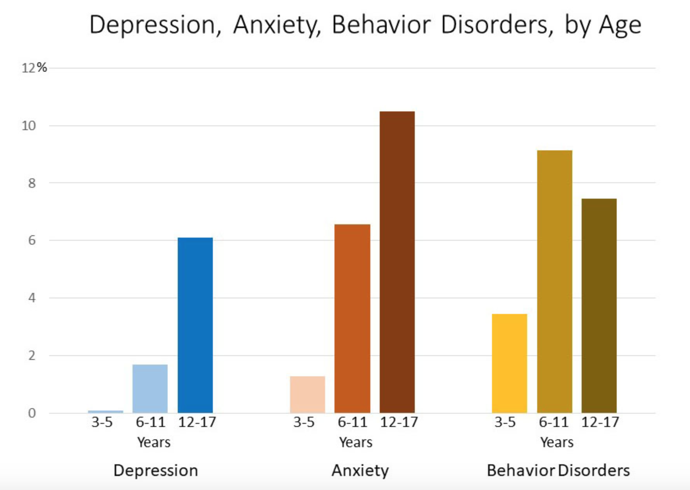
Screening for Depression – When to start?
Begin at age 12
USPTF and GLAD-PC recommend annual universal depression screening among adolescents, 12-18
High prevalence of depression by age 20 – 20%
Siu, AL., Screening for Depression in Children and Adolescents: US Preventative Services Task Force Recommendation Statement. (2016). Pediatrics. 137(3): e20154467.
Zuckerbrot RA, Cheung A, Jensen PS, et al. (2018). Guidelines for Adolescent Depression in Primary Care (GLAD-PC): Part I. Practice Preparation, Identification, Assessment, and Initial Management. Pediatrics. 141(3):e20174081
Notes:
So when to start, the overarching recommendation is that youth should be screened for depression starting at age 12. This is unanimously supported by the Guidelines for Adolescent Depression in Primary Care or GLAD-PC and the US Preventive Services Taskforce or the USPSTF!
The reason for screening starting at age 12, is that the incidence of depression increases significantly at this age. Looking at this bar graph, we can see that the prevalence is less than 2% in ages 6-11, but increases to 6% between ages 12-17. This coincides with the onset of puberty and hormonal changes. And by age 20, the prevalence of depression is 20%, which is the generally accepted prevalence in adults throughout the lifespan. Why does it make sense to start screening in adolescence? Because this is when everything starts to change, puberty begins, high risk behaviors increase, youth begin identifying more with peers than parents, and depression risk increases so it makes sense to start screening regularly at this point........However, there is no specific evidence to guide the recommendation about frequency of screening, but generally annual screening at a minimum is recommended, with screening more regularly depending on how often you are seeing a patient.

Slide 17
Screening for Depression – What to use?
PHQ-9: Patient Health Questionnaire 9 Depression Screening Tool: http://www.pedpsychiatry.org/pdf/depression/PHQ-9%20Modified%20for%20Teens.pdf
CES-DC: The Center for Epidemiological Studies Depression Scale for Children: https://www.brightfutures.org/mentalhealth/pdf/professionals/bridges/ces_dc.pdf
Notes:
Now what to use – Same tools for SD as for MDD generally.
There are SO many screeners for different mental health diagnoses, it is really overwhelming and can sometimes be too much. For this reason, I'll focus on just a few that are good to know about, and I will mostly focus on the PHQ-9 which, if you pick one screener, would be the one I’d recommend to use for screening adolescents for depression. Generally, thinking about if there's one screener you want to become familiar with can be helpful, then just use the same one every time…….I have included links to the screeners I’m going to talk about here. All are freely available. As you know I just said that screening is only recommended for youth 12-18 on an annual basis, but I am going to briefly describe two tools that can be used for younger children if you suspect depression and want more information.

Slide 18
DEPRESSION Screening Tools: PHQ-9: Modified for Teens
For ages 11-17
Past two weeks
13 Items, self-report (from DSM)
Scored--0, 1, 2, 3-- based on days per week symptoms occur
Evidence that tool has good sensitivity and specificity
Past year (persistent depressive disorder)
Function: work (school), home, relationships
Suicidal thoughts past month; Suicide attempt ever
Notes:
The PHQ-9 is probably one of the most well know depression screening tools. This modified version for teens can be used with ages 11-17. Ideally, this could be filled out by the patient while they are waiting in the waiting room for the appointment, or these days, while they are doing the e-check in process. This is recommended by both the GLAD-PC and the USPSTF. It started as 9 questions, but they've added a few more, so now it's 13. But the scoring is based on the first 9. If using a binary cutoff score of 11, the sensitivity is almost 90% and the specificity is 78% when compared with the gold standard DISC-IV for MDD. You can use the scores to indicate level of severity, so higher scores can indicate more severe depression. Another great benefit is that it is available in multiple languages, and if it is positive, you can use the questions to guide your clinical interview with the patient.

Slide 19
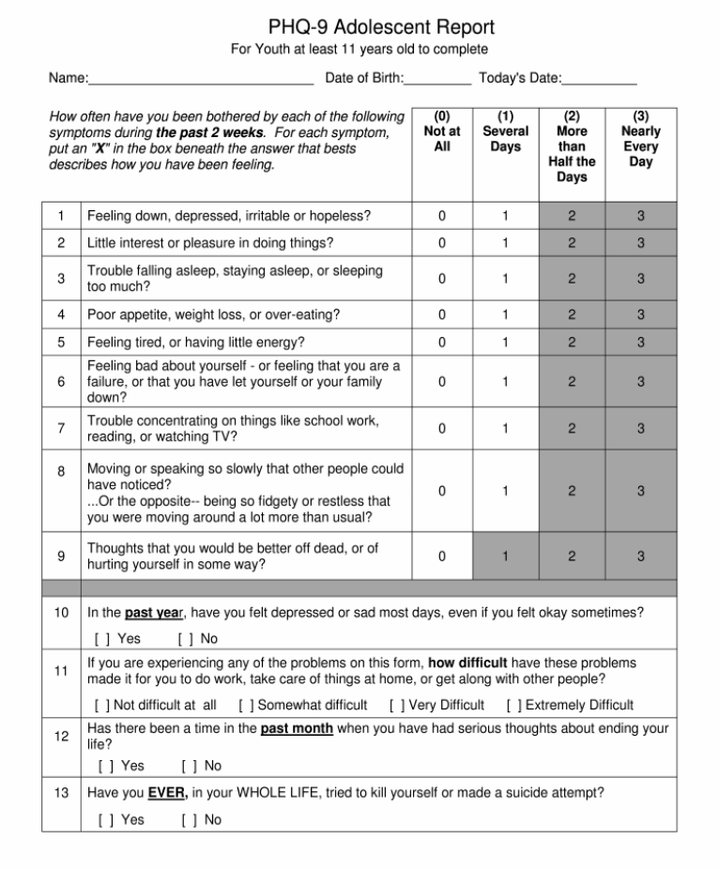
DEPRESSION Screening Tools: Scoring the PHQ-9
Total Score Depression Severity
0 – 4 No or minimal
5 – 9 Mild
-------------------------------------------------
10 – 14 Moderate
15 – 19 Moderately severe
20 – 27 Severe
Notes:
Here is what it looks like and I’ve outlined the cut scores for the first 9 items.

Slide 20
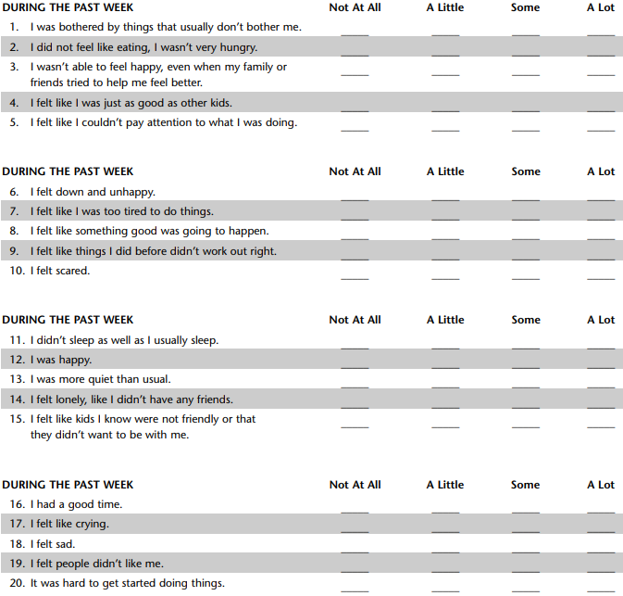
DEPRESSION Screening Tools: CES-DC
For ages 8-17
20-item self-report form
Focus on past week
Scored:
0 = Not at all
1 = A little
2 = some
3 = a lot
Scores range from 0-60
>=15 significant levels of depressive symptoms
Notes:
The Center for Epidemiological Studies Depression scale for Children or the CES-DC is another validated screening tool for depression. Certainly longer than both the PHQ-2 and PHQ-9 so not as efficient, but has been validated for late childhood age youth. So if you suspect depression in a 8-10 year old and want to learn more about symptoms from the child’s perspective this is a validated tool that I would recommend.

Slide 21
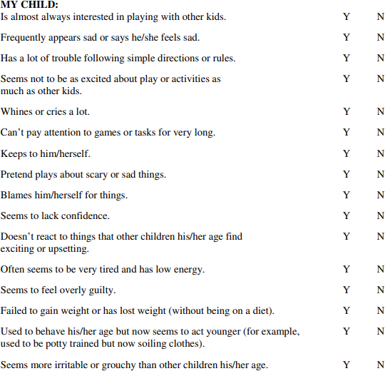
DEPRESSION Screening Tools: Preschool Feelings Checklist
For ages 3-6
16-item parent report form
Score by summing all items answered with yes
>=3 indicates need for more mental health evaluation
Notes:
Finally, I wanted to mention the Preschool Feelings Checklist given there is not much available for young kids. As I mentioned previously annual screening for depression should not begin till age 12, but if you have a young child in your office where you suspect depression might be part of the picture, the preschool feelings checklist is a validated and free tool that you can use to learn more about the child’s symptoms from the parents perspective.

Slide 22
Seasonal Depression: What to ask?
In the Winter, do you…
Feel worse (more sad) ?
Eat more?
Gain weight?
Sleep more?
Have less energy?
Socialize less with others?
Feel better on sunnier days?
Notes:
No particular screener for SD. However, if you’re getting concerned for depression and it might be seasonal, These would be the questions to ask. Remember there need to be 2 or more seasonal episodes in the last 2 years, but it could go on for longer
Uptodate: Seasonal Affective Disorder: Epidemiology, Clinical Features, Assessment, and Diagnosis

Slide 23
Outline
What is SAD/Seasonal Depression?
Clinical Assessment/Diagnosis
Treatment Overview
Nonpharmacological
Pharmacological

Slide 24
Bridge, J. A., Iyengar, S., Salary, C. B., Barbe, R. P., Birmaher, B., Pincus, H. A., ... & Brent, D. A. (2007). Clinical response and risk for reported suicidal ideation and suicide attempts in pediatric antidepressant treatment: a meta-analysis of randomized controlled trials. Jama, 297(15), 1683-1696.
Notes:
Before we dig in to nonpharmacological approaches, I want to highlight findings from a meta analysis on response to anti-depressant treatment. There is a lot of things that happen in these studies that explain the placebo response but the large placebo response is definitely an argument for other types of brief interventions that can be done in the primary care office

Slide 25
The point is:
Just do something!

Slide 26
Non-Pharmacological Management
Active Monitoring
Sleep improvement
Exercise
Bright Light Therapy, Dawn Simulation?
Psychotherapy
Notes:
“”

Slide 27
Seasonal Depression: Prevention tips
Routines: keep consistent!
Make time for healthy habits
Keep expectations realistic
Team effort!
Notes:
Stick to routines. You’ve heard it a thousand times, but it’s still true: routines help kids and adults alike. Having a consistent schedule for sleep, meals, work and family activities can provide stability and keep everyone’s spirits up.
Prioritize healthy habits. Ask kids for their own ideas for healthy activities that they’d be excited to do on a regular basis. Maybe that’s an after-school trip to the park (even in the cold!) or a weekly look through cooking blogs for fun new recipes.
Set realistic expectations. “It’s really challenging when we come up with solutions that are not within our grasp,” says Dr. Bernstein. For instance, you might think that exercising every day is the only way for your family to stay healthy, but work and school schedules get in the way. Try getting together as a family and looking for doable alternatives: What about a game of basketball in the driveway twice a week, or taking turns choosing music for a weekend family dance party?
Whatever you choose to do, a team effort can make it easier to stay on track. “It’s not going to be just the individual who’s dealing with depression or a pattern of challenges,” Dr. Bernstein says. If your child is having a hard time, think about what would be helpful for them and use that to create some practices that the whole family can follow together
Childmind

Slide 28
Guidelines for Adolescent Depression in Primary Care (GLAD-PC)
Organize clinical settings to include integrated or collaborative care models
For mild depression, PCP should consider active support & monitoring first ( 6 – 8 weeks)
For moderate - severe depression or presence of comorbidities, consultation w/ mental health specialist recommended
Moderate: consider treatment in or outside of primary care
Severe: consider referral to specialist for treatment
When treatment needed, recommend EBTs
Notes:
I referenced GLAD-PC earlier but I want to talk about it a bit more here. In 2018, the AAP released updated guidelines on the treatment and ongoing management of depression in primary care. Recommendations included that:
1) PCPs should work with administration to organize their clinical settings to reflect best practices in integrated or collaborative care (facilitating contact with psychiatrists, case managers, embedded therapists).
2) It was also recommended that after initial diagnosis, in cases of mild depression, PCPs should consider a period of 6-8 weeks of active support and monitoring before starting an EBT as evidence from RCTs indicates that a sizable % of patients respond to nondirective supportive therapy and regular symptom monitoring. However, if symptoms persist, treatment with antidepressants or psychotherapy should be offered, whether provided by PCP or mental health.
Active support and monitoring is also essential in cases in which depressed patients and/or their families refuse other treatments.
3) If a PCP identifies an adolescent with moderate or severe depression or complicating factors such as coexisting substance abuse or psychosis, consultation with a mental health specialist should be considered. Appropriate roles and responsibilities for ongoing comanagement by the PCP and mental health clinician(s) should be communicated and agreed on.
4) Whenever treatment is needed and after providing education and support to the patient and family, the range of effective treatment options, including medications, psychotherapies, and family support should be considered. The patient and family should be assisted to arrive at a treatment plan that is both acceptable and implementable, taking into account their preferences and availability of services.

Slide 29
Psychosocial Treatments for Depression – Active Monitoring
Active Monitoring (mild to moderate depression):
Frequent visits w/ PCP
Phone follow-up in between visits
Provide educational materials to youth and families
Prescribe:
Behavioral Activation - Exercise and fun activities
Peer support group
Probably sufficient for many w/ mild depression
Notes:
Active monitoring involves the important things a primary care physician can do BEFORE initiating a formal psychotherapeutic or pharmacological treatment. Some examples of what this active monitoring can look like include
Schedule frequent visits
Prescribe regular exercise and leisure activities
Recommend a peer support group
Review self-management goals
Follow-up with patients via telephone
Provide patients and families with educational materials about depression

Slide 30
Sleep
Sleep disturbances can have a seasonal pattern
There is a simple brief psychotherapy (CBT) for insomnia in adults; it has been adapted for use in adolescents
Sleep hygiene counseling works but requires persistence!
Scheduled regular awakening
Daytime sleep restriction (no naps) and caffeine restriction
Bedtime stimulus control (lights, electronics, music, etc.)
Melatonin, a sedative at higher doses, is a popular sleep aid, but……
Notes:
Riddle

Slide 31
Sleep: Melatonin
Pineal gland hormone regulates 24-hour sleep-wake cycle and other circadian rhythms
Peak levels during night
Daytime dose in young adults of 0.1-0.3 mg increased plasma melatonin to normal night range
Melatonin has sedative effect at higher doses
Adult data: sleep onset about 30 minutes earlier; this effect wears off in about 4 weeks
OTC melatonin preparations range from 1 to 10 mg
In a study of 31 melatonin preparations, melatonin varied from -83% to + 478% of labeled content
USP verified preps are accurate, but cost more and only available in 3 and 5 mgs dosages
Notes:
Riddle

Slide 32
Sleep: Melatonin and Children
Used by lots of parents with or without recommendation of PCP
Best efficacy data for autism, some for ADHD
“Data supporting use of melatonin in developmentally normal children are limited and its long-term safety is unknown.” (Medical Letter, June 29, 2020)
Long-term melatonin supplementation can suppress the hypothalamic-gonadal axis and may be associated with delayed onset of puberty, possibly by preventing the decline in nocturnal levels of melatonin that occur during the onset of puberty
Melatonin may be the most benign sedative for sleep onset, with above caveats, although no meds preferred, if possible
Notes:
Riddle

Slide 33
Exercise
Exercise is associated with improvement in depression
It is not easy to get someone who is depressed to exercise
Type of exercise probably doesn’t matter
Encourage participation in whatever the patient prefers
Notes:
I wanted to make a comment about exercise. It has been associated with improvements in depression. It is not easy to get someone who is depressed to exercise so focusing on whatever they prefer to do is going to be the way forward here rather than honing in on a particular form of exercise.

Slide 34
Light therapy, Dawn Simulation
Adults:
Fluorescent light box, 10,000 lux of white light (Schwartz and Olds 2015)
For reference, sunny outdoor day = 50,000-100,000. Indoor light (even near a window) </=2500 lux
Recommended distance from face varies by device
Start 30 minutes exposure daily, early morning, as close to awakening as possible
Children: limited data
May help modestly, more in seasonal depression than non-seasonal?
Time commitment may be prohibitive
Well tolerated*
Dawn simulation may help morning awakening (Fromm et al 2011)
Notes:
SAD may have to do with sensitivity to light (variation in the melanopsin gene?) (Schwartz and Olds 2015)
Adult data:
Recommendations are vague.
Fluorescent light box, 10,000 lux of white light at a specified distance from the user’s eyes (the distance is dependent on the particular device), beginning with 30 minutes exposure in the early morning, as close to awakening as feasible”
For reference, a sunny outdoor day can be 50,000-100,000 lux but indoor light (even near a window) seldom goes above 2500
Etiology may have to do with sensitivity to light (variation in the melanopsin gene?) (Schwartz and Olds 2015)
(Schwartz and Olds 2015)
Child data:
28 children ages 7-17: double blind crossover. 1 hour of BLT plus 2 hours of dawn simulation. SIGH-SAD-P total depression scores were significantly decreased from baseline compared to placebo. No difference from baseline in the placebo group. “at the end of the study, 78% of the parents questioned and 80% of the children questioned rated light therapy as the phase during which the child ‘felt best.’ “ (Swedo et al. 1997)
Old: 28 kids, 7-17yo. The trial compared light therapy (2 hours in the evening) with relaxation training in a single-blind crossover design. Light therapy produced significant improvement in the winter depression group, but not in the seasonal group (Sonis et al 1987)
Lights have UV filters. Risks of dry eyes/skin. Pretty well tolerated. Some evidence that it could trigger mania in someone with bipolar (depending on what time of day it is used) so those patients should be referred
Dawn therapy: one small study (Fromm et al 2011) used 103 kids, 7-18. “ got up easier and reported a higher alertness during the second lesson at school”

Slide 35
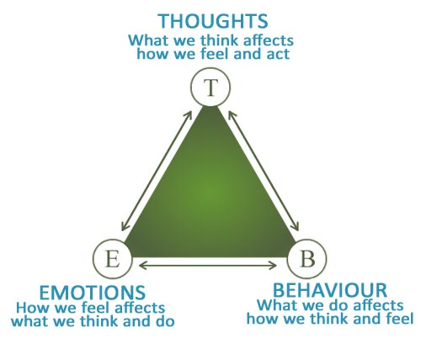
CBT for Depression Components
Psychoeducation about depression
Mood monitoring
Behavioral activation
Problem-solving skills
Cognitive Restructuring
Social Skills training
Relaxation ~ as appropriate
Homework Assignments
Notes:
The American Psychological Association guidelines recommend the use of CBT for the initial treatment of depression. CBT is the gold standard for treating children and adolescents with depression and anxiety. It works by giving youth skills to cope with symptoms like depressed mood, negative or anxious thoughts, or somatic responses. A core point of CBT is helping youth to understand that their thoughts, feelings and behaviors are interrelated and so if we change one we can change all three.
Here is is a list of the components of CBT for depression. I have put in bold a few components that may be useful during a primary care visit. We’ll talk mostly about these

Slide 36
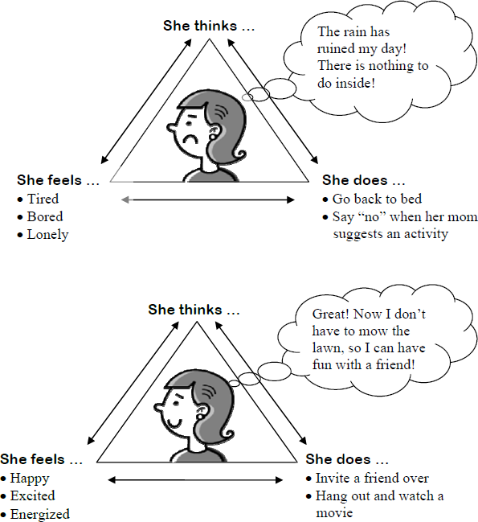
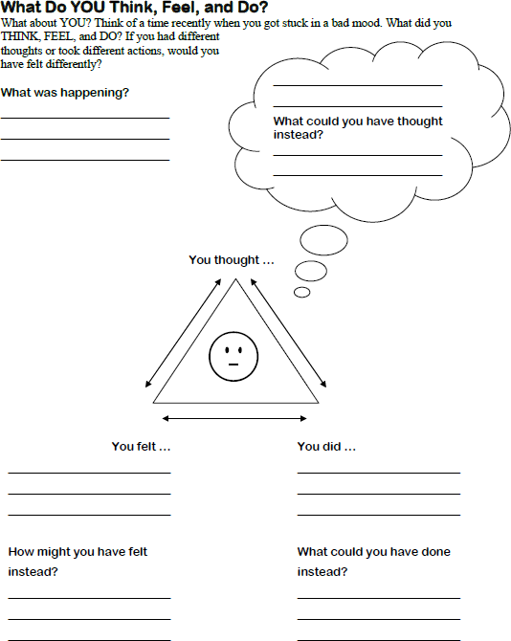
Psychoeducation on Depression Continued –Cognitive Triangle
Notes:
Once education has been provided on the contributing factors, symptoms, and course of depression the next step is to talk about the cognitive triangle. The clinician should start by pointing out that there are 3 important parts of our personalities: behavior, thoughts, and emotions. These three parts work together. Each of the three parts of our personalities affects the other two parts.
Ex: a teenager is playing basketball and making most of their shots, the behavior is shooting, the thoughts are something like "I'm doing well at this" and the emotion is happiness. If they start missing shots they may think, "Uh-oh, I'm doing something wrong in the way I'm shooting," and they may feel discouraged. If this teenager starts to think, "I'll ask my coach to give me some help with this," he or she may feel less discouraged and more hopeful. Then their behavior will probably be to ask for help and to practice harder and they can improve. Or, they may first change their behavior, by trying something different in their body movements. If this works, they may think something like "I've got it. I figured it out." They will feel encouraged and proud
This example highlights the reciprocal influences between behavior, thoughts, and emotions.
Behavior affects our thoughts and emotions.
Thoughts affect our emotions and our behavior.
Positive thoughts or positive behavior lead to good emotions or feelings like joy, happiness, self-esteem, pride.
Negative thoughts or negative behavior lead to negative emotions or feelings, like depression, low self-esteem, or hopelessness.
It is hard to change our emotions just by trying to change the way we feel. It is easier to change our thoughts or our behavior, which will then change our emotions. In the example given of the teenager shooting foul shots, the teenager had to think about the problem differently or do something differently before he or she could feel better.
When a teenager is depressed, their thoughts, emotions, and behavior work together in a “downward spiral.” For example, they may get a poor grade on a test, and feel depressed, think they are stupid, and stop studying (a behavior). Or maybe a girlfriend/boyfriend breaks up with them, and they feel rejected, start to think no one will ever love them, and change their behavior so that they stop going to places where they might meet new friends.
However, change is possible. They can turn a "downward spiral" into an “upward spiral” by changing the way they behave or the way they think about something. To stay with the same examples, the adolescent may get a poor grade and feel disappointed at first. However, if they think they could do better next time with some more studying, and then actively prepare for the next test, soon the negative emotion goes away, and the spiral turns around. It becomes an "upward spiral." They may feel badly about a breakup with a girlfriend or boyfriend; but, after a while they start to think that there are many other people who could love them, and whom they could love. Then, they would make efforts to meet more people and they would feel hopeful and positive.

Slide 37
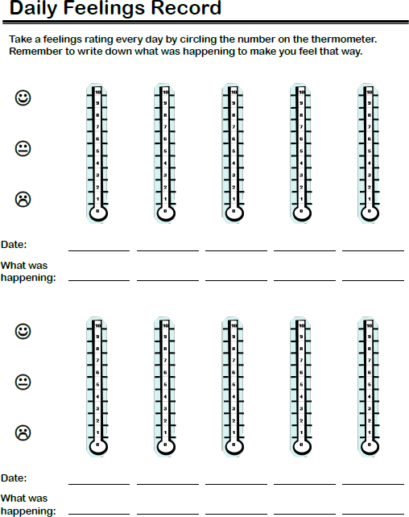
CBT for Depression Components – Mood Monitoring
Mood monitoring = paying attention to how we feel so we can learn what situations lead to feeling more or less depressed and identify thoughts connected with those situations and feelings
Ask youth about specific times when:
Felt bad and get details about situations – what happened, what were they thinking about, how were they feeling
Felt good or happy and get details about those situations
Practice ratings together in session, then encourage daily tracking/rating at home
Review mood tracking at each session
Notes:
Once the clinician has given the family psychoeducation about depression, the next skill to focus on is mood Monitoring. Mood Monitoring means paying attention to how we feel. Mood Monitoring helps youth to see what kinds of situations lead to them feeling more or less depressed (angry, guilty, or lonely), and what kinds of negative thoughts may be connected to those emotions. Mood Monitoring will also help them to see what situations and thoughts are connected with feeling better or feeling happy. With this skill, the adolescent will understand their depression better, and then be able to do something about it.

Slide 38
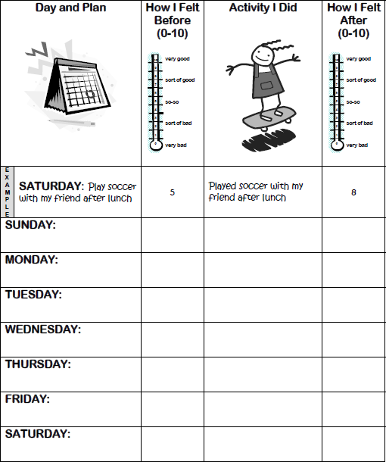
CBT for Depression Components – Behavioral Activation
Engaging in activities improves mood
4 types of activities improve mood:
youth enjoyed it before
w/ someone they enjoy spending time with
that keep youth busy
that help someone else
Help patient:
Generate a list of pleasant activities
Schedule time for these activities during the week
Notes:
Following mood monitoring, it is typical to focus on the behavior part of the cognitive triangle. Depression is linked with a lack of active, enjoyable behavior. One powerful way to combat depression is to engage in pleasant activities. Even if we do not feel like doing anything when depressed, by doing things we enjoy, or used to enjoy, we can change our emotions in a positive direction. This is what is referred to as behavioral activation. The idea is to get moving and active, so you not only get that physical momentum, but you also start to experience more positive thoughts from having success and interacting more with others. Behavioral activation helps counter the isolation that people with depression often experience, which can reinforce their depressed mood.
There are typically 4 types of activities recommended as part of behavioral activation. These include activities the youth previously enjoyed, activities with someone they enjoy spending time with, activities that keep them busy and activities that help someone else.
The clinician’s role is to help the youth generate a list of pleasant activities that cover these 4 categories and then to schedule time for these activities each day. As part of this, the clinician should make sure activities selected are practical, not contingent on others, and are inexpensive so that there are no external barriers to the youth engaging in them.

Slide 39
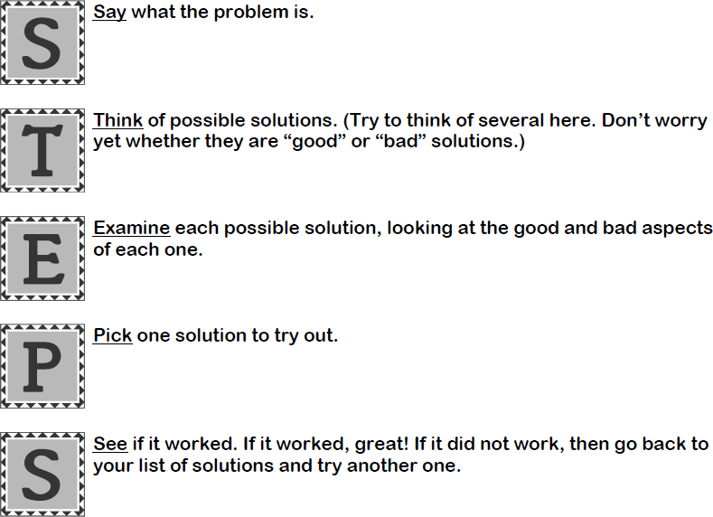
CBT for Depression Components – Problem-Solving Skills
Solving problems can improve mood while not solving them contributes to low mood
Notes:
By this point in treatment, youth will likely have shared some social, interpersonal, familial or academic problems contributing to their depression, or some problem getting in the way of completing the treatment homework assignments. The clinician can refer to these as examples of common problems that youth face. Since everyone faces problems in their lives, and since problems can lead people to feel discouraged or even depressed, the goal with this is to help youth learn a general way of solving problems that can be applied to a range of situations.
The STEPS model shown here is just one problem-solving model, but there are many similar acronyms that youth can use to remember the steps to problem-solving.

Slide 40
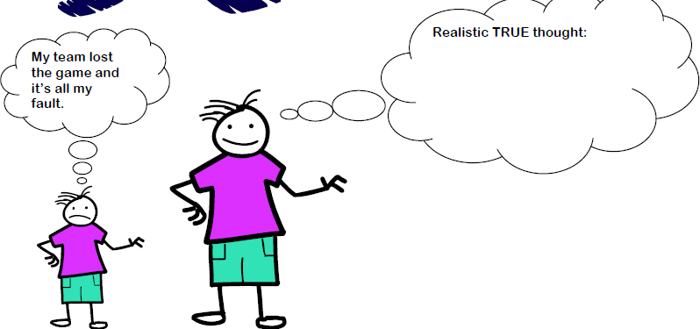
CBT for Depression Components – Cognitive Restructuring
Identify and change automatic negative thoughts to more realistic thoughts by asking:
What’s the evidence?
Is there another way to look at the situation?
What would you tell a friend who had that thought?
If it is true, would that really be so bad?
Notes:
Now that we have covered some of the strategies that focus on the behavior part of CBT, we are going to move into cognitive skills. When youth are in a bad mood they are more likely to have negative thoughts and negative thoughts can put them in a bad mood
Cognitive restructuring is a process of helping youth identify and change automatic, negative thoughts into more realistic thoughts and that changing the thoughts can lead to different emotions. This skill is particularly helpful when youth are dealing with situations not really in their control (e.g., parents fighting, family finances, social distancing restrictions, etc.)
The first step is helping youth to recognize the negative thoughts. Among depressed youth, there are some common thinking errors that correspond to the acronym of BLUE and it can be helpful to share this acronym with your patients. These thinking errors include:
Blaming myself: Taking too much personal responsibility for negative events (e.g., Its all my fault that we lost the soccer game)
Looking for the bad news: paying attention only to the negative info and ignoring positive info (e.g., focusing on one bad event in a day that was generally fine – “I got two answers wrong on my test- the whole day is ruined,” “This day was the worst – I had to take a quiz and they had lasagna for lunch in the cafeteria”)
Unhappy guessing: expecting bad outcomes when we don’t really know how things will turn out (“I’m definitely going to fail the test,” “no one will come to my birthday party”)
Exaggerating: Making things seem worse than they really are (I’m not allowed to see my friends today. My life is horrible; I failed the test today and I am going to fail the whole school year)
Once youth get adept at recognizing the negative thoughts, they can then start to restructure them. It can be helpful for you to work with the youth to ask themselves these questions as part of challenging the thought. Whats’ the evidence to support this thought? Is there another way to look at the situation?, what would I tell a friend who had that thought. And, if the thought is true, would it really be so bad?

Slide 41
Examples of negative/unhelpful thoughts
It’s all my fault that we lost the soccer game”
“I got 2 answers wrong on my test. This day is ruined”
“I’m definitely going to fail the test”
“No one is going to come to my birthday party”
“I’m not allowed to see my friends because of COVID – my life is horrible”
“I’ll never be as good as my sister at math”
“My parents are fighting and its all my fault”
Notes:
Blaming myself: Taking too much personal responsibility for negative events (e.g., Its all my fault that we lost the soccer game)
Looking for the bad news: paying attention only to the negative info and ignoring positive info (e.g., focusing on one bad event in a day that was generally fine – “I got two answers wrong on my test- the whole day is ruined,” “This day was the worst – I had to take a quiz and they had lasagna for lunch in the cafeteria”)
Unhappy guessing: expecting bad outcomes when we don’t really know how things will turn out (“I’m definitely going to fail the test,” “no one will come to my birthday party”)
Exaggerating: Making things seem worse than they really are (I’m not allowed to see my friends today. My life is horrible; I failed the test today and I am going to fail the whole school year)

Slide 42
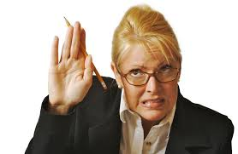
Umm…what about the meds?!

Slide 43
SSRI’S
Generic | Brand Name
Fluoxetine (MDD 8+; OCD 6+) | Prozac
Escitalopram (MDD 12+) | Lexapro
Sertraline (OCD 7+) | Zoloft
Fluvoxamine (sigma1) | Rarely used in USA
Citalopram | Less safe than Lexa
Paroxetine | Nonlinear kinetics

Slide 44
SSRI Differences
Escitalopram (Lexapro)
No major isoenzyme interactions
Generic scored 10 & 20 mg tablets (only one prescription for dose range)
Least activating (better for sleep)
Sertraline (Zoloft)
Moderate inhibitor of CYP450 2D6, 2B6
Wider dosing range (max is 200 mg/day)
Fluoxetine (Prozac)
Very long half-life
Strong inhibitor of CYP450 2D6
Most activating
Notes:
Zoloft: anecdotally more GI disturbance initially but good data for anxiety

Slide 45
General Principles
START LOW, GO SLOW…….BUT not too slow…….
Antidepressant effect size* (for comparison, stimulants for ADHD = 1.0)
0.7 for anxiety
0.2 for depression (2/2 high placebo response rate)
Side effects generally minimal and reversible if SSRI discontinued
4-8 weeks to reach therapeutic dose and maximum benefit
Screening lab: TSH
*Locher C et al, JAMA Psychiatry, 74: 1011-1020; 2017
Notes:
Must discuss black box warning
So what to expect
Subclinical and past thyroid dysfunction is a risk factor for depression and antidepressant non-response. SSRIs can decreast thyroid T4 a bit too

Slide 46
Doses (mg)
Agent | Start Adult—Teen--Child | Maximum Adult | Increments Adult-Teen-Child
Sertraline | 50 25-50 <25 | 200 | 50 25-50 <25
Fluoxetine | 20 10 5 | 20* | 20 10 5
Escitalopram | 10 5-10 5 | 20** | 10 5-10 5
* 60 mg/day for bulimia nervosa
** 10 mg/day for adults with GAD
Notes:
So, how to dose?
For depression, fluoxetine
Fluoxetine prescribing information: “In controlled trials used to support the efficacy of fluoxetine, patients were administered morning doses ranging from 20 to 80 mg/day. Studies comparing fluoxetine 20, 40, and 60 mg/day to placebo indicate that 20 mg/day is sufficient to obtain a satisfactory response in Major Depressive Disorder in most cases. Consequently, a dose of 20 mg/day, administered in the morning, is recommended as the initial dose. A dose increase may be considered after several weeks if insufficient clinical improvement is observed. Doses above 20 mg/day may be administered on a once-a-day (morning) or BID schedule (i.e., morning and noon) and should not exceed a maximum dose of 80 mg/day. “

Slide 47
SSRI Dose Equivalencies
Fluoxetine 20 mg
Escitalopram 10 mg
Sertraline 50 mg*
*Least valid or the 3 equivalencies; much larger range of values across studies.
NOTE: Adult data; increases to fluoxetine 40 mg equivalent can increase response, higher dose yields only more side effects
Furukawa TA et al. Optimal dose of selective serotonin…..Lancet Psychiatry: 6, 601-609, 2019.
Notes:
So how do these things intercompare with each ohters?

Slide 48
Reversible Side Effects of SSRIs
None (most common)
GI discomfort, nausea
Behavioral activation……suicidality (1 per 100)
more common in younger children
agitation, restlessness, insomnia, impulsivity
behavioral disinhibition
Sexual
diminished libido
delayed orgasm or anorgasmia
erectile dysfunction
Pregnancy

Slide 49
Serotonin syndrome*
GI: nausea, vomiting, diarrhea
Mental Status: agitation, delirium, hallucinations, coma
Autonomic Instability: tachycardia, labile blood pressure, diaphoresis, hyperthermia, flushing, dizziness
Neuromuscular: tremor, hyperreflexia, rigidity, myoclonus, incoordination
*5HTP supplements and tryptans for migraines common causative agents
Notes:
Patients need to be counseled what to look for and to seek
5htp: OTC supplement taken in hopes of boosting serotonin

Slide 50
Discontinuation Syndrome
Flu-like symptoms
GI symptoms – nausea, vomiting, diarrhea
--------------------
Dizziness, vertigo
Tingling/numbness
--------------------
Sleep disruption
Anxiety, agitation
Irritability, low mood
Notes:
Taper
Counsel patient on non self-discontinuing abruptly

Slide 51
Other “Antidepressants”
Duloxetine (Cymbalta) SNRI FDA indication for C&A GAD, milder sexual AEs
Bupropion (Wellbutrin) similar to amphetamine, no serotonin effect, seizures
Venlafaxine (Effexor) SNRI more side effects than duloxetine
Mirtazapine (Remeron) serotonergic; sedating and appetite inducing
Lamotrigine (Lamictal) rare fatal rash; used for bipolar depression

Slide 52
Medication Monitoring
Assess clinical response at 4-week intervals
If minimal or no response at 8 weeks (at therapeutic dose), may need alternative treatment
Goal should be remission at 12 weeks
FDA recommendation:
See every week for the first 4 weeks, biweekly thereafter
Telephone if not in person
HOWEVER: no data about impact on suicide risk
Notes:
AACAP clinical practice parameter for children and adolescents
It’s hard and theres no one size fits all response. Have increased concern if there are safety risks.

Slide 53
Sources
https://childmind.org/article/seasonal-affective-disorder/
Swedo, S., Allen, A., Glod, C., Clark, C., Teicher, M., Richter, D., Hoffman, C., Hamburger, S., & Dow, S. (1997). A controlled trial of light therapy for the treatment of pediatric seasonal affective disorder. Journal of the American Academy of Child & Adolescent Psychiatry, 36(6), 816–821. https://doi.org/10.1097/00004583-199706000-00019
Nillni, Y. I., Rohan, K. J., Rettew, D., & Achenbach, T. M. (2009). Seasonal trends in depressive problems among United States children and adolescents: A representative population survey. Psychiatry Research, 170(2-3), 224–228. https://doi.org/10.1016/j.psychres.2008.07.011
Glod, C. A., Teicher, M. H., Polcari, A., McGreenery, C. E., & Ito, T. (1997). Circadian rest-activity disturbances in children with seasonal affective disorder. Journal of the American Academy of Child & Adolescent Psychiatry, 36(2), 188–195. https://doi.org/10.1097/00004583-199702000-00009
Carskadon, M.A. , & Acebo, C. (1993). Parental reports of seasonal mood and behavior changes in children. Journal of the American Academy of Cbild & Adolescent Psychiatry, 32, 264-269.
Swedo, S.E. , Pleeter, J.D. , Richter, D.M. , Hoffman, C.L. , Allen, Aj. , Hamburger, S.D. , Turner, E.H. , Yamada, E.M. , & Rosenthal, N.E. (1995). Rates of seasonal affective disorder in children and adolescents. American Journal of Psychiatry, 152, 1016-1019.
Sonis WA, Yellin AM, Garfinkel BD, Hoberman HH. The antidepressant effect of light in seasonal affective disorder of childhood and adolescence. Psychopharmacol Bull 1987; 23: 360-363.
Schwartz, R. S., & Olds, J. (2015). The Psychiatry of Light. Harvard Review of Psychiatry, 23(3), 188–194. https://doi.org/10.1097/hrp.0000000000000078
Targum, S. D., & Rosenthal, N. (2008, May). Seasonal affective disorder. Psychiatry (Edgmont (Pa. : Township)). Retrieved January 12, 2022, from https://www.ncbi.nlm.nih.gov/pmc/articles/PMC2686645/
Notes:
Alphabetize***

Slide 54
Thank you!
Maryland Behavioral Health Integration in Pediatric Primary Care (BHIPP)
1-855-MD-BHIPP (632-4477)
www.mdbhipp.org
Follow us on Facebook, LinkedIn, and Twitter! @MDBHIPP
For resources related to the COVID-19 pandemic,
please visit us at BHIPP Covid-19 Resources.

